Slide 1
Team Presentation
TUM Flyers
Technical University Munich
engelj@in.tum.de

Slide 2
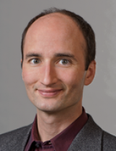
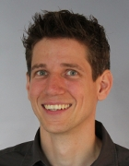
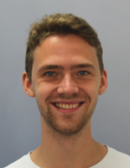
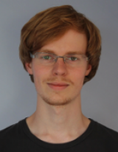
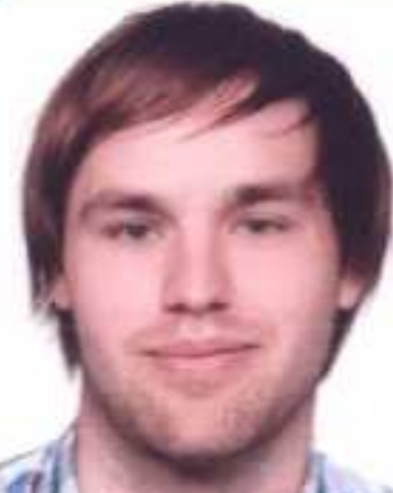
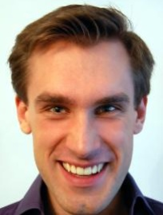
Challenge 3 Team name: TUM Flyers
Current Team:
# | Name | Organization | E-Mail | Expertise/ Speciality
1 | Daniel Cremers | TU Munich | cremers@tum.de | SLAM, 3D Reconstruction
2 | Jürgen Sturm | TU Munich | juergen.sturm@in.tum.de | RGBD-SLAM, Quadrotor, 3D Reconstruction
3 | Jakob Engel | TU Munich | engelj@in.tum.de | Mono- / Stereo-SLAM, Quadrotor, 3D Reconstruction
4 | Christian Kerl | TU Munich | christian.kerl@in.tum.de | RGBD-SLAM, Quadrotor, 3D Reconstruction
5 | Oliver Dunkley | TU Munich | omwdunkley@gmail.com | (Nano-)Quadrotor, Monocular SLAM
6 | Philipp Hoch | TU Munich | hoch.phil@gmail.com | (Nano-)Quadrotor, Control Theory

Slide 3
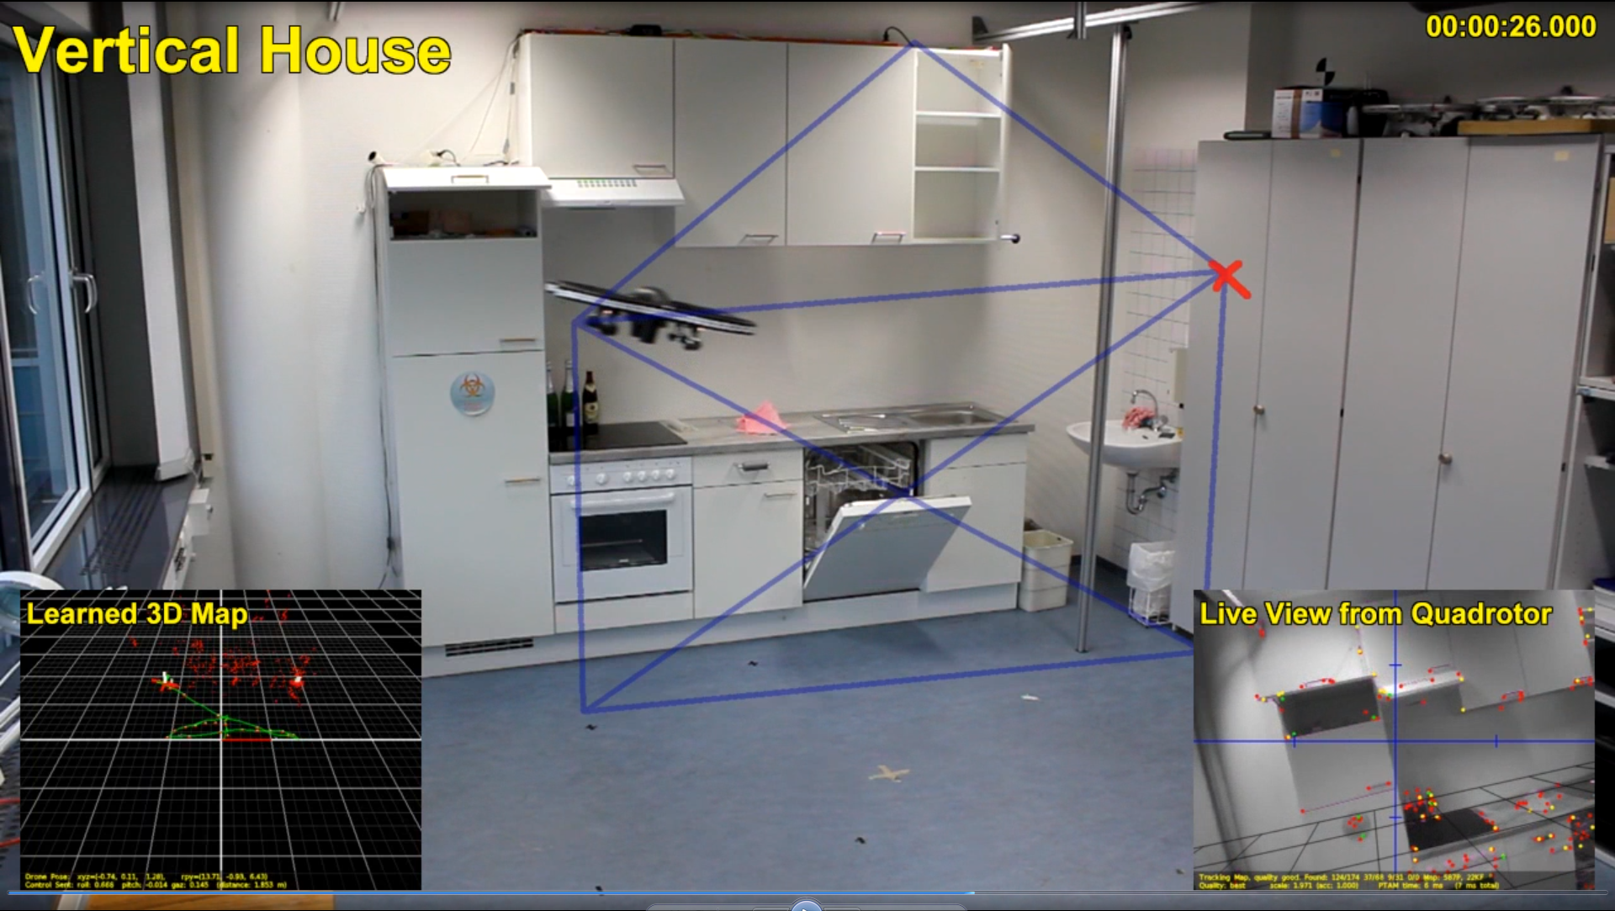
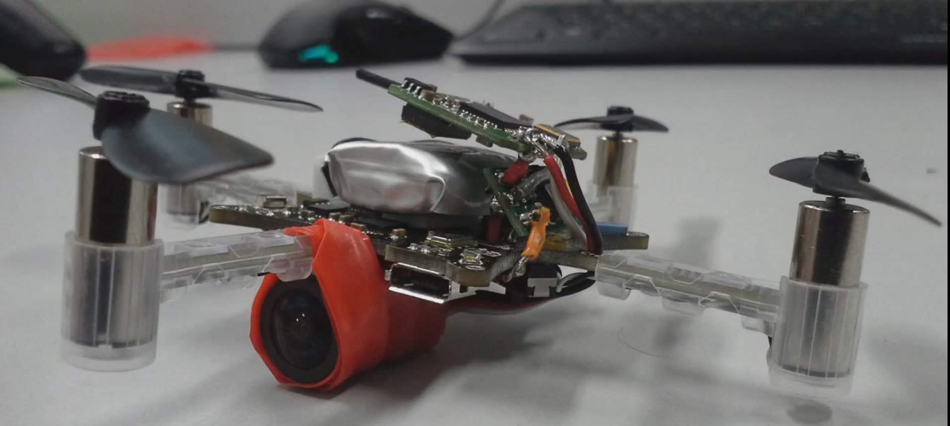
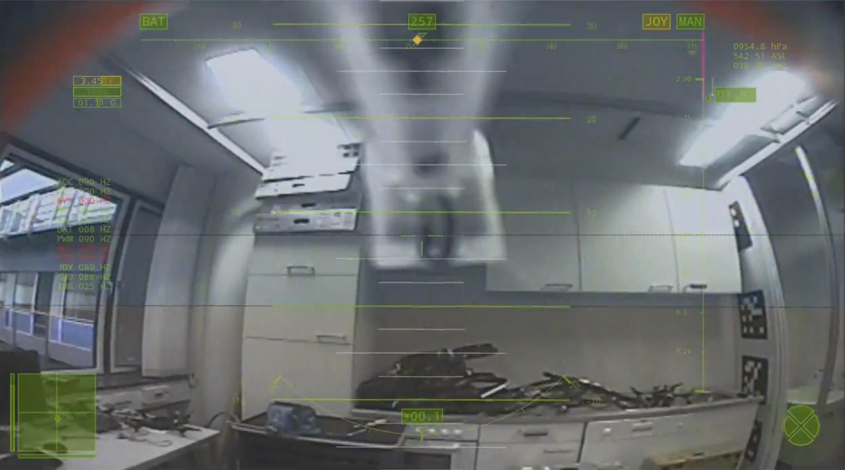
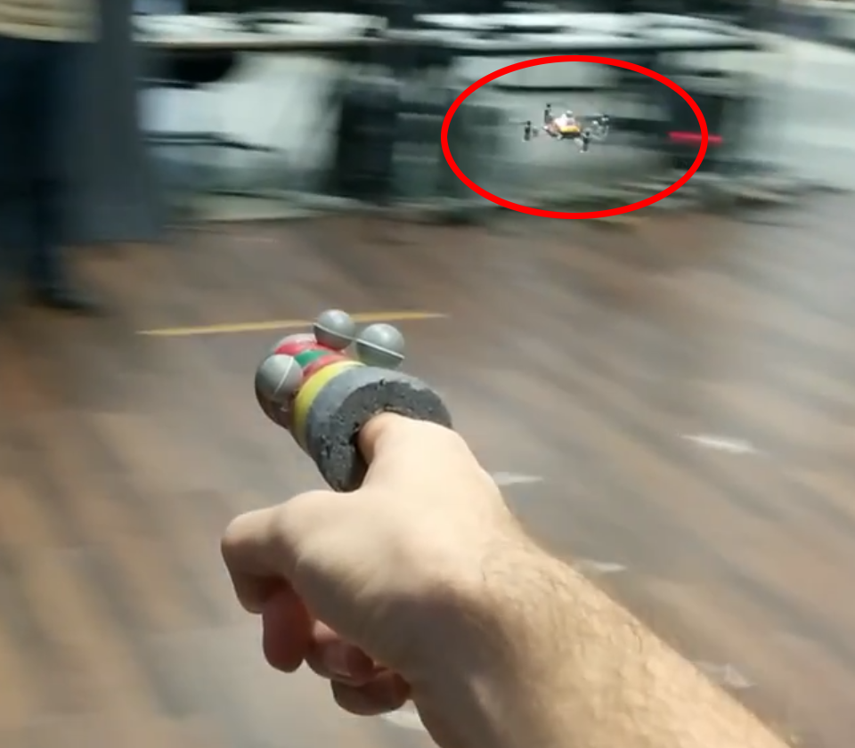
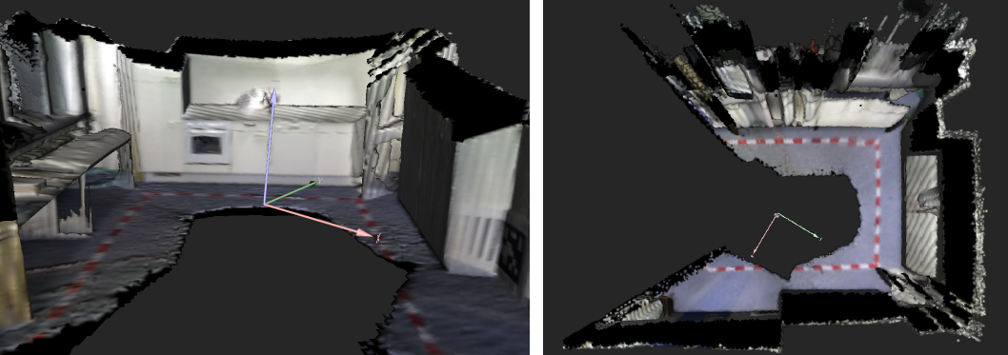
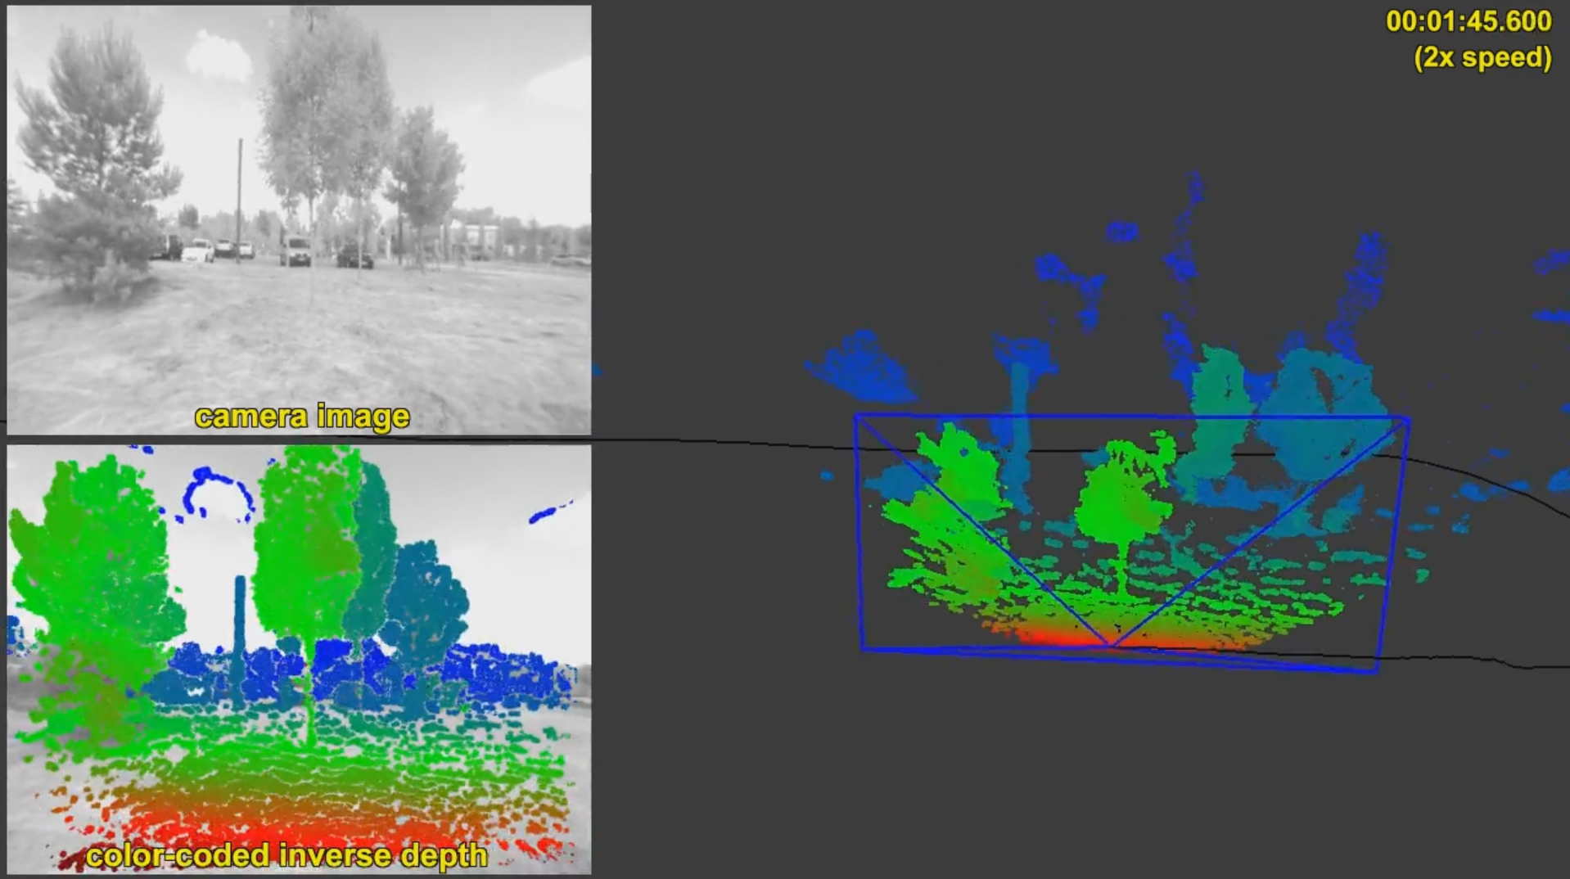
Challenge 3 Team name: TUM Flyers
Vision-based autonomous flight with AR.Drone
Autonomous nano-quadrotor flight
(Dense) 3D reconstruction, monocular direct SLAM

Slide 4
Challenge 3 Team name: TUM Flyers
Contact Person Information :
Name | Jakob Engel
Company | TU Munich
Department | Informatik 9
Website | http://vision.in.tum.de/members/engelj
E-Mail | engelj@in.tum.de
Phone Number | +49-89-289-17750
Street Name | Boltzmannstrasse
House Number | 3 | City | Garching
ZIP Code | 85748 | Country | Germany
Selected Recent Publications:
Scale-Aware Navigation of a Low-Cost Quadrocopter with a Mono-Camera (J. Engel, J. Sturm, D. Cremers), RAS ‘14.
Dense Tracking and Mapping with a Quadrocopter (J. Sturm, E. Bylow, F. Kahl, D. Cremers) UAV-g ‘13.
Semi-Dense Visual Odometry for a Monocular Camera (J. Engel, J. Sturm, D. Cremers), ICCV ‘13.

