Slide 1
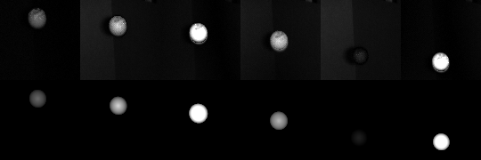
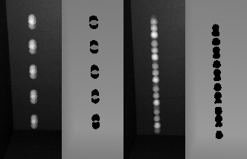
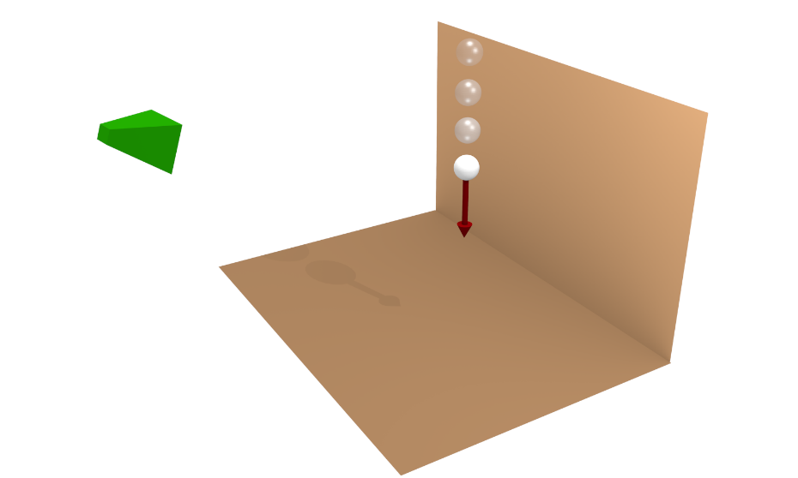
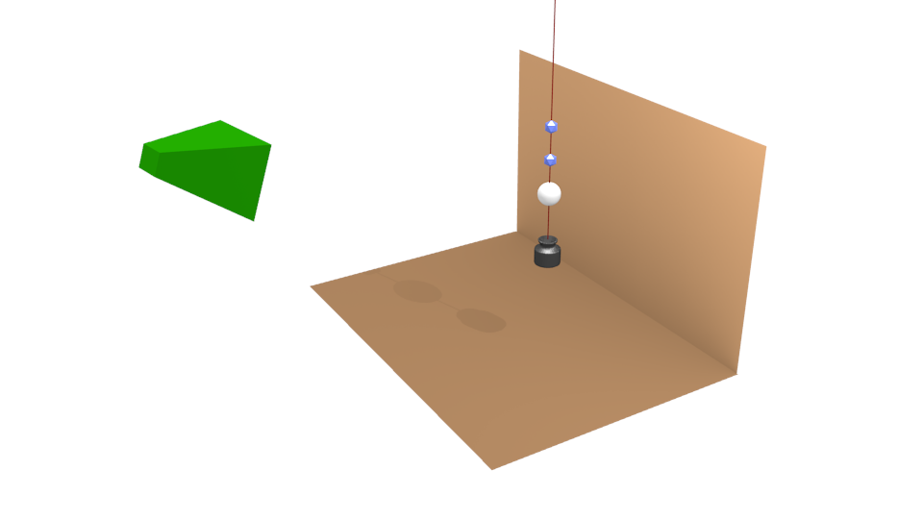
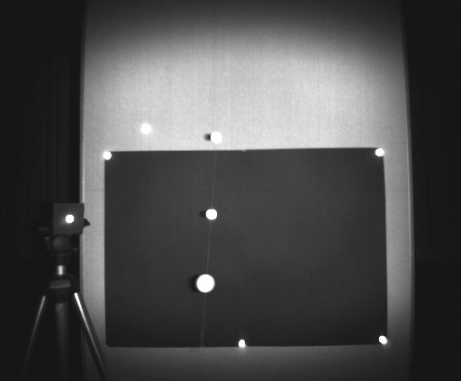
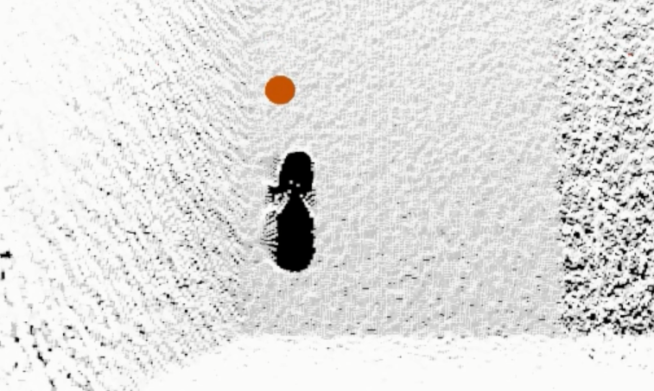


Model-Based Tracking at 300Hz using Raw Time-of-Flight Observations
Jan Stühmer, Sebastian Nowozin, Andrew Fitzgibbon, Richard Szeliski, Travis Perry, Sunil Acharya, Daniel Cremers and Jamie Shotton
Introduction
  We show how to perform model-based object tracking directly on the
  raw infrared captures of a time-of-flight (Tof) camera.
  We focus on phase-based time-of-flight sensing, which reconstructs each low frame-rate depth image from a set of short exposure `raw' infrared captures. These raw captures are taken in quick succession near the beginning of each depth frame, and differ in the modulation of their active illumination.
  Contributions
  First, we detail how to perform model-based tracking against these raw captures.
  Second, we show that by taking the raw captures uniformly in time, we obtain a 10x higher frame-rate, and improve the ability to track fast-moving objects.
  Our method is efficiently implemented on the GPU and allows to track an object with 300 frames per second.
Model-based Tracking
  We use a model-based tracking approach with a generative observation model to relate the tracked position to the observation over time and a temporal model for tracking stability [1,2]. While our Motion model is standard, the observation model for raw ToF capture is a novel contribution:
  Observation Model
  We propose an observation model which removes the dependence on a ToF depth reconstruction and instead compute observation likelihoods directly against the raw ToF captures:
Model Based Tracking: Depending on the frequency and phase configuration of the individual exposures, the object appears with different illuminations in the raw ToF captures. Our generative forward model allows to synthesize the appearance of the object for theses different illuminations (Columns correspond to these different exposures)
First row: Observed raw ToF image
Second row: Rendered image of the best hypothesis
Object hypothesis
Measured response
Expected ideal object response
Phase-Modulation Time-of-Flight: Modern ToF cameras operate based on the principle of phase modulation: a modulated light source emits a sinusoidal light signal at a specific frequency, and a special sensor images the light's reflection, gain-modulated at the same frequency.
For each pixel we obtain a sequence of nine measurements $R_{1},…,R_{9}$ (3 frequencies $×$ 3 phases) via
$R_{i}=\frac{ρ}{d^{2}}{ S}_{i}\left(d\right)+ε_{i}$ ,
where $d>0$ is the depth of the imaged surface
and $ρ>0$is the surface albedo.
The ideal responses are dependent on modulation frequency and phase delay and are given by an idealized calibrated response curve [3]:
$$S_{i} :\left[d_{min},d_{max}\right]\overset{→}{} \left\{−I_{min},I_{max}\right\}$$
Raw ToF observation
Background model
Failure of Kinect Depth Tracking
Benefit of Equispacing
Comparison with a Commercial Motion Capture System
Exposure Timing | Object speed | RMSE | RMSE [mm]
 |  |  | x | y | z
clustered | 1,33 km/h | 16,3 mm | 4,3 | 2,3 | 15,5
 | 2,12 km/h | 19,3 mm | 8,4 | 9,1 | 14,7
equidistant | 1,01 km/h | 15,5 mm | 4,5 | 3,3 | 14,4
 | 2,32 km/h | 23,7 mm | 6,4 | 6,9 | 21,8
Equispaced exposure timing (bottom) leads to
a more stable depth estimate when tracking
from raw time of flight captures in comparison
to standard exposure timing (top).
Red crosses correspond to depth values from
the time of flight depth reconstruction engine
and demonstrate the validity of our approach.
References
[1] M. Isard and A. Blake. CONDENSATION – conditional density propagation for visual tracking. IJCV, 1998.
[2] N. J. Gordon, D. J. Salmond, and A. F. Smith. Novel approach to nonlinear/non-Gaussian Bayesian state estimation. IEEE Proceedings F, 1993.
[3] C. S. Bamji et al. A 0.13 $μ$m CMOS system-on-chip for a 512 $×$ 424 time-of-flight image sensor with multi-frequency photo-demodulation up 130 MHz and 2 GS/s ADC. J. Solid-State Circuits, 2015.
The model-based tracking approach allows to
track the object even when the standard depth
reconstruction fails due to fast motion.
ICCV – International Conference on Computer Vision 2015
research.microsoft.com, vision.in.tum.de

