Slide 1
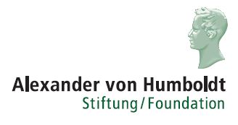
Realistic Photometric Stereo Using Partial Differential Irradiance Equation Ratios
R. Mecca, E. Rodolà, and D. Cremers
Shape Modeling International – Lille, France – June 25th 2015

Slide 2
Photometric Stereo (PS)
Problem:
Estimate surface normals by observing an object under different lighting conditions.
depth
The problem is usually described by a set of irradiance equations:
reflectance function
image function

Slide 3
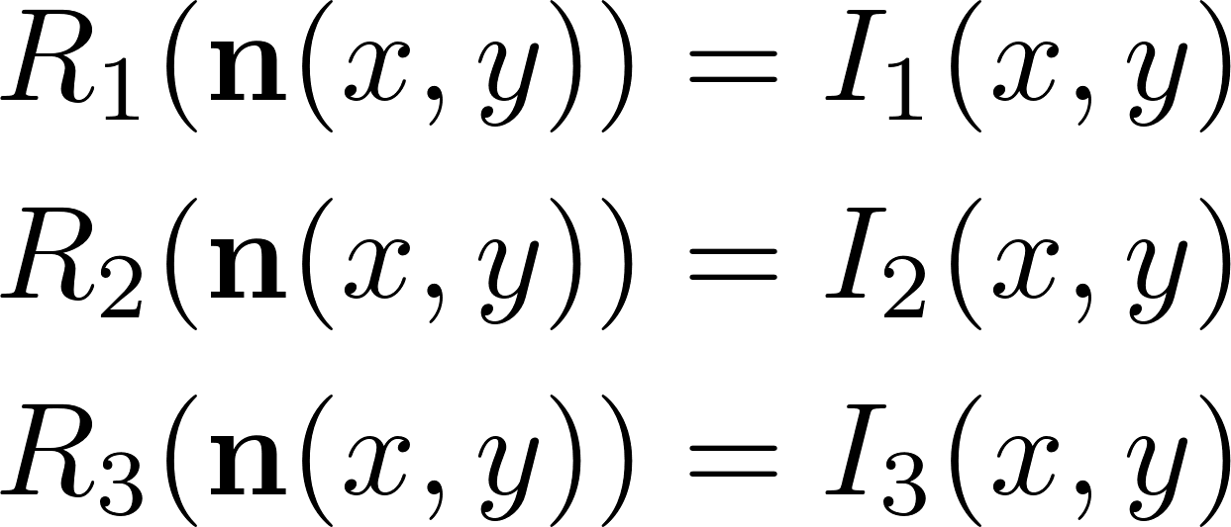
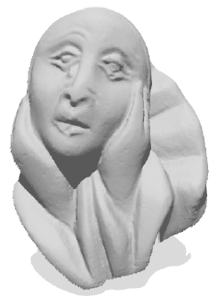
Common assumptions
In theory, 3 photos are enough (in a calibrated setting):
non-linear
In practice, many more are used (10 – 100).
Typical assumptions:
Lambertian surface
reflected
Light source at infinity
incident
No perspective transf.

Slide 4
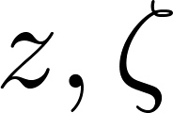
Parametrization
Pinhole camera model
Multiple light sources in general positions (e.g., non-planar, more than 3)
Arbitrary light attenuation
(e.g., non-radial)
Unknown albedo
Specular surfaces

Slide 5
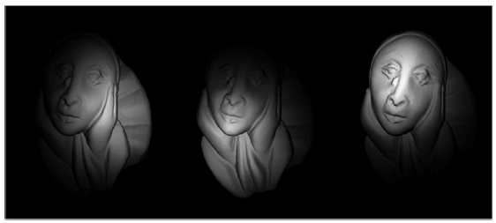
Lambertian model
Each light source j gives rise to an irradiance equation:
diffusive albedo (unknown)
surface normal (unknown)
light attenuation (unknown)
light direction (unknown)
So what is calibration giving us?
Light position
Attenuation model
Attenuation parameters

Slide 6
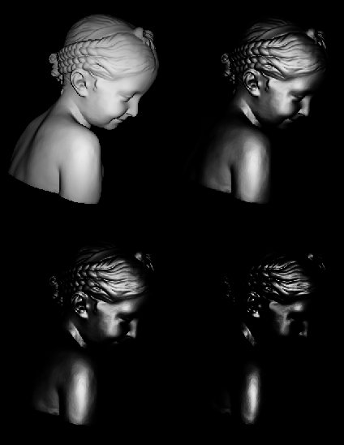
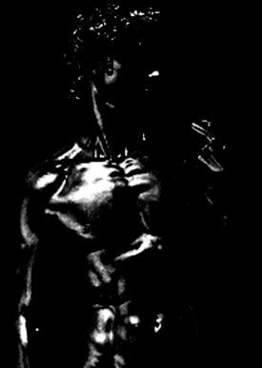
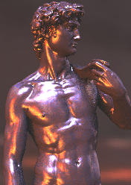
Specular model
For specular surfaces, we consider the Blinn-Phong shading model.
specularity
coefficient
specular albedo (unknown)
viewing direction (unknown)
camera position (known)
Increasing values of c
reflected
incident
Rendering by A. Ghosh

Slide 7
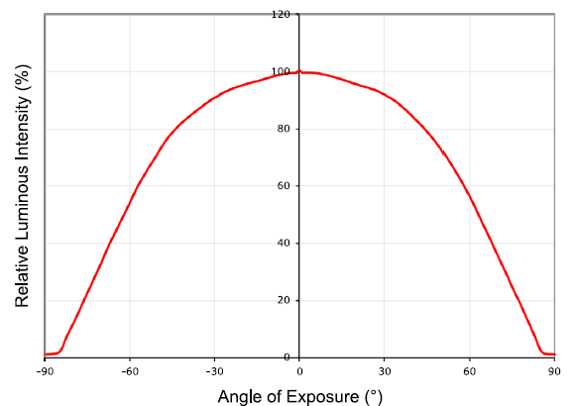
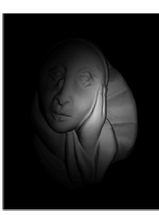
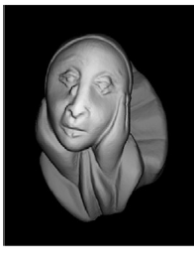
Light attenuation
A classical model for light attenuation is the quadratic energy reduction:
Other, more realistic models include radial propagation:
Actual LED data sheet

Slide 8
A different(ial) approach
Let us consider the image ratio between images i and j:
After some algebra, we get to a quasi-linear PDE having the form:
The specific form of the light attenuation function does not affect our differential model.
The same can be done for the specular model, leading to exactly the same structure:

Slide 9
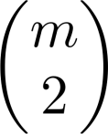
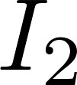
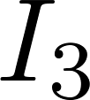
Working with multiple images
Considering all possible pairs of images, we get a set of equations:
quasi-linear
During the reconstruction process, choices are taken per-pixel:

Slide 10
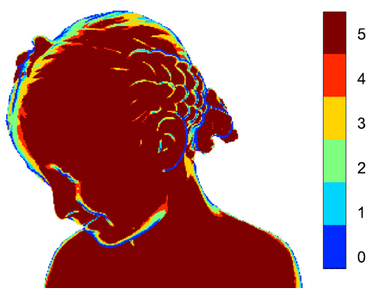
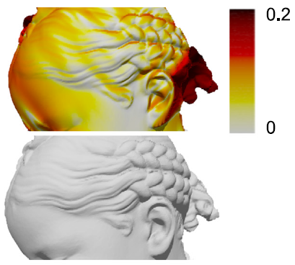
Self-shadows

Slide 11
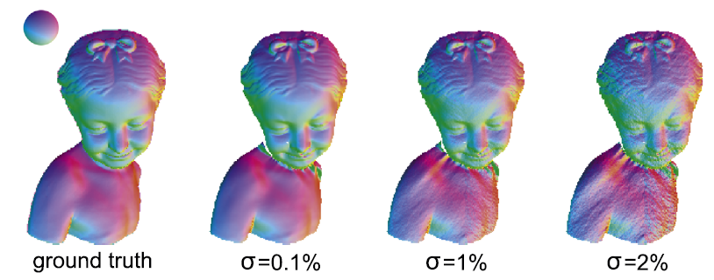
Image noise (diffuse case)

Slide 12
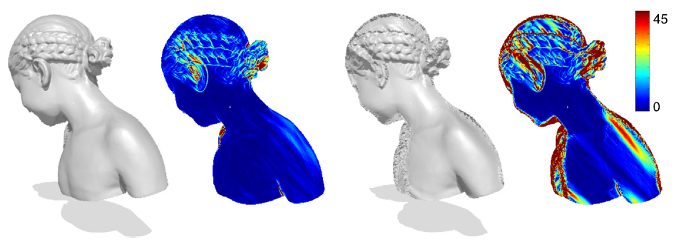
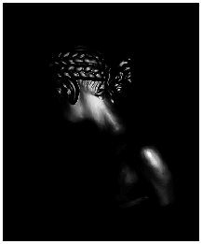
Image noise (specular case)
The low signal-to-noise ratio in the darker image regions makes the reconstruction less stable.
(results obtained with 5 images)
Can be solved by introducing a regularizer (e.g., to promote smoothness)

Slide 13
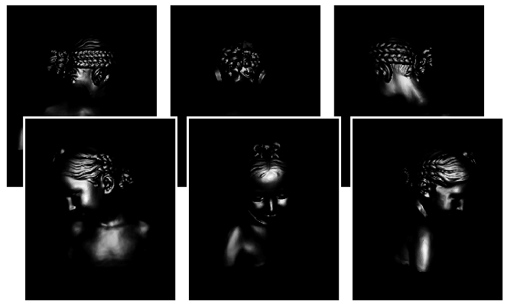
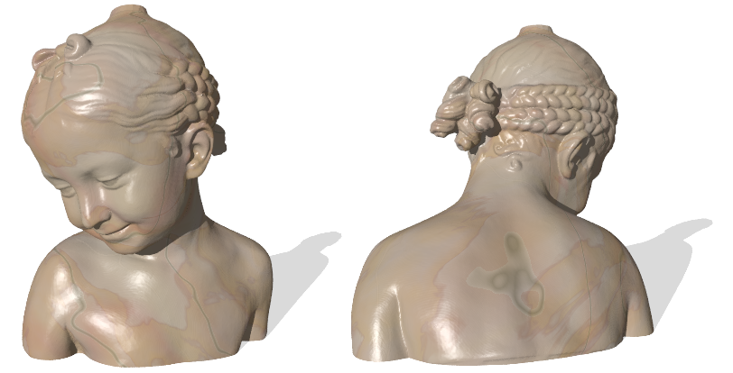
Full reconstruction
6 partial views
5 images per view
strong light attenuation
purely specular infomation

Slide 14
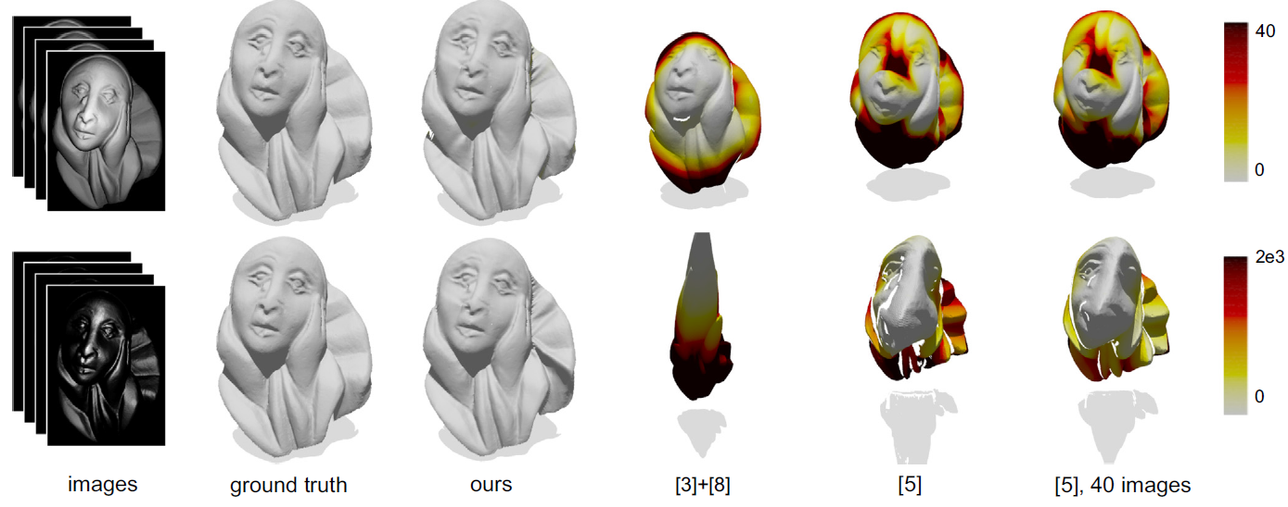
Comparisons
[3]+[8] : baseline
[5] : recent method (Ikehata et al. CVPR’12)

Slide 15
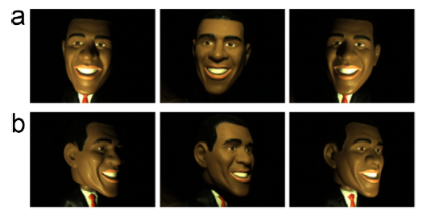
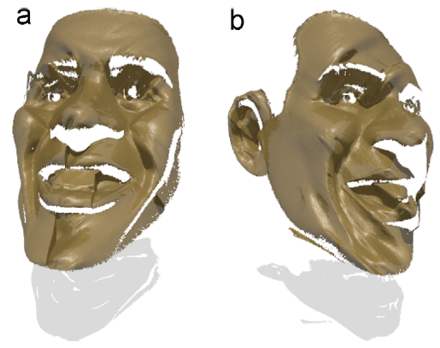
Real data
3 photos, 1.2 Megapixel
The toy has 5cm diameter, placed at 25cm from the camera
Drawback: Need to perform photometric calibration of the scene and the camera (light attenuation, specularity coeff., focal length, etc.)

Slide 16
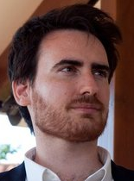
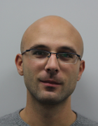
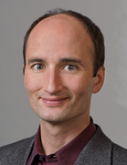
Thank you!
Questions?

