Slide 1
Point-wise Map Recovery and Refinement from Functional Correspondence
E. Rodolà, M. Moeller, D. Cremers
Technische Universität München

Slide 2
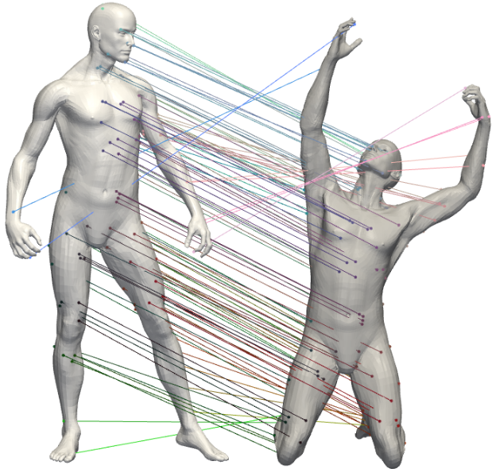
Shape matching

Slide 3
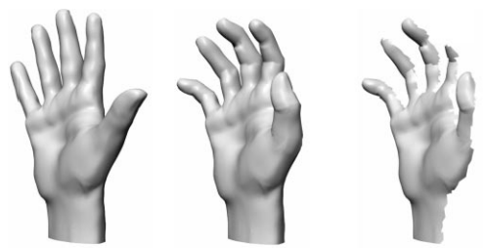
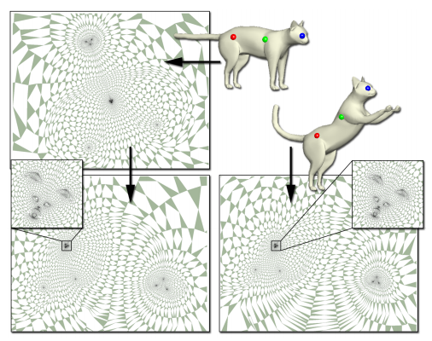
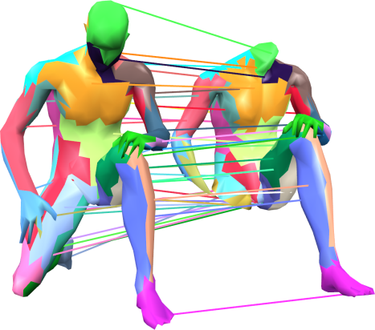
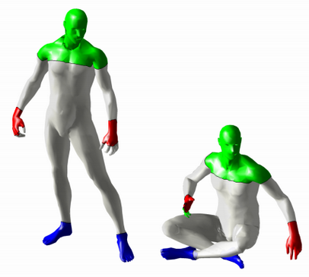
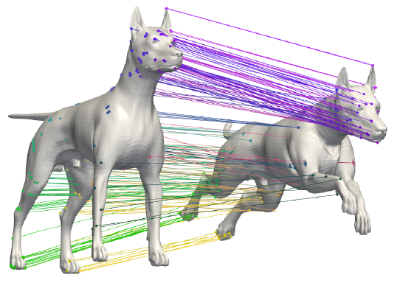
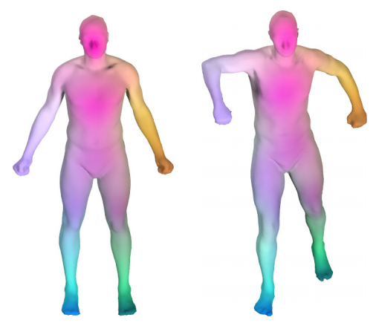
Related work
Metric/measure distortion
[Mémoli et al. 2005, 2007, 2009]
[Bronstein et al. 2006]
Conformal mappings
[Lipman et al. 2009, 2011]
Elastic deformation energies
[Litke et al. 2005]
[Windheuser et al. 2011]
Region-based matching
[Pokrass et al. 2011]
Graph-based
[Knossow et al. 2009]
[Rodolà et al. 2012, 2013]
Functional maps
[Ovsjanikov et al. 2012]
[Pokrass et al. 2013]

Slide 4
Functional representation
Given a scalar function on shape M, we can induce a function
on the other shape by composition:
We can denote this transformation by a functional , such that
linear

Slide 5
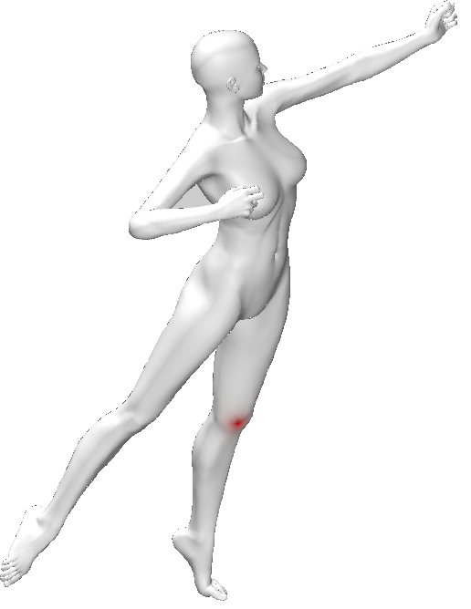
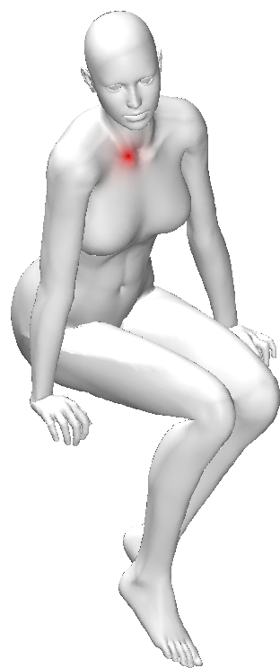
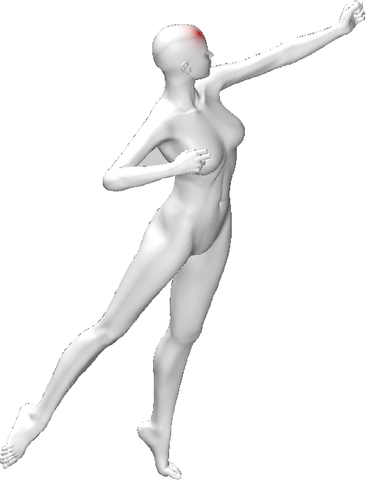
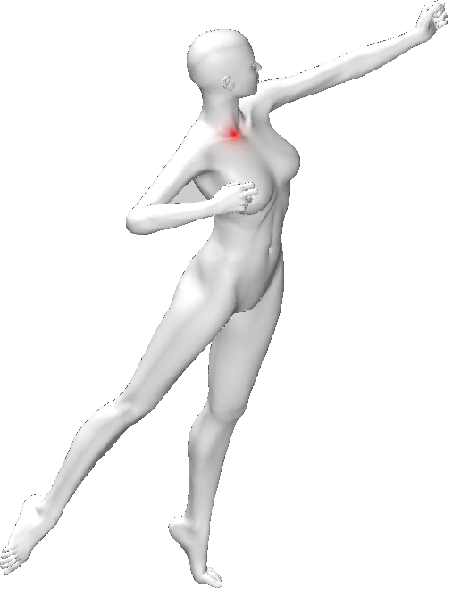
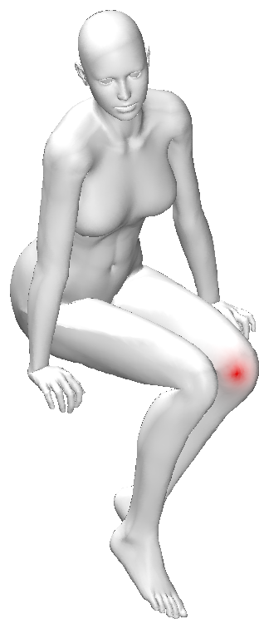
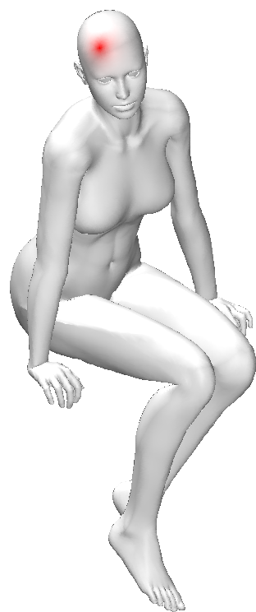
Functional representation
Point-to-point maps are a special case in which f and g are indicator functions.

Slide 6
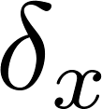
Choice of a basis
Indicator functions

Slide 7
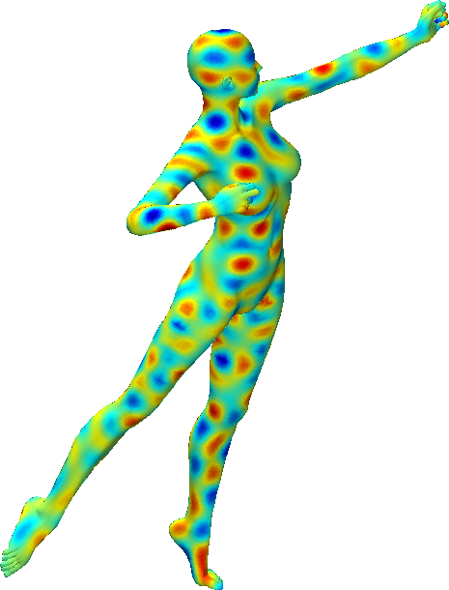
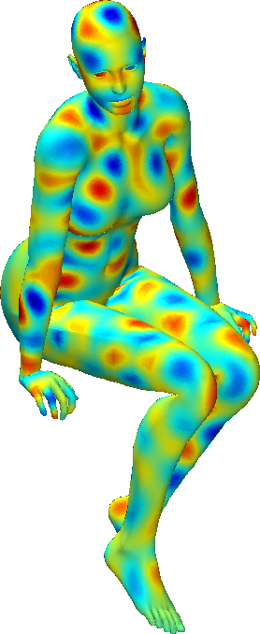
Choice of a basis

Slide 8
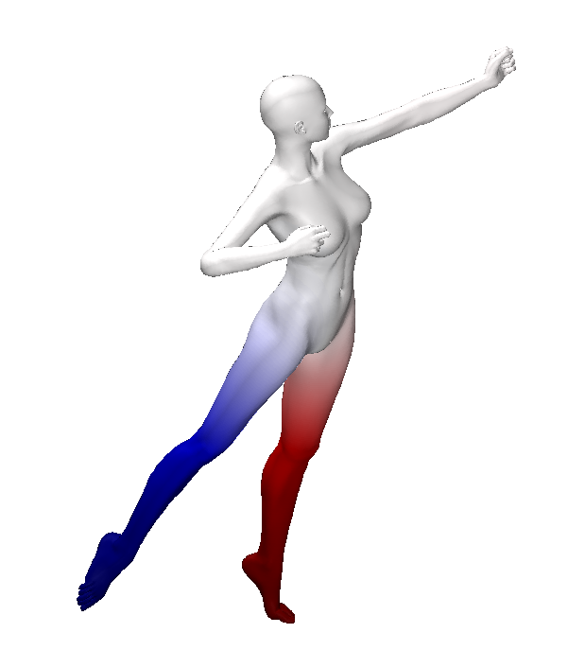
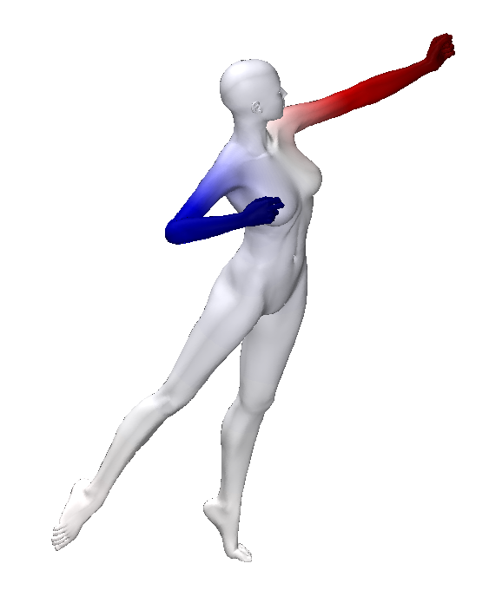
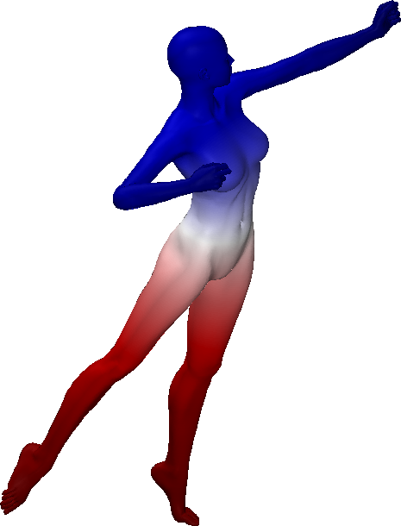
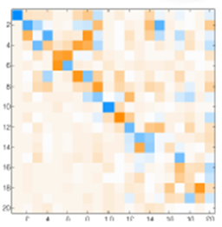
Choice of a basis
Laplacian eigenfunctions

Slide 9
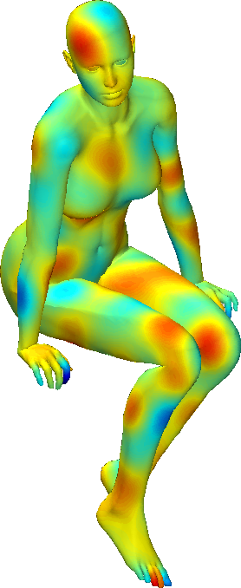
Choice of a basis

Slide 10
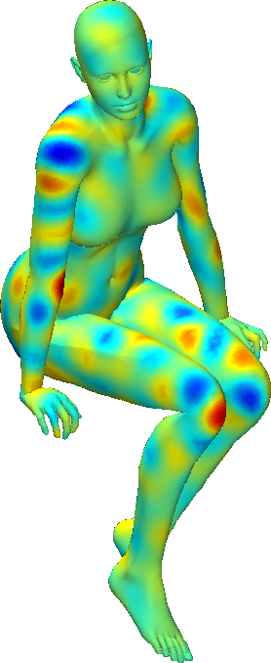
Choice of a basis

Slide 11
Choice of a basis

Slide 12
The recovery problem
P =
= C
Rank n
Rank
Recovery problem: How to get back to the point-to-point map from its functional representation?
The inverse problem is highly underdetermined.

Slide 13
Point-wise map recovery
We consider the general recovery problem:
bijective maps
regularizer (e.g., promote smooth maps)
Very challenging to solve in general: the quadratic integer programming problem is a special case.

Slide 14
A nearest-neighbor problem
Consider the indicator function around point .
representation of an indicator function in the eigenbasis
representation of all the indicator functions
can be regarded as a set of n points in

Slide 15
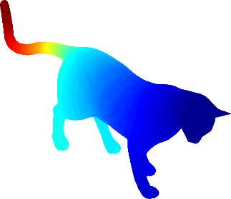
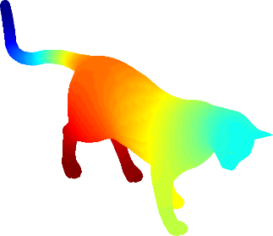
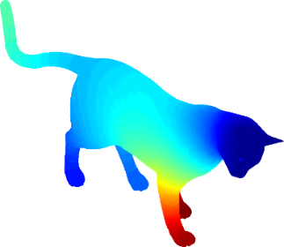
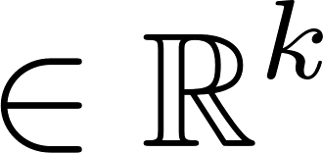
A nearest-neighbor problem
Consider the indicator function around point .
representation of an indicator function in the eigenbasis
representation of all the indicator functions

Slide 16
A nearest-neighbor problem

Slide 17
A nearest-neighbor problem
The functional map aligns the spectral embeddings of the shape points
The point-to-point assignment can be recovered by nearest-neighbors in
apply C

Slide 18
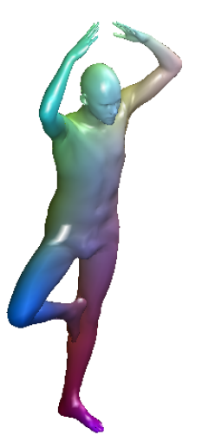
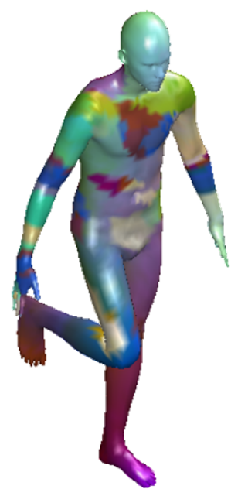
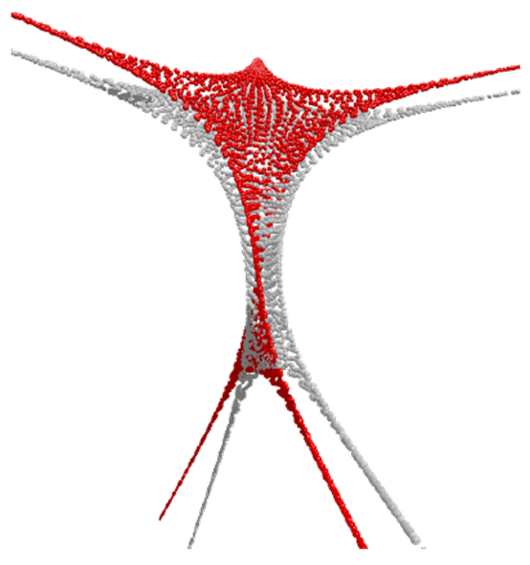
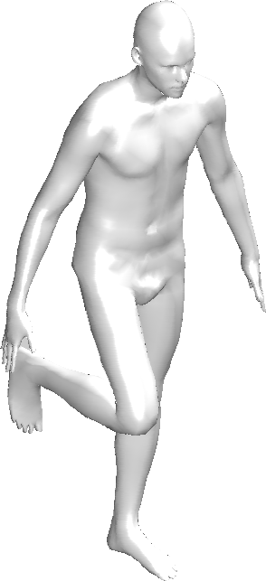
Example

Slide 19
A nearest-neighbor problem
If the given solution (input C) has low quality, nearest-neighbors is not very useful.
Can we simultaneously improve the input map and recover the point-to-point correspondence?

Slide 20
A nearest-neighbor problem
If the given solution (input C) has low quality, nearest-neighbors is not very useful.
Can we simultaneously improve the input map and recover the point-to-point correspondence?

Slide 21
A probabilistic model
The columns of are modes of a continuous probability distribution over (a GMM)
The columns of constitute a discrete sample drawn from the distribution
We want to align the modes to the data.

Slide 22
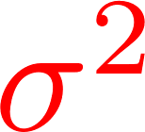
Probabilistic model
Variances
unknown transformation aligning to
Maximize the likelihood via EM algorithm

Slide 23
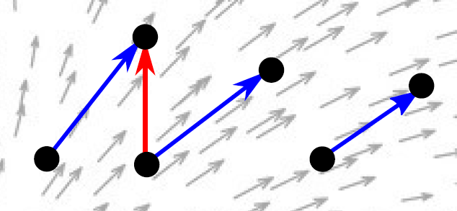
Probabilistic model
what kind of transformation?
displacement field
Promote smooth displacements:

Slide 24
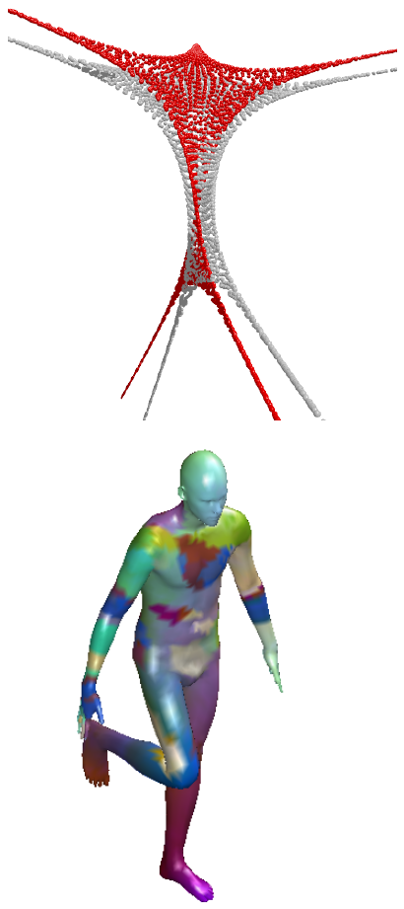
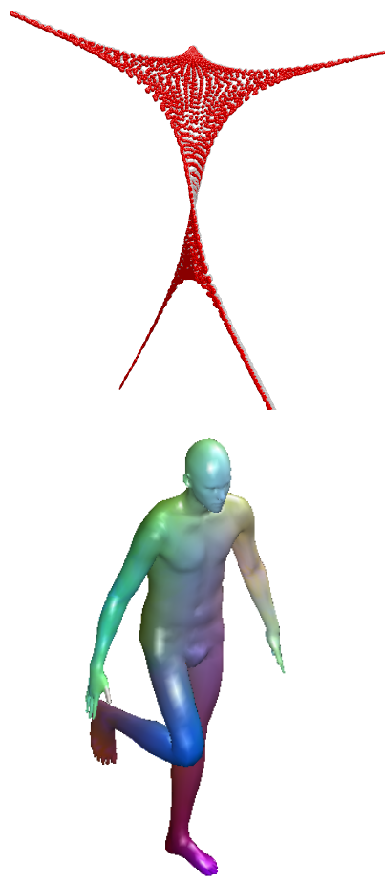
Nearest-neighbors
Ours

Slide 25
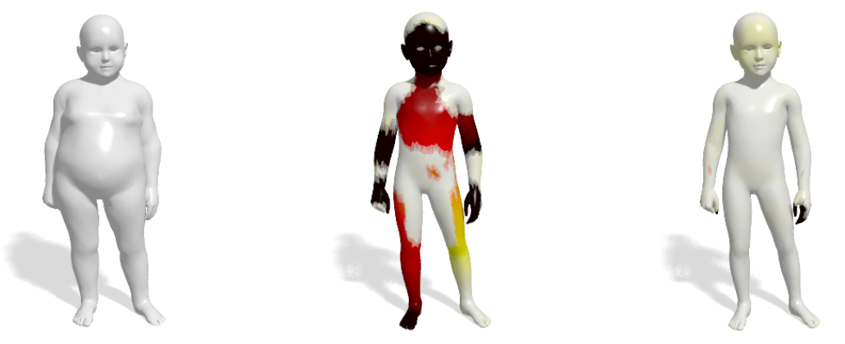
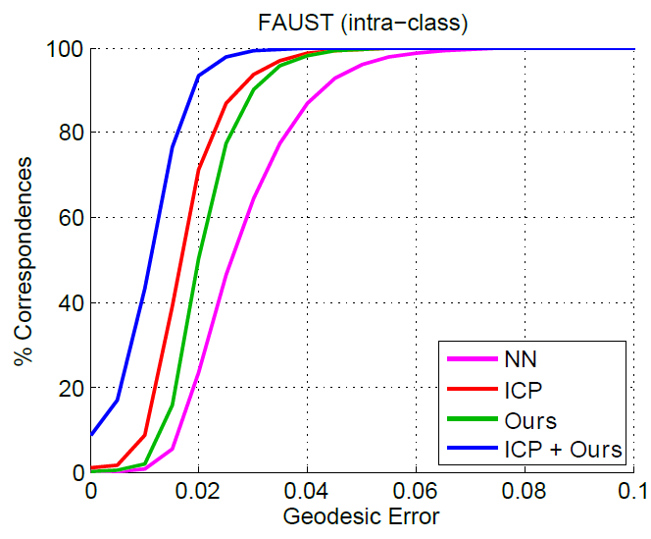
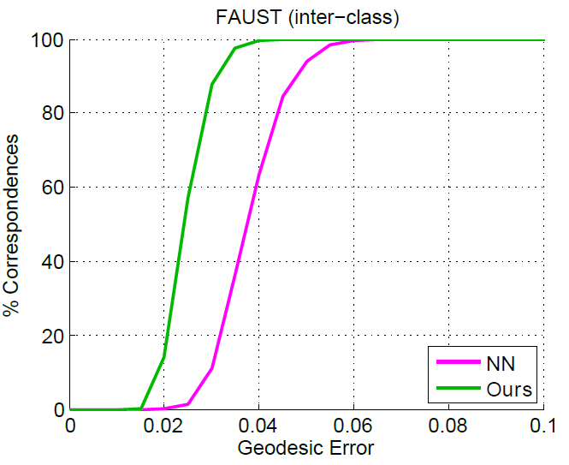
Nearest-neighbors
Ours
Isometric
Not isometric

Slide 26
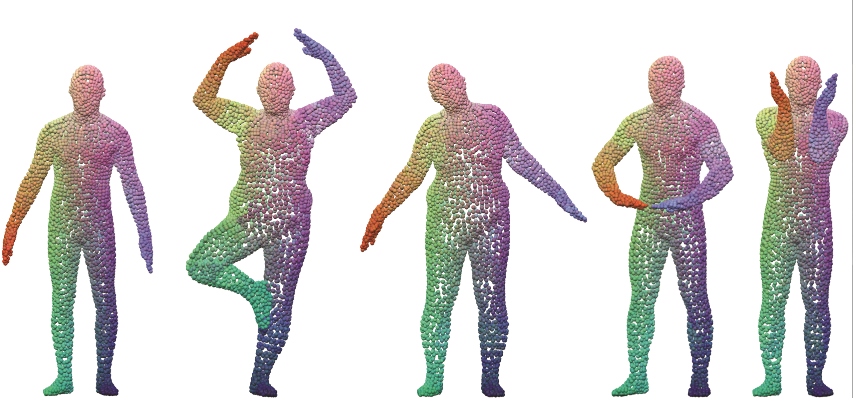
Point clouds

Slide 27
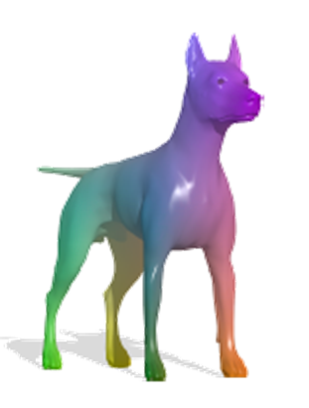
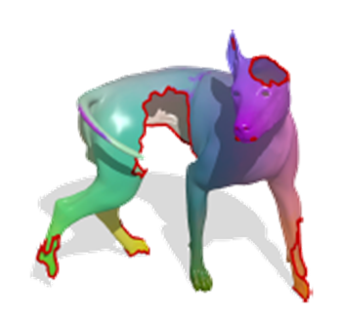
Future: Partial matching
Partial Functional Correspondence
[Rodolà et al., CGF 2015]

Slide 28
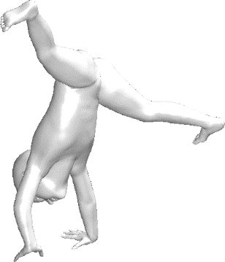
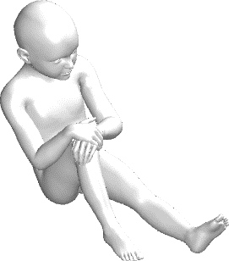
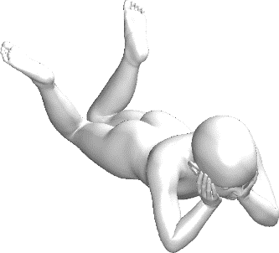
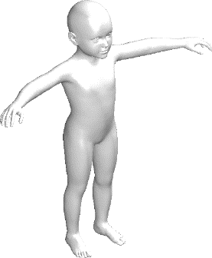
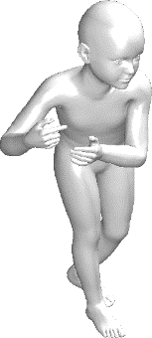
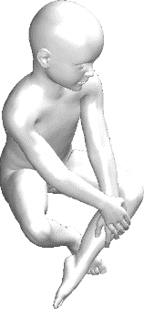
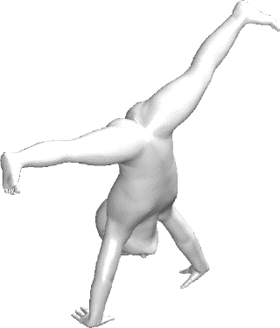
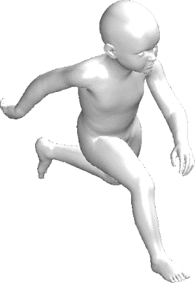
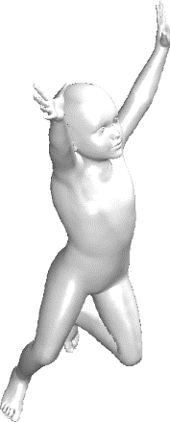
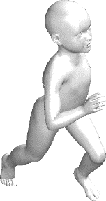
Future: Shape collections
Joint alignment of multiple mixture models?

Slide 29
Thank you!

Slide 30
Mapping indicator functions
Do this for all shape points
Basis truncation has a delocalizing effect on the max

Slide 31
Probabilistic model
unknown transformation aligning to
The alignment problem is solved by minimizing:

