Slide 1
Robust Person Following Using a Quadcopter
Thesis - Mid Term talk
Tayyab Naseer
tayyab.naseer@mytum.de

Slide 2
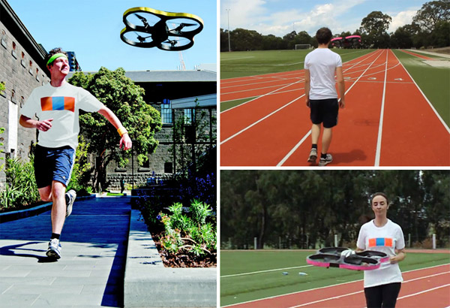
Motivation
Record spectacular sports videos while hiking, skiing etc.
Go Pro
Joggobot

Slide 3
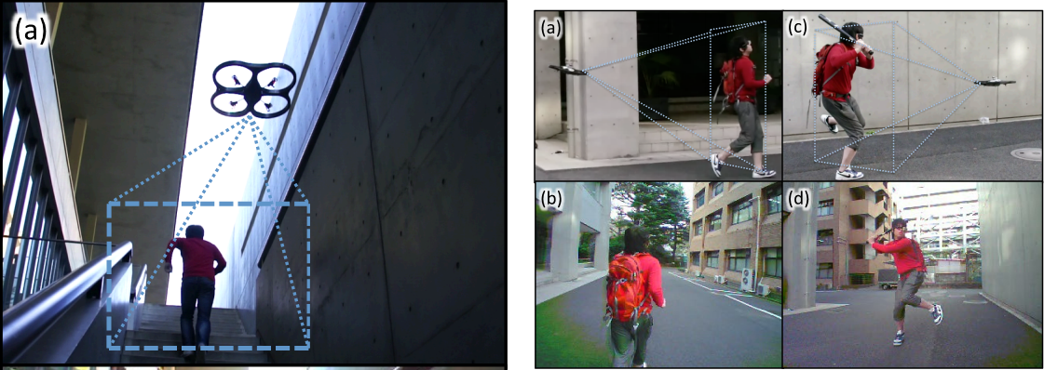
Motivation
External Visual Imagery
Ref: Keita Higuchi, Graduate School of Interdisciplinary Information Studies
The University of Tokyo
Flying Sports Assistant: External Visual Imagery Representation for Sports Training

Slide 4
Objective
Quadrocopter tracks and follows a person robustly
Pose control based on the orientation of the tracked person
Record a video from a third-person perspective
Avoid obstacles based on visual navigation

Slide 5
Challenges
Existing trackers do not work well on mobile platforms
Jerks in quadrocopter’s motion disturb the tracker
- Modify an existing tracker to make it more robust
- Use human movement prediction models if tracking is lost
Not much existing literature available on person tracking with camera mounted on flying robots

Slide 6
Current (practical) limitations:
Ceiling camera tracks the checkerboard so the movement is restricted to 1mx1m area
Use visual odometry (from Christian)
Use multiple ceiling markers

Slide 7
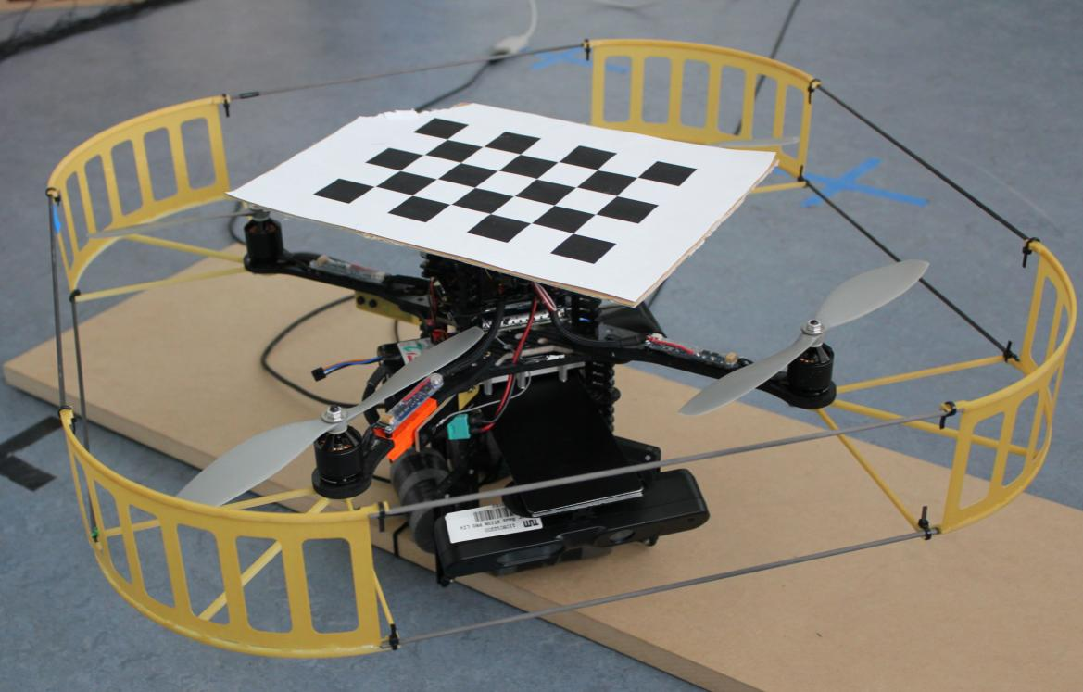
Work Flow
RGBD-Images
Waypoints
Motion
Capture
Trajectory
Control
Visual
Odometry
Position
Control

Slide 8
Asus Xtion Sensor Limitations
Asus Specifications 58° H, 45° V
1.8m
45°
2.89m
3.5m
0.8m
3.5m
Notes:
Horizontal distance of 3.8m

Slide 9
Hardware – Asctec Pelican

Slide 10
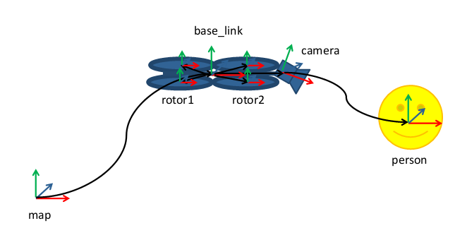
Coordinate frames

Slide 11
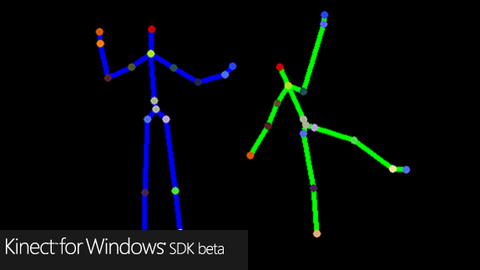
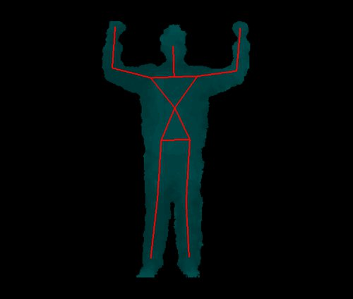
Motion Capture
Evaluation of existing trackers based on RGB-D data
Microsoft SDK
Based on background subtraction
Not Open Source
Not available for ROS
OpenNI
Based on background subtraction
Not Open Source
Available for ROS
CHOICE

Slide 12
Other Trackers
ROS People Detection Package (Navarro-Serment et.al 2010 [1])
Not Trained -> Detects almost everything as human
Provides bounding box
No Joints/Orientations
[1] Author of Package
Soh De Loong

Slide 13
OpenNI User Segmentation
0 0
0
3
3

Slide 14
ROS OpenNI Tracker – Transforms Superimposed

Slide 15
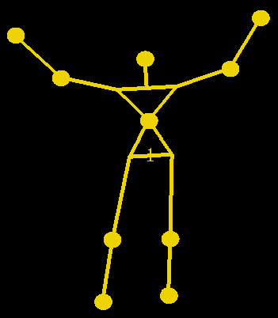
Handling background subtraction
Forward image
warping
Live Depth
Map
Median Filtering
OpenNI Tracker

Slide 16
Why Forward Warping ?
x | x | x | x | x
x | x | x | x | x
x | x | x | x | x
x | x | x | x | x
x | x | x | x | x
x | x
x | o | x
Transformation
Inverse
Transformation
Current Depth Map
Warped Depth Map

Slide 17
Forward Image Warping
Notes:
Can distribute the values among its 4 neighbours and then keeping the track of the weights and then normalizing them at the end. Splatting

Slide 18
Preliminary Tracking Results
Original Stabilized

Slide 19
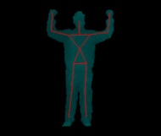
Performance Analysis
Tracking with Stabilized depth
Is Tracking ?
No Tracking with Original
Depth in 722 frames

Slide 20
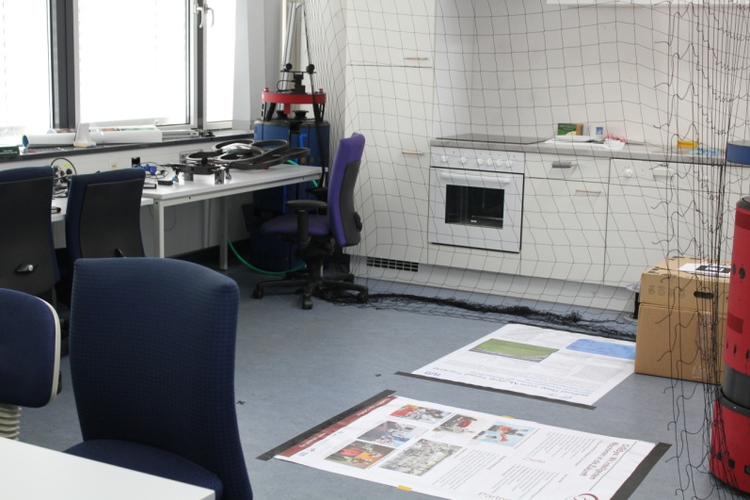
Visualization in RVIZ

Slide 21
Trajectory Control
Base_link
Person
Waypoint
Notes:
Person
Waypoint
Quadrocopter

Slide 22
Simulated Tracking of Quadcopter

Slide 23
Joint Movement Prediction
Prediction of joints movement based on accumulated knowledge about their trajectories
Exponentially weighted moving average on average velocities
Advantageous for occluded scenarios when joints confidence is less than the threshold
α values close to zero indicate that past values will have lingering effect

Slide 24
Joint Movement Prediction

Slide 25
Summary
Sensor Limitations
Motion capture
Coping with background subtraction issue
Preliminary results of tracking with warped images
Simulated results of trajectory control
Next steps:
Running the tracker on the quadrocopter
Trajectory control of the quadrocopter
Follow a person in a room

Slide 26
Discussion
Thank you for your attention
Ideas are welcome ☺

