Slide 1
Interactive Multilabel Segmentation with Proportion Priors
Claudia Nieuwenhuis

Slide 2
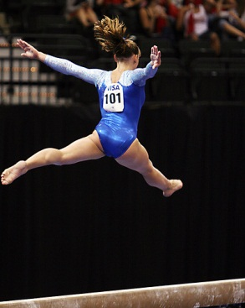
Co-Segmentation

Slide 3
?
Original
Segmentation Result

Slide 4
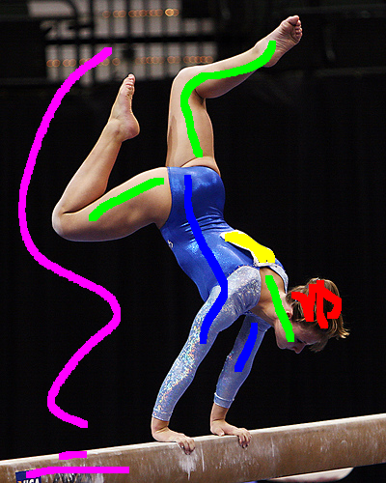
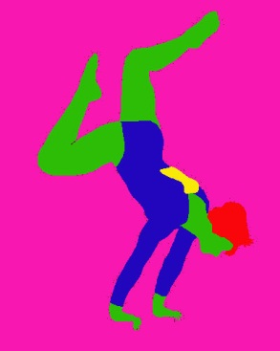

Slide 5
Proportion Priors
Advantages
Relate size of object parts or different objects to each other
Retain correct segmentation under difficult conditions
Scale invariance
Prevent disappearance of small, elongated or background-similar object parts
Problem: Self-occlusions

Slide 6
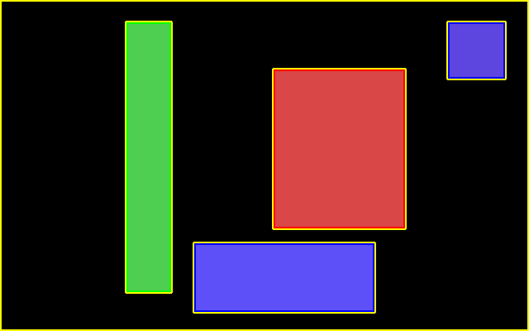
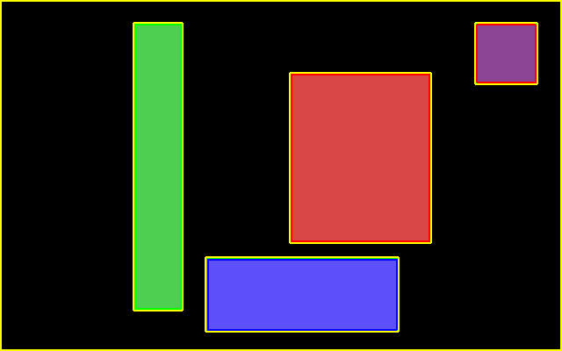
Results
Artificial Image
GGreen | Blue | Red
20%-25% | 20%-25% | 48%-55%
Original
Without Prior
With Prior

Slide 7
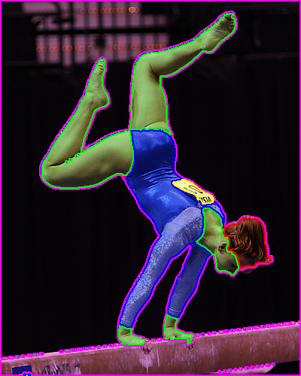
Results
Gymnastics
GHair | Skin | Sports Dress | 101-Sign
5%-15% | 35%-60% | 30%-50% | 0%-10%
Original
Without Prior
With Prior

Slide 8
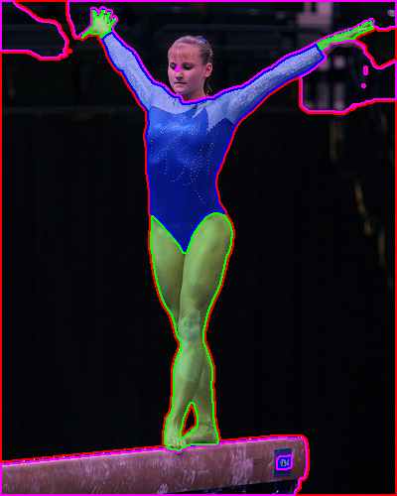
Without Prior
With Prior

Slide 9
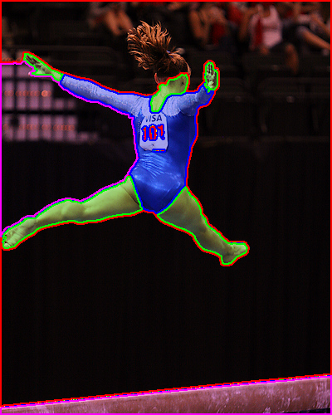
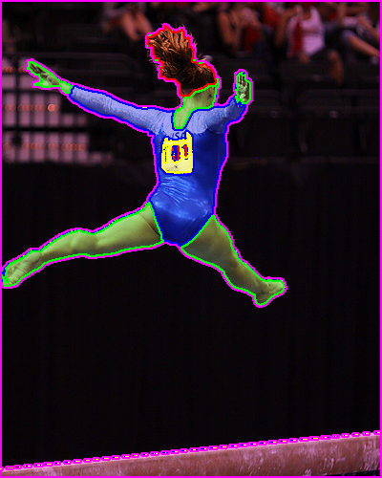
Without Prior
With Prior

Slide 10
Without Prior
With Prior

Slide 11
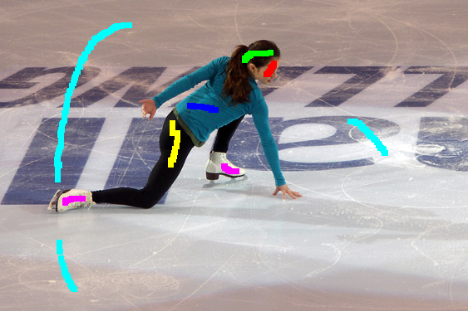
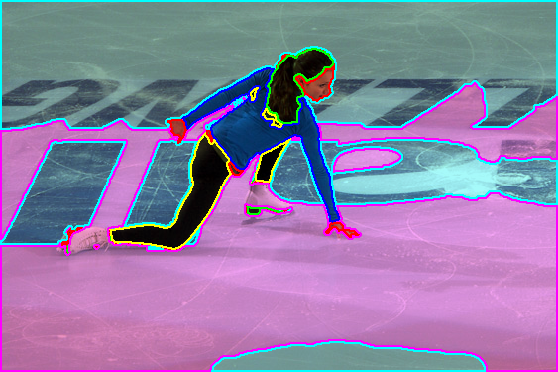
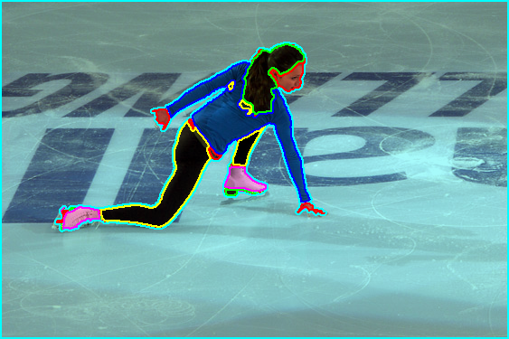
Results
Figure-Skating
GHair | Skin | Pullover | Trousers | Skates
5%-11% | 11%-17% | 31%-39% | 24%-35% | 9%-19%
Original
Without Prior
With Prior

Slide 12
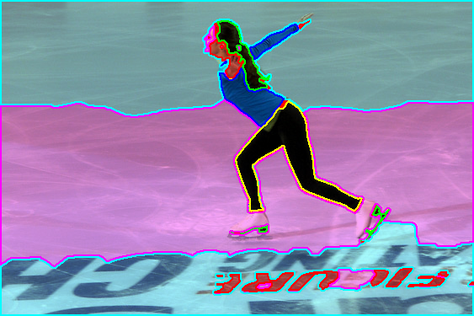
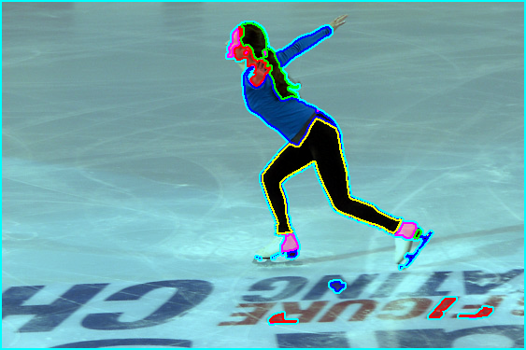
Without Prior
With Prior

Slide 13
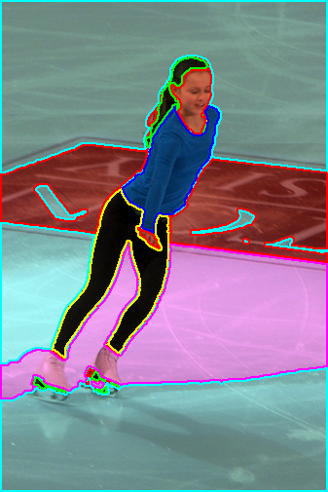
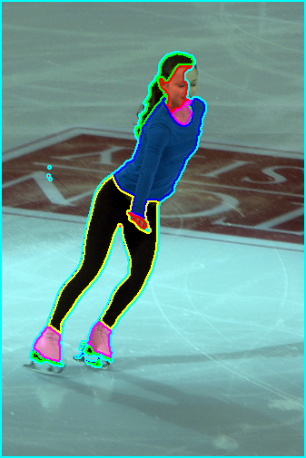
Without Prior
With Prior

