Slide 1
Relative Volume Constraints
for 3D Image Editing
Eno Töppe, Claudia Nieuwenhuis, Daniel Cremers
May 25th, 2012
Computer Vision Group TU Munich

Slide 2
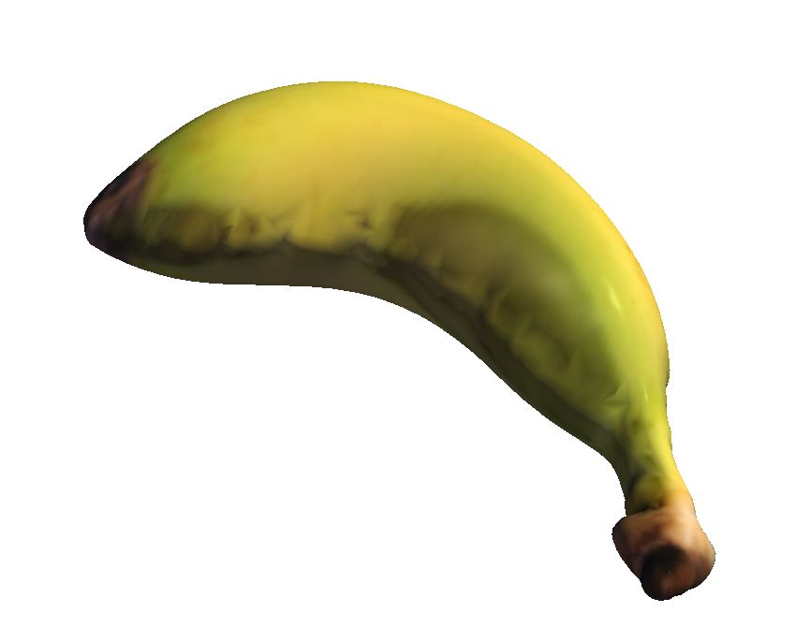
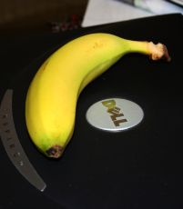
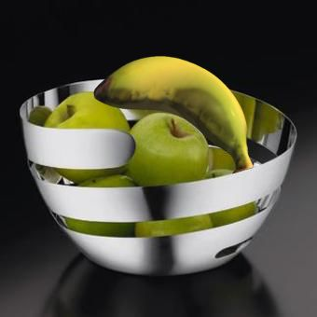
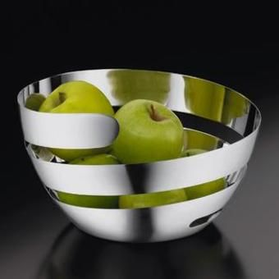
Single View Reconstruction
Single Image
3D Representation
New Lighting
and Material
Notes:
single view reconstruction
easy task for humans
one of the simplest ways to deal with ill-posedness -> user interaction
minimize user interaction

Slide 3
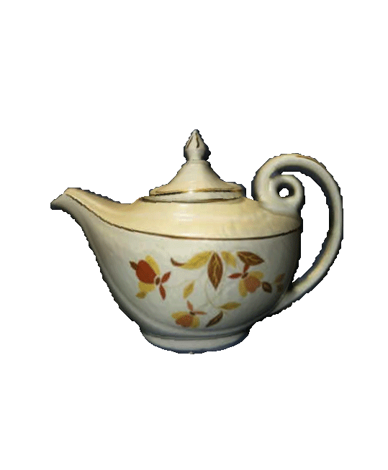
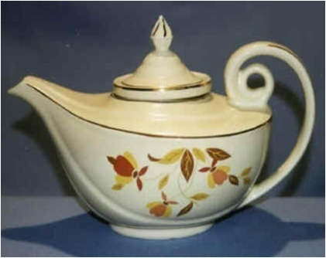
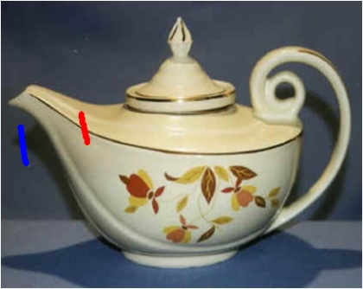
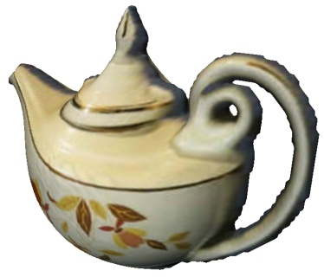
Workflow
input image
segmentation
reconstruction
final result
user strokes
Graphcut-based
segmentation¹
interactive
adaption of
volume /
smoothness
¹ Boykov, Jolly: Interactive graph cuts for optimal boundary region
segmentation of objects in n-d images. ICCV ‘01

Slide 4
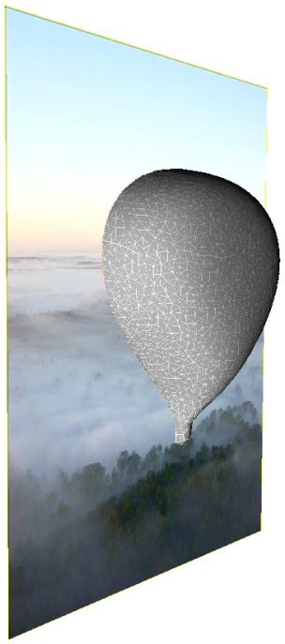
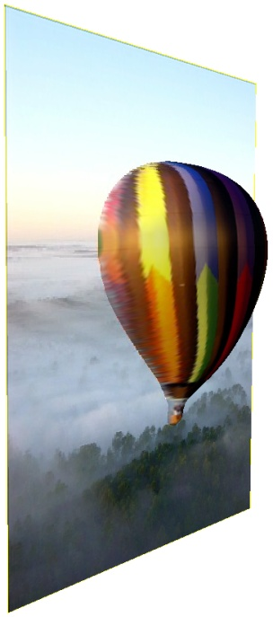
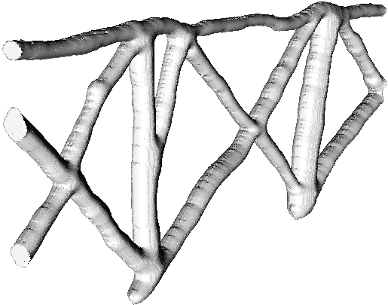
Results

Slide 5
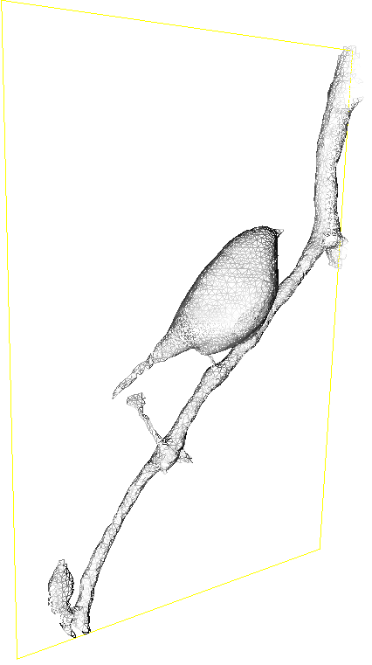
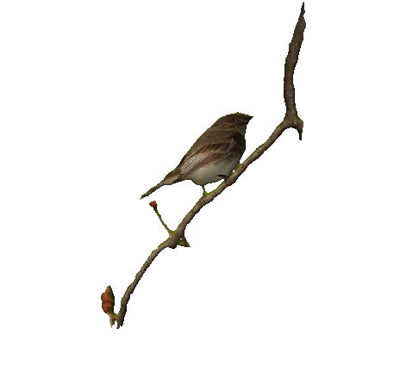
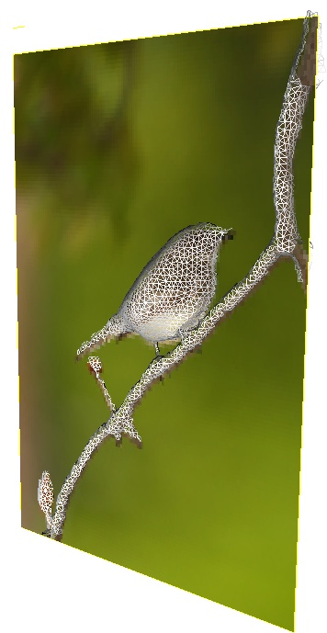
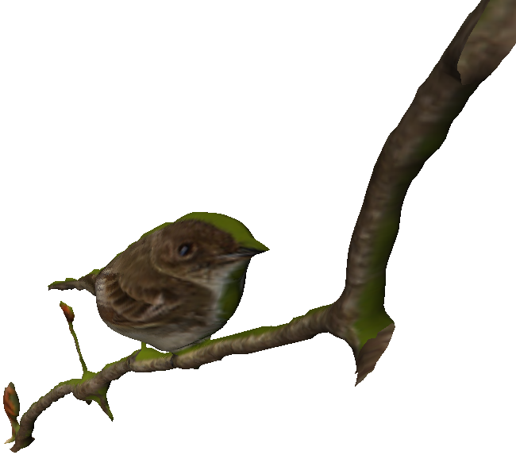
Results
Notes:
volume constraint leads to natural volume inflation without heuristics, e.g. distance transform, balloon forces

Slide 6
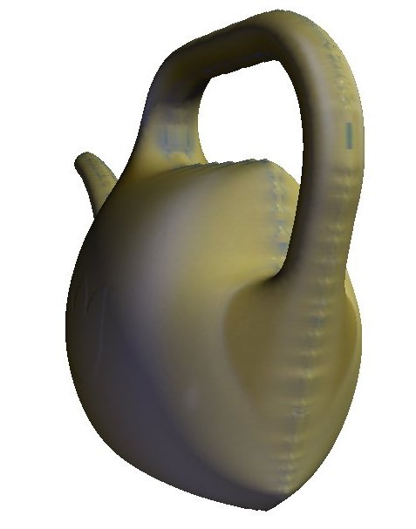
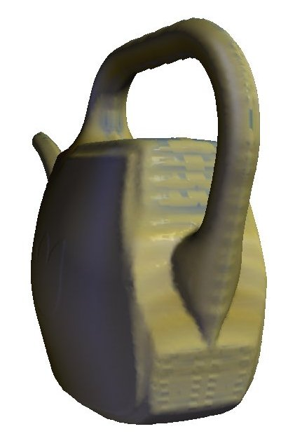
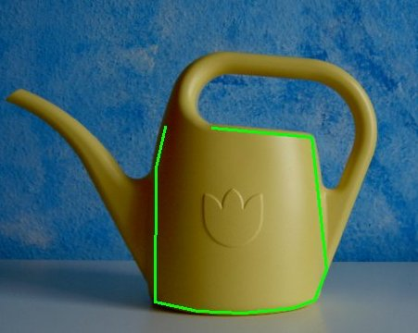
Sharp Edges
Minimal Surface
with Fixed Volume
The Same with
Local Smoothness Relaxation
Notes:
planar: use of vanashing points & lines, orthogonality
curved: 1.energy minimization 2. heightmaps 3.,4.curved objects
generally: a lot of user input (except [6]), topology problem
Focus:
real world images
curved objects
arbitrary topology
simple and intuitive editing

Slide 7
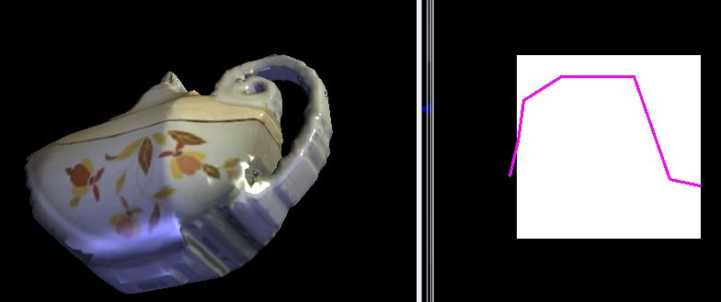
Relative Depth Profiles
Reconstruction with
Relative Depth
Depth Profile indicating
Relative Depth
Notes:
Non-parametric: numerical stability, complicated remeshing
Inflation technique: all previous works explicitly define depth values or have inflation heuristics

Slide 8
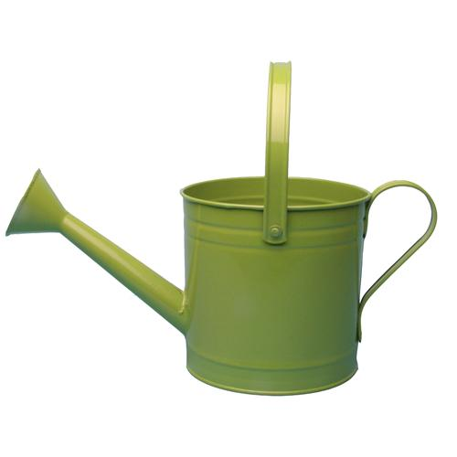
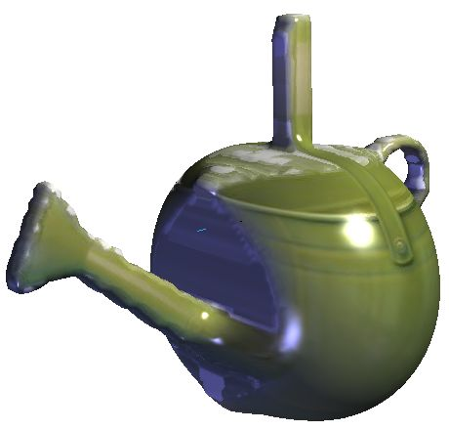
Relative Depth Profiles
Input Image
Reconstruction with
Fixed Volume

Slide 9
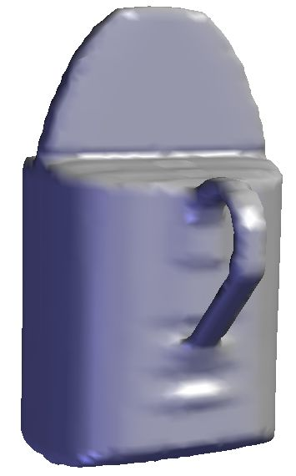
Relative Depth Profiles
Depth Profile indicating
Relative Depth
Reconstruction with
Relative Depth Profile

Slide 10
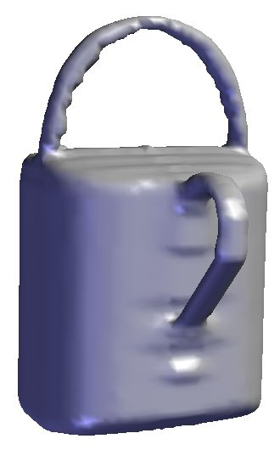
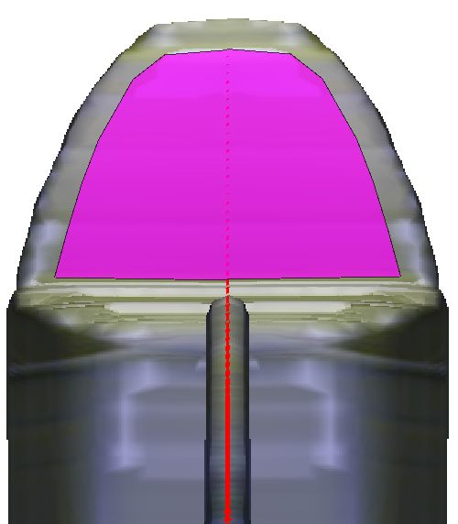
Subvolume Ratios
Reconstruction with
Relative Depth Profile
and
Subvolume Ratio
User Drawn Area
Indicating Projected Subvolume

Slide 11
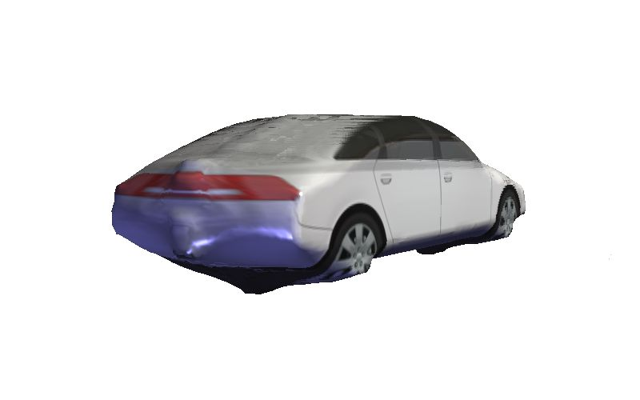
Results
Input Image
Reconstruction with
Constant Volume
+
Local Smoothness

Slide 12
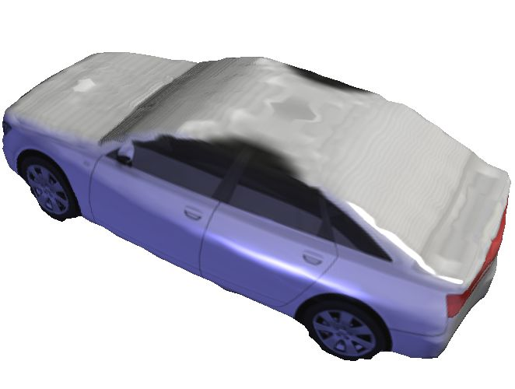
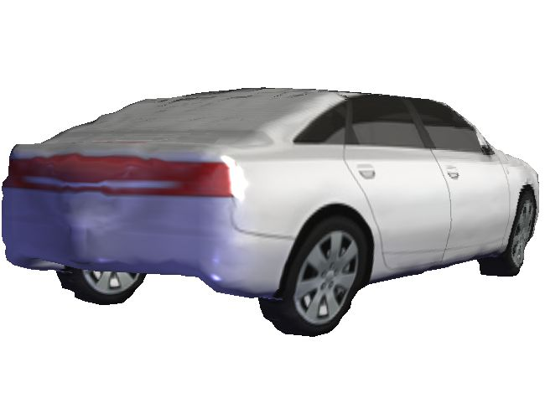
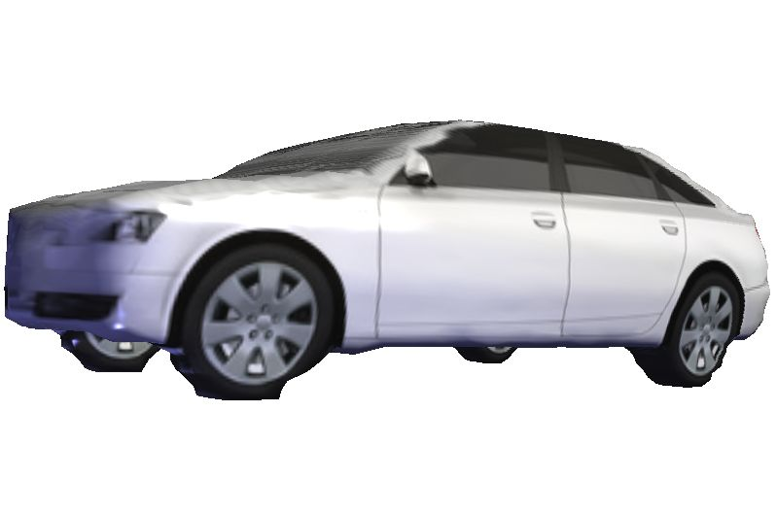
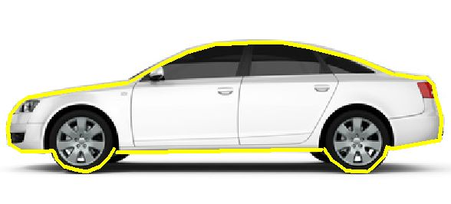
Results
Reconstructions with New Constraints
Local Smoothness

Slide 13
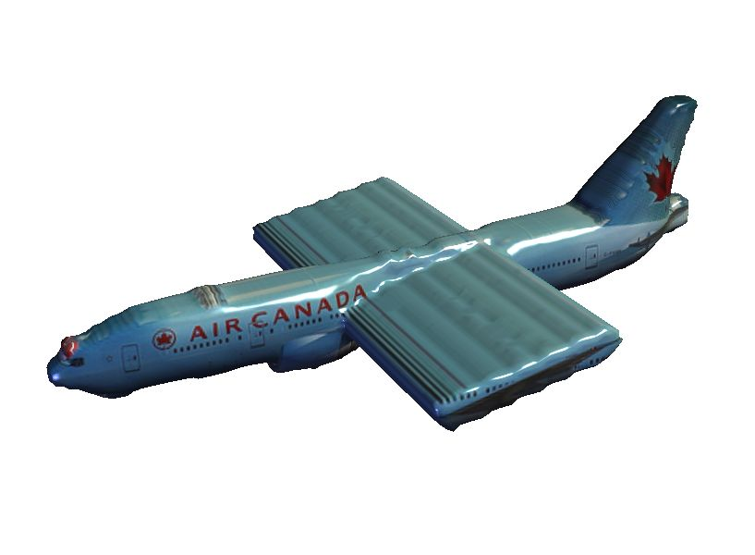
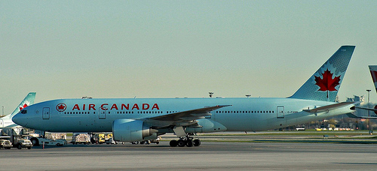
Results
Input Image
Reconstruction with
Constant Volume
+
Local Smoothness

Slide 14
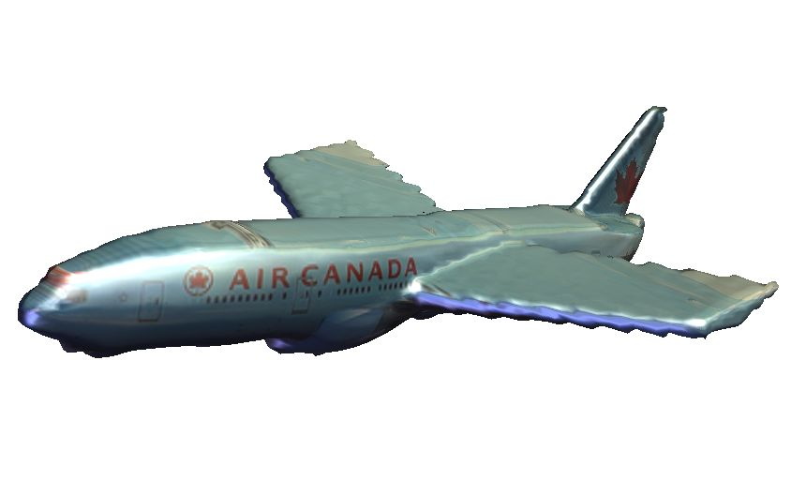
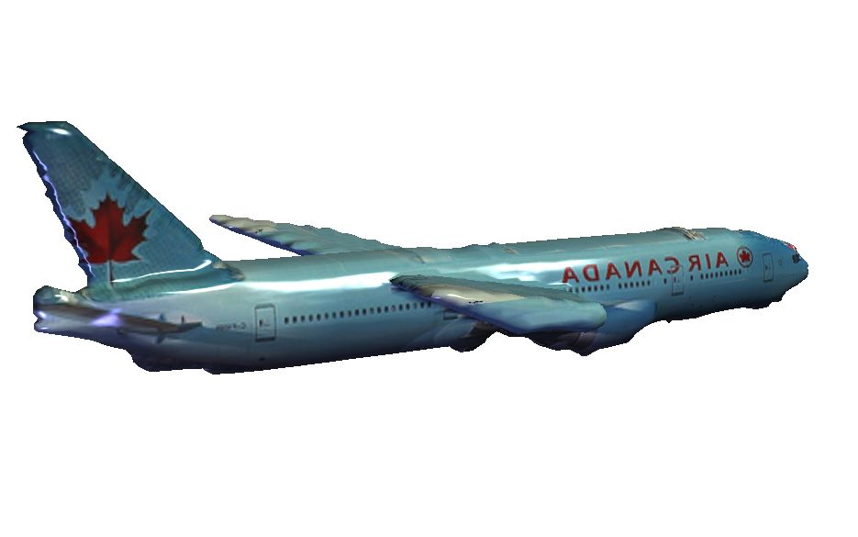
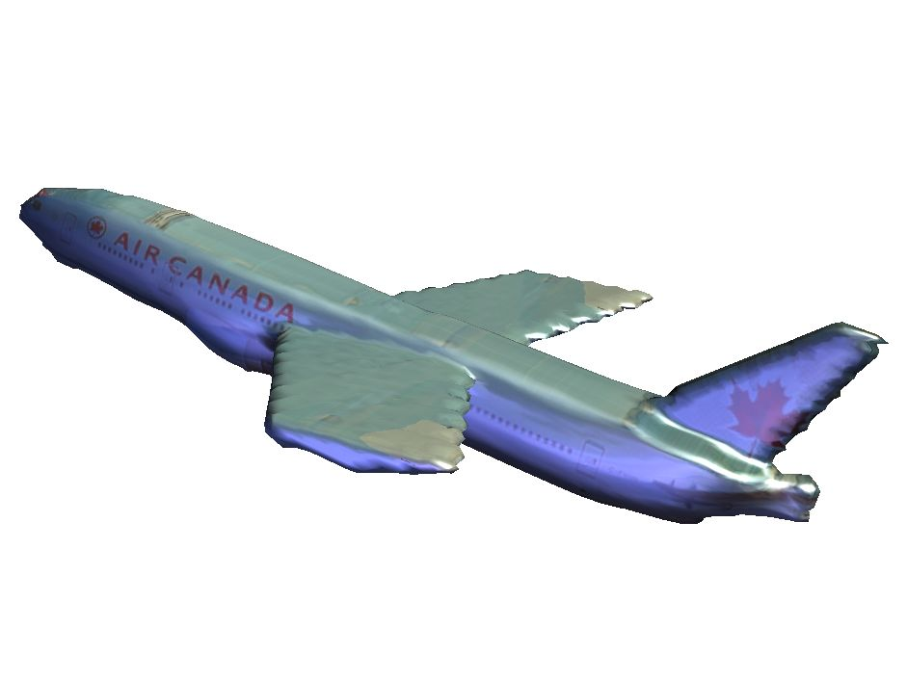
Results
Reconstructions with New Constraints

Slide 15
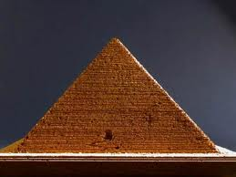
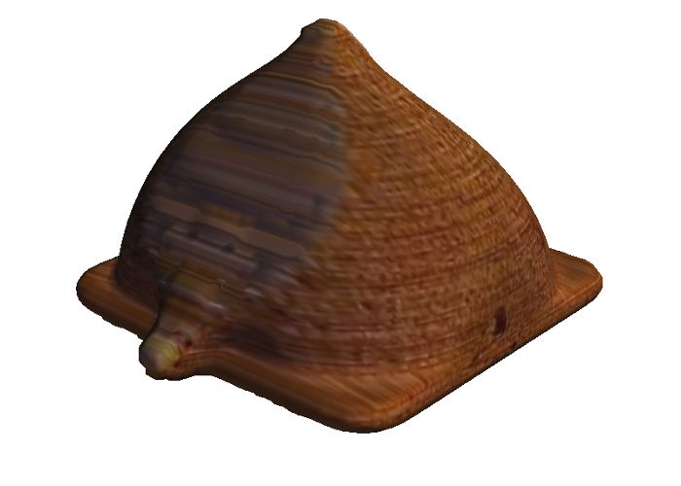
Results
Input Image
Reconstruction with
Constant Volume
+
Local Smoothness

Slide 16
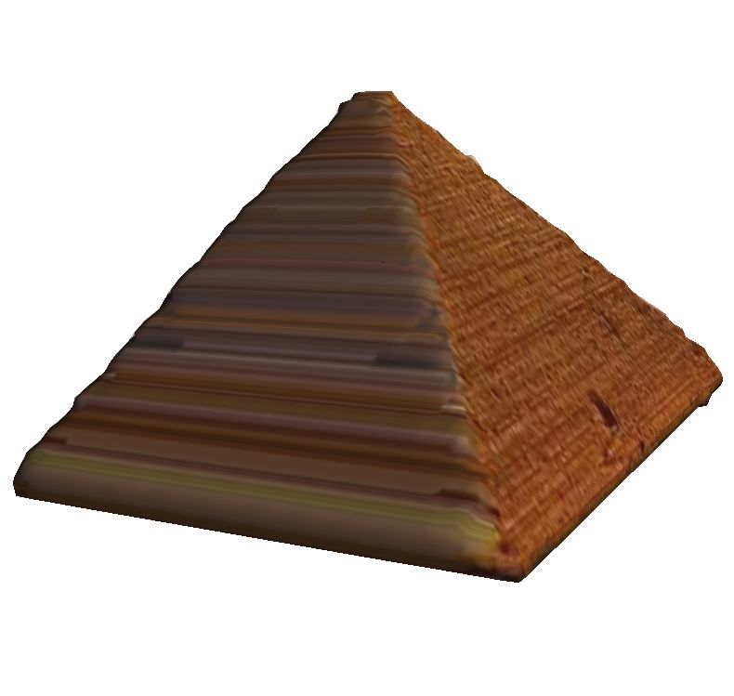
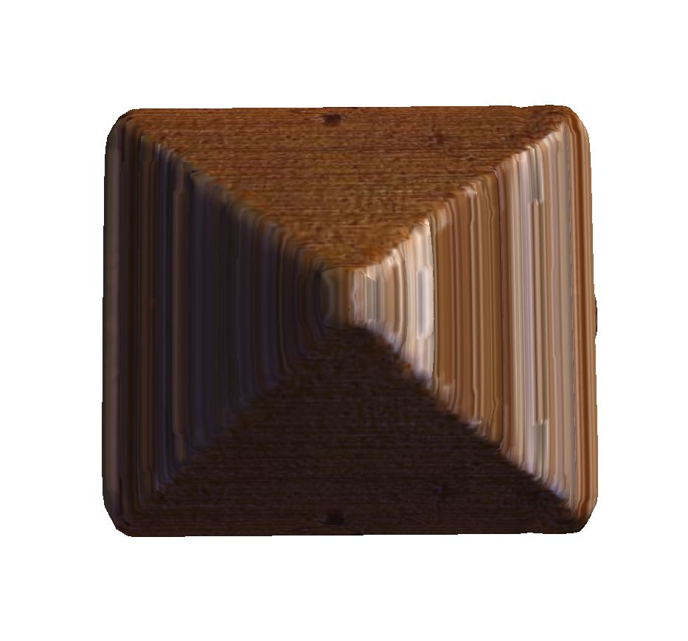
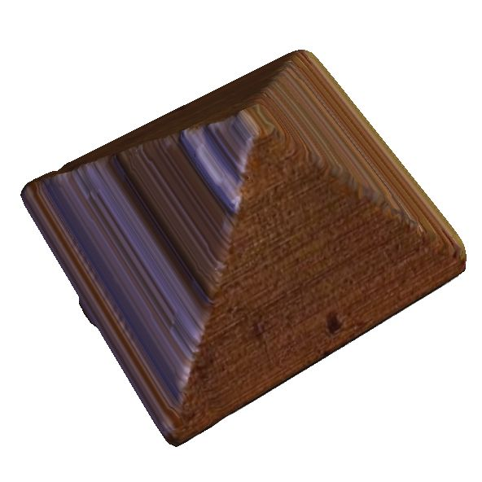
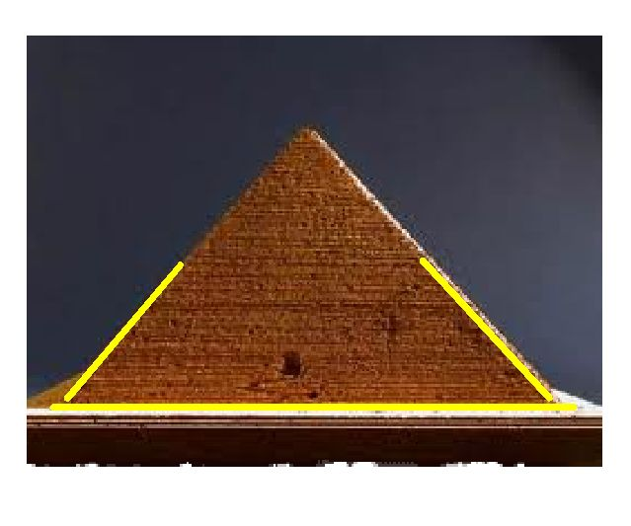
Results
Reconstructions with New Constraints
Local Smoothness

Slide 17
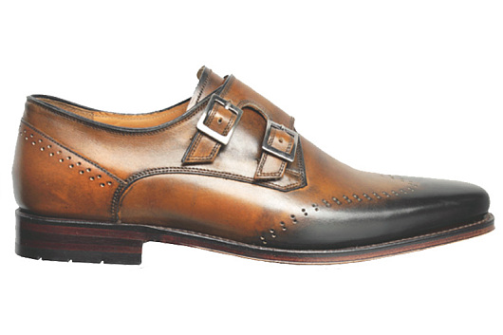
Results
Input Image

Slide 18
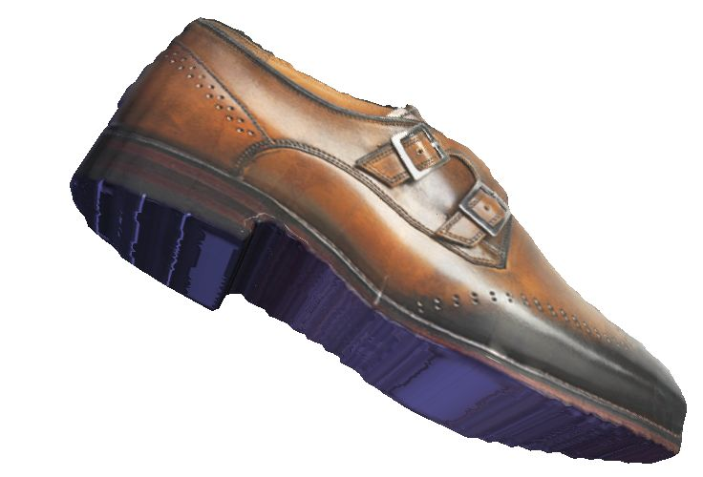
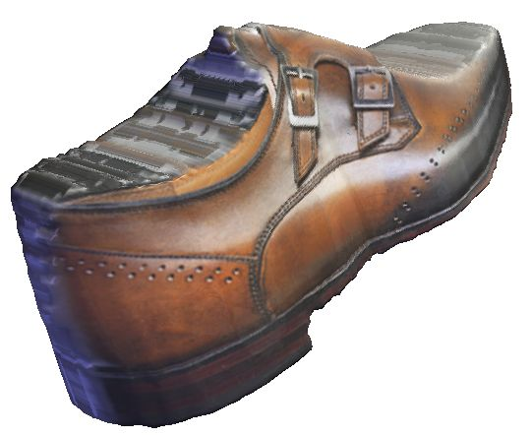
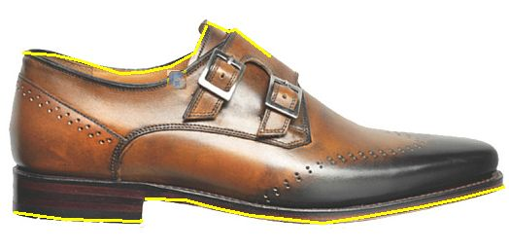
Results
Reconstructions with New Constraints
Local Smoothness (User Input)

Slide 19
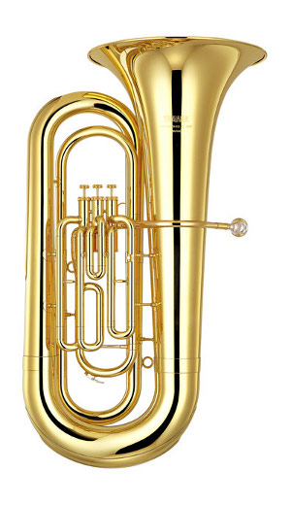
Results
Input Image

Slide 20
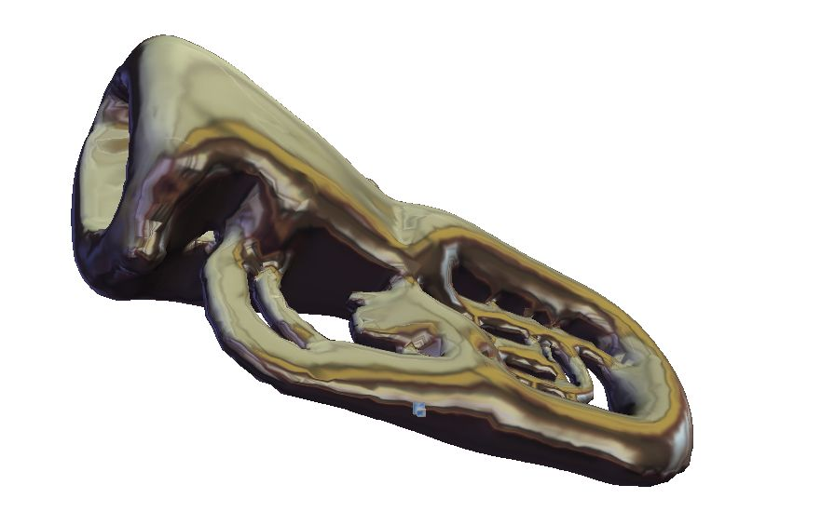
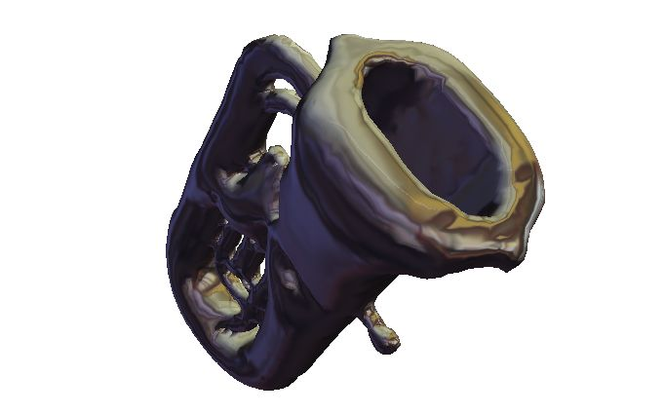
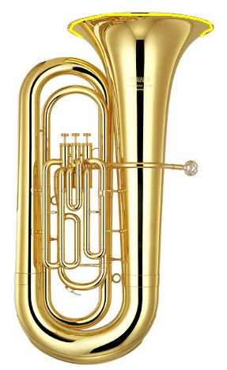
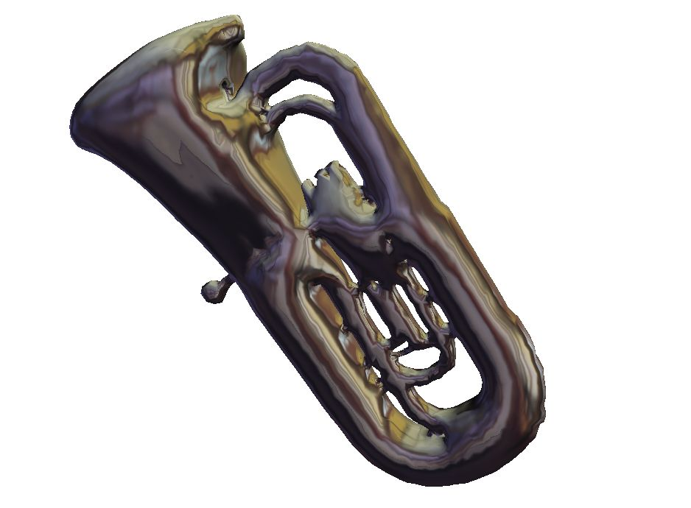
Results
Reconstructions with New Constraints
Local Smoothness
(User Input)

Slide 21
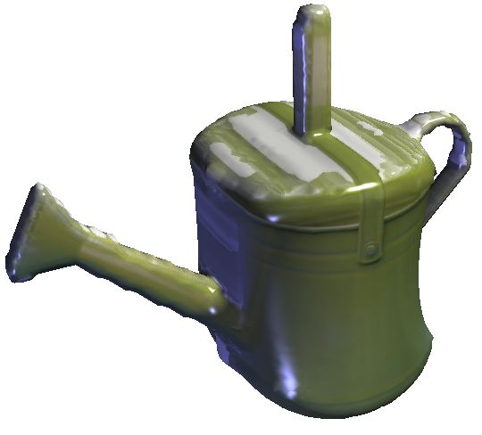
Results
Input Image
Reconstruction with
Constant Volume
+
Local Smoothness

Slide 22
Results
Reconstructions with New Constraints

