Slide 1
KinectFusion: Real-Time Dense Surface Mapping and Tracking
Ivy, Tian Jin

Slide 2
Outline
Introduction
Background
Method
Experiments
Summary

Slide 3
Introduction
Real-time mapping
Regardless of lighting conditions
Low-cost commodity camera and graphics hardware
→Kinect sensor

Slide 4
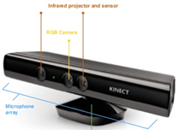
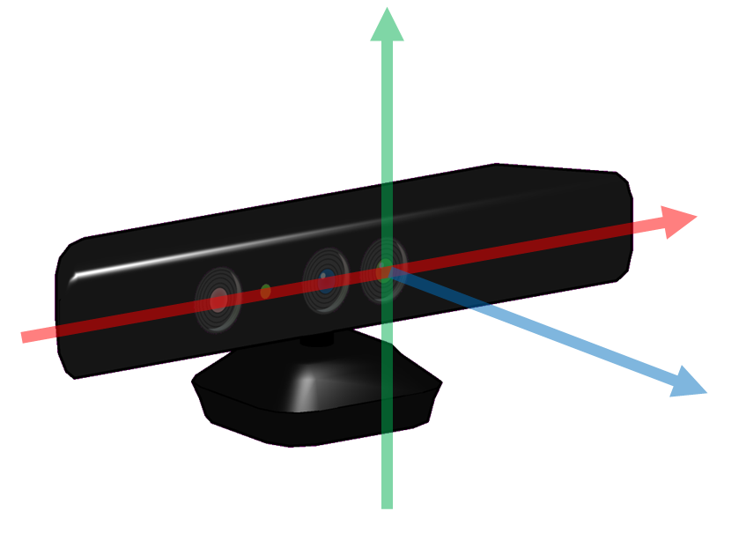
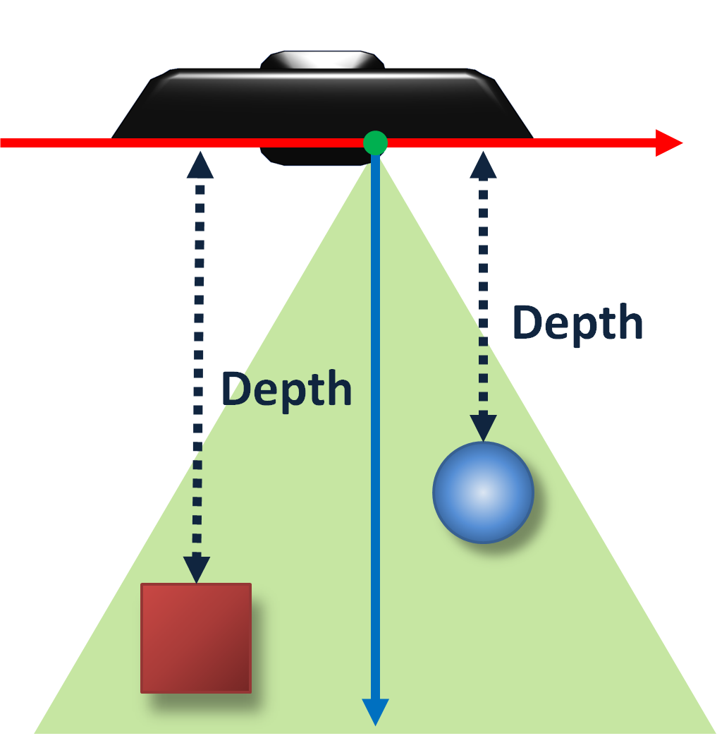
Background
Kinect sensor

Slide 5
Method
Iterative Closest Point
Truncated Signed Distance Function
Surface measurement
Sensor pose estimation
Surface reconstruction update
Surface prediction

Slide 6
Method ------ Preliminaries
Time: k
Camera pose (a rigid body transformation matrix):
Transfer a point in the camera frame into the global co-ordinate frame
Using K to denote the camera calibration matrix
which transforms points on the sensors plane into image pixels.
homogeneous vectors

Slide 7
Method ------ Surface measurement
Pre-processing stage
Generate a dense vertex map and normal map pyramid

Slide 8
Method ------ Surface measurement
Raw depth map R_{k}
Weighted value
Bilateral filter
Depth map with reduced noise D_{k}
Back-project the filtered depth values into the sensors frame of reference k
Vertex map V_{k}
Cross product the neighboring vertices to compute normal vectors
To compute camera pose from coarse to fine, which can speed up the computation
Level 160*120
Level 320*240
Level 640*480
Normal map N_{k}
Depth map
Vertex and normal map pyramid
Level = 3

Slide 9
Method ------ Mapping as Surface Reconstruction
The global scene fusion process
Truncated Signed Distance Function (TSDF) representation
“Each consecutive depth frame, with an associated live camera pose estimate is fused into one single 3D reconstruction”

Slide 10
Method ------ Mapping as Surface Reconstruction
TSDF representation
Two components are stored:

Slide 11
Method ------ Mapping as Surface Reconstruction
How to compute the distance value?
3D point (global coordinates)
The ray from the camera center to the 3D point p
Normalization factor
2D pixel point
SDF trancation
Weighted value?
Proportional to

Slide 12
Method ------ Mapping as Surface Reconstruction
Global TSDF?
------weighted average
Global TSDF
TSDF of current frame
Truncated weights

Slide 13
Method ------ Surface prediction from ray casting the TSDF
TSDF distance value = 0 → surface
A per-pixel ray-casting is performed
-ve
+ve
Zero crossing
Surface here!
camera

Slide 14
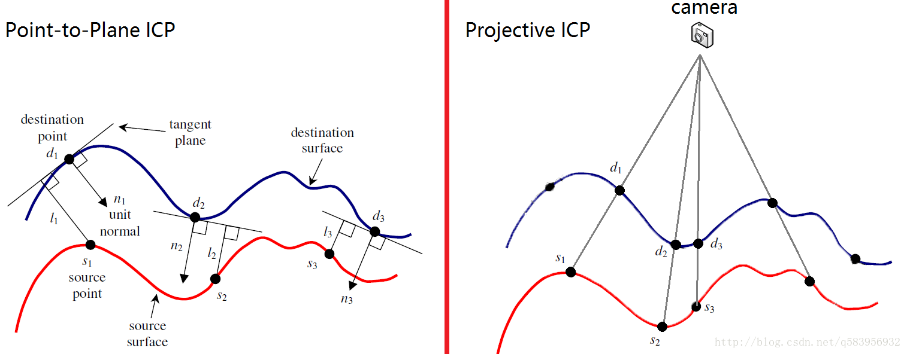
Method ------ Sensor pose estimation
Iterative closest point (ICP) algorithm
→can be used to compute the rigid body transformation

Slide 15
Method ------ Sensor pose estimation
Frame-to-model ICP?
Measured surface
Predicted surface

Slide 16
Experiments
The Kinect sensor is placed on a fixed turntable
Capture every 19s
N=560 frames
(e) MN frames without precise repetition

Slide 17
Experiments ------ Alignment
Drift-free

Slide 18
Experiments ------ Processing time -Constant

Slide 19
Experiments ------ Observations and Failure Modes
Robustness to lighting indoor scene
Main failure:
Large planar scene
No features
Hard to align

Slide 20
Summary
Key concept
Up-to-date surface representations fusing all data from previous scans with TSDF
Frame-to-model
Fully parallel algorithms
Challenges
<= 7m³

Slide 21
Thanks!
Q&A?

