Slide 1
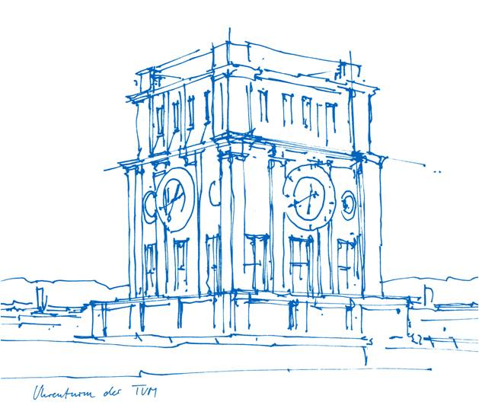
BundleFusion: Real-time Globally Consistent 3D Reconstruction using On-the-fly Surface Re-integration
ANGELA DAI, Stanford University
MATTHIAS NIESSNER, Stanford University
MICHAEL ZOLLHÖFER, Max-Planck-Institute for Informatics
SHAHRAM IZADI, Microsoft Research
CHRISTIAN THEOBALT, Max-Planck-Institute for Informatics
Published in ACM Transactions on Graphics, February 2017

Slide 2
Online 3D Reconstruction
KinectFusion: first real-time volumetric fusion
[Newcombe et.al , Izadi et al 11]

Slide 3
Online 3D Reconstruction: Challenges Tracking: global consistency, loop closure, re-localization

Slide 4
BundleFusion: Overview

Slide 5
BundleFusion: Overview

Slide 6
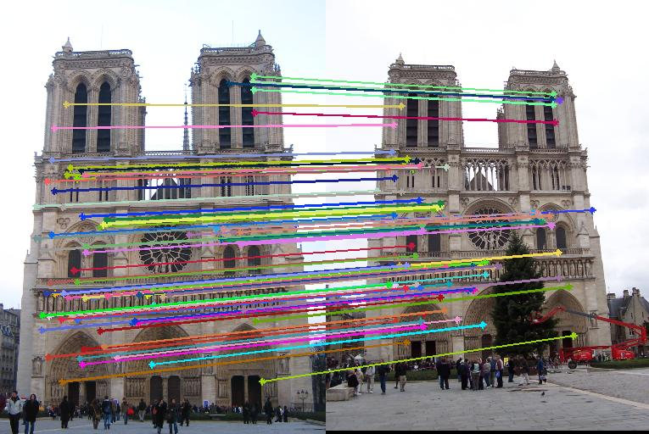
Correspondence Filtering
Example from Georgia Tech College of Computing
1.Key point correspondence filter: find consistent transform

Slide 7
Correspondence Filtering
2. Surface area filter: remove badly conditioned correspondence sets
Unstable transform
Images modeled from Foter.com

Slide 8
Correspondence Filtering
3. Dense projection: check high re-projection error
frames transform

Slide 9
BundleFusion: Overview

Slide 10
Sparse-to-Dense Optimization
Initialize with sparse features, continue with dense features
Coarse to fine alignment
where
pairwise correspondences k-th feature point from i-th frame

Slide 11
Sparse-to-Dense Optimization
fine scale alignment
gradient of the luminance of frame color
3D projection of the k-th pixel of the i-th frame
perspective projection
normal of the k-th pixel of the i-th frame
depth

Slide 12
Sparse-to-Dense Optimization: Example

Slide 13
Local-to-Global Strategy
1. Local Intra-Chunk Pose Optimization
2. Per-Chunk Keyframes
3. Global Inter-Chunk Pose Optimization

Slide 14
BundleFusion: Overview

Slide 15
Dynamic Scene Update: On-the-fly
Surface Integration
signed distance of the voxel projective distance
voxel {
distance;
color;
weight;
}
voxel weight integration weight

Slide 16
Dynamic Scene Update: On-the-fly
Surface De-Integration: remove di from weighted average
voxel {
distance;
color;
weight;
}

Slide 17
Results

Slide 18
Results

Slide 19
Performance
Dual GPU Performance – global dense optimization <500ms
Tailored Gauss Newton solver

Slide 20
Conclusions
● Real-time reconstruction with commodity RGB-D sensors
● Global pose optimization
● Online loop closures
● Real-time re-localization
● On-the-fly scene updates

