Slide 1
Master Seminar - HuMANS: 3D Human Motion ANalysiS
Cecilia Curreli, Mariia Gladkova

Slide 2
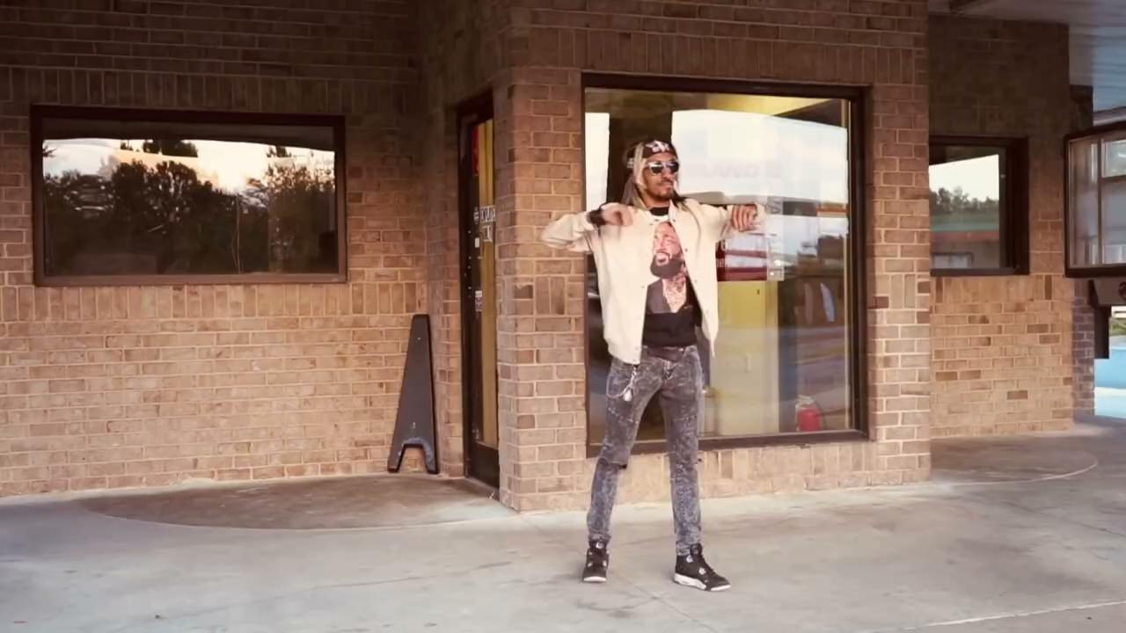
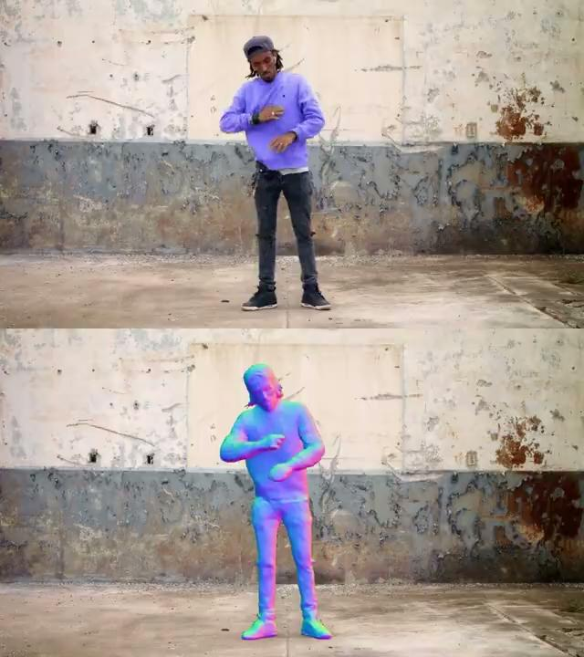
Why HuMANS?
Understanding human world is an exciting direction of great research interest!
[1] Weng, Chung-Yi, et al. "Humannerf: Free-viewpoint rendering of moving people from monocular video." CVPR (2022).
[2] Guo, Chen, et al. "Vid2avatar: 3d avatar reconstruction from videos in the wild via self-supervised scene decomposition." CVPR (2023).

Slide 3
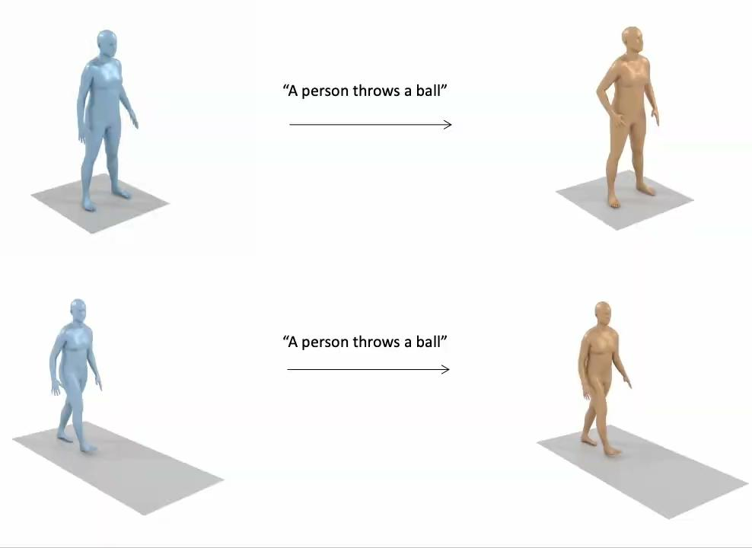
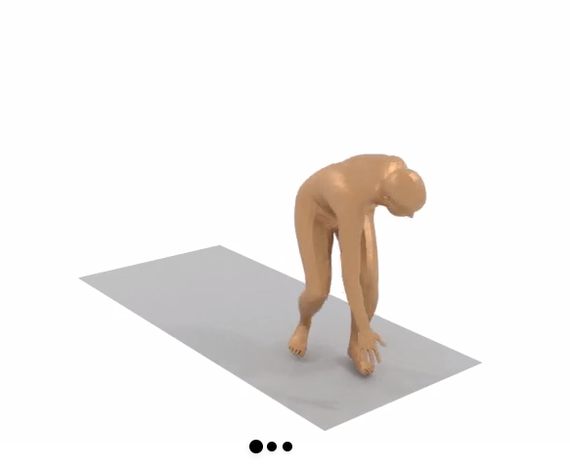
Why HuMANS?
Understanding human world is an exciting direction of great research interest!
Tevet et al. "MDM: Human Motion Diffusion Model" ICLR (2023). Videos from: https://guytevet.github.io/mdm-page/

Slide 4
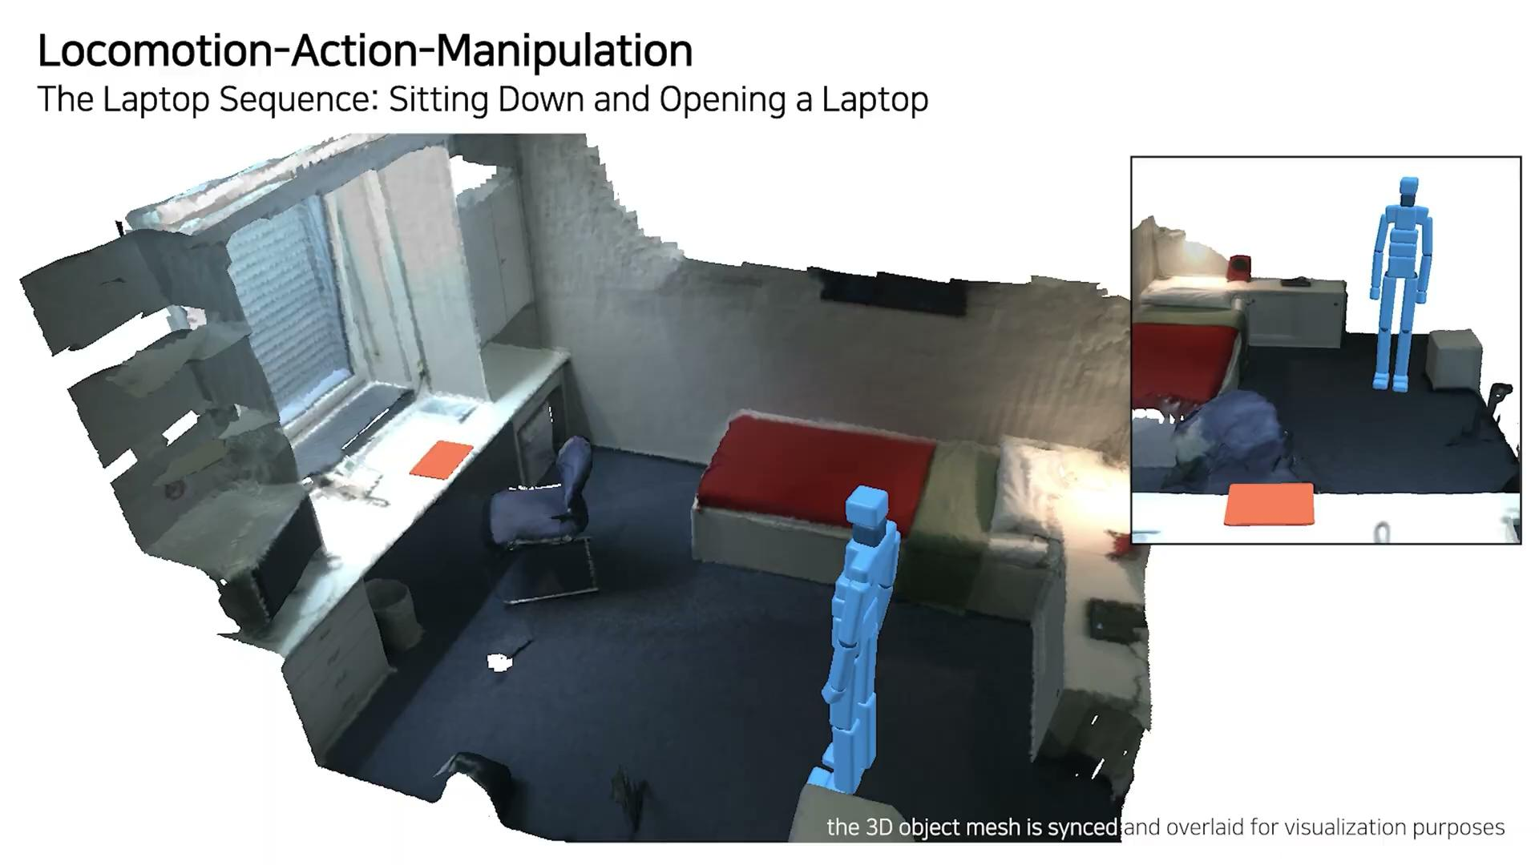
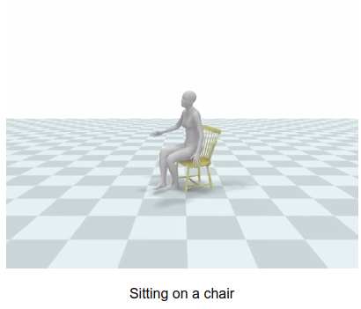
Why HuMANS?
Understanding human world is an exciting direction of great research interest!
[1] Kulkarni et al. "NIFTY: Neural Object Interaction Fields for Guided Human Motion Synthesis" ArXiV (2023) Video source: https://nileshkulkarni.github.io/nifty/
[2] Lee et al. "Locomotion-Action-Manipulation: Synthesizing Human-Scene Interactions in Complex 3D Environments” ICCV (2023). Video source: https://jiyewise.github.io/projects/LAMA/

Slide 5
What are the topics discussed?
4D reconstruction & novel view synthesis
Human motion generation
Human pose estimation and motion prediction
Human-object interaction
Human datasets and benchmarks
… and many more!

Slide 6
How does the schedule look like?
Session I
3 presentations on human motion generation
Session III
3 presentations on human pose estimation and prediction
Preliminary meeting
Paper selection
deadline
February 14th
May 15th
May 29th
February 7th
April 1st
May 8th
May 22nd
Application deadline
Apply via matching system and send us your application per email !
Session II
3 presentations on novel view synthesis
Session IV
3 presentations on human-object interaction
May 2024, mark your calendars ;)

Slide 7
Further orga stuff
Meet your supervisor
At least 1 week before presentation: paper discussion
Monday before presentation: slides discussion
Write a report
LaTeX template would be provided
4 pages summarizing the paper and providing your high level insights
Report deadline is due in 3 weeks after your presentation
All meetings and seminar sessions are mandatory to attend

Slide 8
How does the grading look like?
Presentation: 50%
Report: 40%
Active participation and questions during seminar: 10%

Slide 9
What do I need to know beforehand?
Previously attended DL lectures, such as I2DL, CV III, 3D Scanning & Motion Capture, and other
Knowledge of linear algebra, probabilities, non-linear optimization is highly beneficial
We focus on learning methods, so brushing off the dust from DL notes will help!

Slide 10
I’m interested, how do I apply?
Apply via matching system and assign our seminar high priority
Send an email to humans-ss24@vision.in.tum.de (example on the next slide) with
Short info about your background (see template)
Transcript of records
Resume
Two-step verification: matching system + email

Slide 11
Any tips for the email?
Make it concise and relevant to the seminar scope.

Slide 12
Any remaining questions?
Reach out via email for lost+found questions!

