Slide 1
Seminar: The Evolution of Motion Estimation and Real-Time 3D Reconstruction
Presenter - Annalena Belnarsch
Supervisor - Christiane Sommer
December 01, 2020

Slide 2
A Presentation Regarding the Paper: Real-Time Camera Tracking and 3D Reconstruction Using Signed Distance Functions [1]
Erik Bylow
Jürgen Sturm
Christian Kerl
Fredrik Kahl
Daniel Cremers
Robotics: Science and Systems (RSS),
Online Proceedings (Vol. 9)
2013

Slide 3
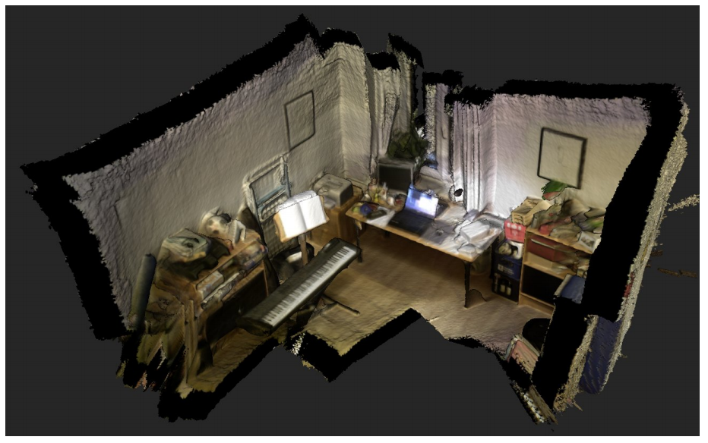
Introduction
The presented paper describes a method for
real-time camera tracking
and 3D reconstruction
of static indoor scenes
by using an RGB-D camera
Fig. 1: Reconstructed room with a hend-held sensor. [1]

Slide 4
Introduction
The presented paper describes a method for
real-time camera tracking
and 3D reconstruction
of static indoor scenes
by using an RGB-D camera
Comparable previous work
KinectFusion¹: Real-Time Dense Surface Mapping and Tracking
Uses a signed distance function (SDF) for geometry representation
Uses the iterated closest point (ICP) algorithm for camera motion estimation
Novelty in the presented paper
Camera tracking is estimated directly on the SDF
Fig. 1: Reconstructed room with a hend-held sensor. [1]
¹Newcombe et al. 2011 [2]

Slide 5
Outline
Basics
Method Description
Experiments and Results
Personal Comments
Summary

Slide 6
Outline
Basics
Method Description
Experiments and Results
Personal Comments
Summary

Slide 7
Method Description – Basics
Notation
RGB image function $I_{RGB}:ℝ^{2}→ℝ^{3}$
Depth image function $I_{d}:ℝ^{2}→ℝ$
3D point $x={\left(x,y,z\right)}^{T}∈$ $ℝ^{3}$,
Pixel point ${x^{′}=\left(i,j\right)}^{T} ∈$ $ℝ^{2}$
Rotation of the camera $R∈SO\left(3\right)$
Translation of the camera $t∈$ $ℝ^{3}$
Twist coordinates $ξ={\left(v,w\right)}^{T}$ $∈$ $ℝ^{6}$, with linear velocity $v$ $∈$ $ℝ^{3}$, angular velocity $w$ $∈$ $ℝ^{3}$
Note: Lie algebra of twists¹
$$se\left(3\right)≡\left\{\hat{ξ}=\left(\begin{matrix}\hat{w} & v \\ 0 & 0\end{matrix}\right) | \hat{w}∈so\left(3\right), v∈ℝ^{3}\right\}⊂ℝ^{4x4}$$
to the Lie group SE(3)
$$SE\left(3\right)≡\left\{g=\left(\begin{matrix}R & t \\ 0 & 1\end{matrix}\right) | R∈SO\left(3\right), t∈ℝ^{3}\right\}⊂ℝ^{4x4}$$
¹ Cremers 2019 [3]

Slide 8
Method Description – Basics
Pinhole camera model with intrinsic paramters
Focal length $f_{x},f_{y}$
Optical center $c_{x},c_{y}$
Projection of a 3D point onto the image plane
$$π\left(x,y,z\right)={\left(\frac{f_{x}x}{z}+c_{x},\frac{f_{y}y}{z}+c_{y}\right)}^{T}$$
Reconstruction of a 3D point corresponding to a pixel point
$$z=I_{d}(i,j)$$
$$ρ\left(i,j,z\right)={\left(\frac{\left(i−c_{x}\right)z}{f_{x}},\frac{\left(j−c_{y}\right)z}{f_{y}},z\right)}^{T}$$

Slide 9
Outline
Basics
Method Description
Experiments and Results
Personal Comments
Summary

Slide 10
Method Description – Overview
Update Geometry Representation
Update Camera Pose Estimation

Slide 11
Method Description – Update Geometry Representation
Representation of the SDF
$\text{≙}$two discrete voxel grids of resolution m:
Distance $D{:[0,…, m−1]}^{3}→ℝ$
Weight $W{:[0,…, m−1]}^{3}→ℝ$
Tri-linear interpolation within the grid to get
the signed distance value $ψ\left(x\right)$
surface
voxel grid
$$ψ\left(x\right)>0$$
$$ψ\left(x\right)=0$$
$$ψ\left(x\right)<0$$
camera
Fig. 2: Visualization of the discrete voxel grid underlying the SDF.

Slide 12
Method Description – Update Geometry Representation
Update step
Given:
Depth information $I_{d}:ℝ^{2}→ℝ$
Camera pose: $ξ_{n}$
Idea:
For each depth image, update the signed
distances of the observed voxels
surface
voxel grid
$$ψ\left(x\right)>0$$
$$ψ\left(x\right)=0$$
$$ψ\left(x\right)<0$$
camera
Fig. 3: Visualization of the discrete voxel grid underlying the SDF. Accentuation of observed voxels.

Slide 13
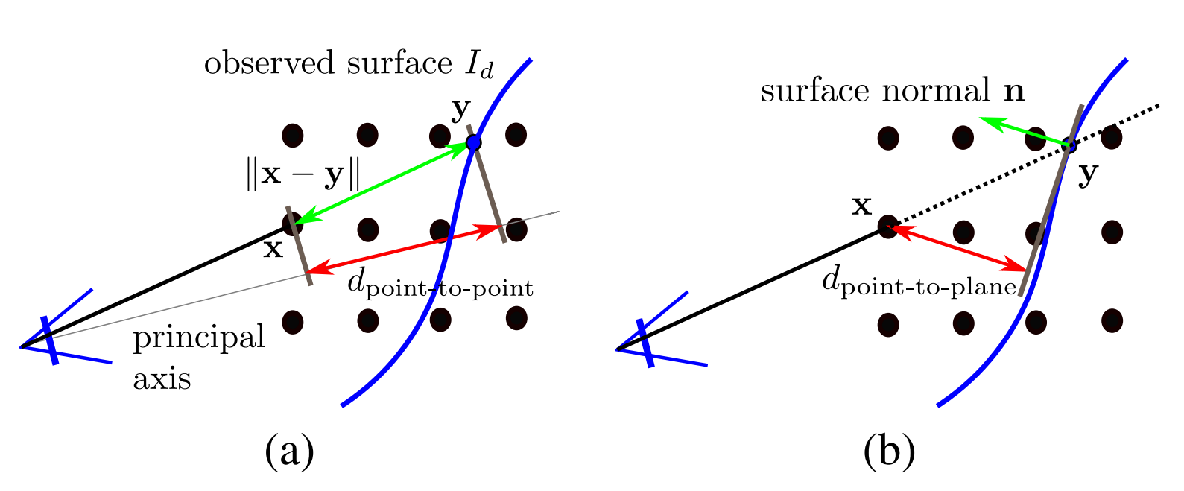
Method Description – Update Geometry Representation
Approach:
For each observed voxel, approximate the current distance $d_{n+1}$ based on a projective distance
Dependant on depth information $I_{d}$ and current camera pose $ξ_{n}$
Fig. 4: Visualization of (a) projective point-to-point distance (b) projective point-to-plane
distance. [1]

Slide 14
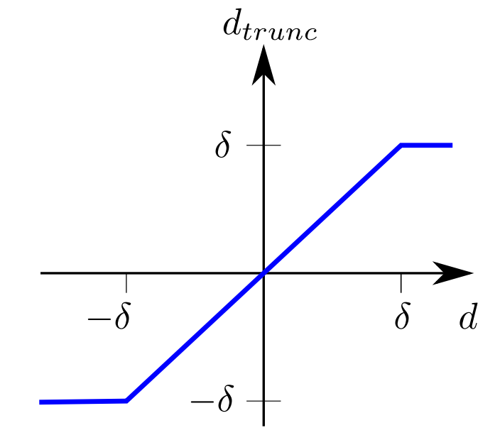
Method Description – Update Geometry Representation
Approach:
Truncate large estimated distances due to the error-prone approximation of the distance
Fig. 5: Truncation function. [1]

Slide 15
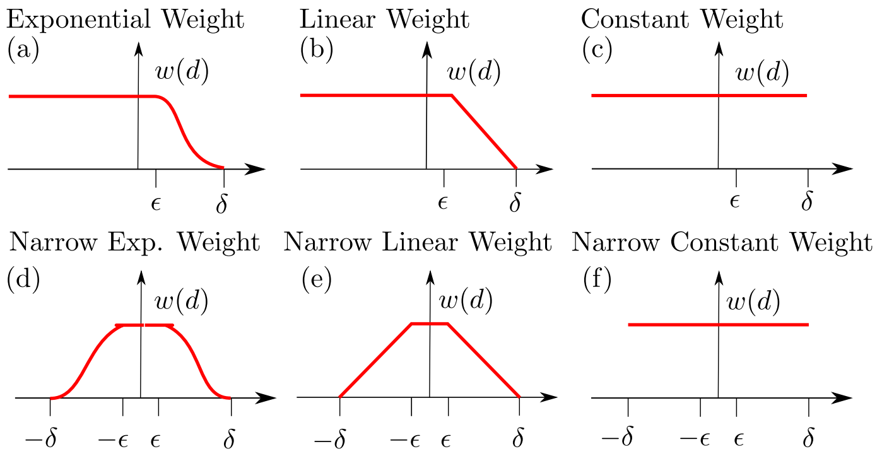
Method Description – Update Geometry Representation
Approach:
For each observed voxel, calculate a weight $w_{n+1}$dependent on the estimated distance
camera2
$$d_{Wall}≥δ$$
v2
$$ψ\left(x\right)<0$$
$$d_{Wall}$$
$$ψ\left(x\right)=0$$
v1
$$ψ\left(x\right)>0$$
$$ψ\left(x\right)>0$$
$$ψ\left(x\right)=0$$
$$ψ\left(x\right)<0$$
camera1
camera2
camera1
Fig. 6: A selection of weighting functions. [1]
Fig. 7: Visualization of the benefit of the minimum depth $δ$.

Slide 16
Method Description – Update Geometry Representation
Approach:
For each observed voxel, update the estimated signed distance as running weighted average:
$$D ←\frac{WD+w_{n+1}d_{n+1}}{W+w_{n+1}}$$
and update the weight grid
$$W←W+w_{n+1}$$

Slide 17
Method Description – Overview
Update Geometry Representation
Update Camera Pose Estimation

Slide 18
Method Description – Update Camera Pose Estimation
Update step
Given:
Depth information $I_{d}:ℝ^{2}→ℝ$, (${z=I}_{d}(i,j))$
SDF $ψ:ℝ^{3}→ℝ$
Idea:
For each pixel $(i,j$) the corresponding 3D point $x_{i,j}^{G}$ in the global coordinate system can be represented as a function of the camera pose: $x_{i,j}^{G}=F(i,j, z,R,t)$
$x_{i,j}^{G}$ lies on the surface for correct $R,t$ → $ψ\left(x_{i,j}^{G}\right)=0$ for correct SDF
Find the camera pose $R,t$ that minimizes the signed distance values $ψ\left(x_{i,j}^{G}\right)$

Slide 19
Method Description – Update Camera Pose Estimation
Approach:
Assumption: Gaussian noise in the depth measurements
Maximize the likelihood of observing $I_{d}$ at a certain camera pose (with respect to $R,t$)
Minimize the error function in twist coordinates:
$$E\left(ξ\right)=\sum_{i,j}{ψ_{i,j}{(ξ)}^{2}}$$
with $ψ_{i,j}\left(ξ\right)=ψ\left(x_{i,j}^{G}\right)$
Gauss-Newton method for nonlinear minimization:
Initial pose estimate: $ξ^{(0)}=ξ_{n} \text{≙}$ estimated previous camera pose
Iteration: $ξ^{(k+1)}=ξ^{(k)}−A^{\left(−1\right)}b$
Stop criterions: number of iterations, ${\left\|ξ^{(k+1)}−ξ^{(k)}\right\|}_{∞}$
→ $ξ_{n+1}$

Slide 20
Method Description – Overview
Update Geometry Representation
Update Camera Pose Estimation

Slide 21
The following sequence of images was inspired by Fig. 2 in the original paper [1].

Slide 22
$$ξ_{0}$$

Slide 23
Definition Voxel Grid
$$ψ\left(x\right)>0$$
$$ψ\left(x\right)=0$$
$$ψ\left(x\right)<0$$
$$ξ_{0}$$

Slide 24
SDF Update
$$ξ_{0}$$

Slide 25
Reconstructed Surface:
Assumption: Updated SDF is very accurate
$$ξ_{0}$$

Slide 26
Camera Pose Estimation: Gauss-Newton Method Iteration
$$ξ^{(0)}$$
$$ξ_{0}$$

Slide 27
Camera Pose Estimation: Gauss-Newton Method Iteration
$$ξ^{(0)}$$
$$ξ_{0}$$

Slide 28
Camera Pose Estimation: Gauss-Newton Method Iteration
$$ξ^{(1)}$$
$$ξ_{0}$$

Slide 29
Camera Pose Estimation: Gauss-Newton Method Iteration
$$ξ^{(2)}$$
$$ξ_{0}$$

Slide 30
Camera Pose Estimation: Gauss-Newton Method Iteration
$$ξ^{(k)}$$
…
$$ξ_{0}$$

Slide 31
Camera Pose Update
$$ξ_{1}$$
$$ξ_{0}$$

Slide 32
SDF Update
$$ξ_{1}$$
$$ξ_{0}$$

Slide 33
Reconstructed Surface:
Assumption: Updated SDF is very accurate
$$ξ_{1}$$
$$ξ_{0}$$

Slide 34
Camera Pose Estimation: Gauss-Newton Method Iteration
$$ξ^{(0)}$$
$$ξ_{1}$$
$$ξ_{0}$$

Slide 35
Camera Pose Estimation: Gauss-Newton Method Iteration
$$ξ^{(0)}$$
$$ξ_{1}$$
$$ξ_{0}$$

Slide 36
Camera Pose Estimation: Gauss-Newton Method Iteration
$$ξ_{1}$$
$$ξ^{(1)}$$
$$ξ_{0}$$

Slide 37
Camera Pose Estimation: Gauss-Newton Method Iteration
$$ξ^{(2)}$$
$$ξ_{1}$$
$$ξ_{0}$$

Slide 38
Camera Pose Estimation: Gauss-Newton Method Iteration
$$ξ^{(k)}$$
…
$$ξ_{1}$$
$$ξ_{0}$$

Slide 39
Camera Pose Update
$$ξ_{2}$$
$$ξ_{1}$$
$$ξ_{0}$$

Slide 40
SDF Update
$$ξ_{2}$$
$$ξ_{1}$$
$$ξ_{0}$$

Slide 41
Reconstructed Surface:
Assumption: Updated SDF is very accurate
$$ξ_{2}$$
$$ξ_{1}$$
$$ξ_{0}$$

Slide 42
Method Description – Overview
Update Geometry Representation
Update Camera Pose Estimation
Meshing and Colorization

Slide 43
Method Description – Meshing and Colorization
Given:
SDF $ψ:ℝ^{3}→ℝ$ (voxel grids $D$ and $W$)
Color information $I_{RGB}:ℝ^{2}→ℝ^{3}$
Idea Meshing:
The estimated surface can be identified at the zero crossing in the SDF
Approach Meshing:
Apply the marching cubes algorithm [4]

Slide 44
Method Description – Meshing and Colorization
Idea Colorization:
Use another voxel grid for color $R, G, B$ and the corresponding weight $W_{c}$
Approach Colorization:
For each voxel that is close to the surface $\left\|d\right\|<ε$, get the color information ${\left(r,g,b\right)}^{T}=I_{RGB}(i,j)$
Calculate the corresponding weight dependant on the current SDF weight $w_{n+1}$and the angle between ray and principle axis $θ$:
$$w_{c}^{n+1}=w_{n+1}cosθ$$
Update the estimated color as running weighted average:
$$R ←\frac{W_{c}R+w_{c}^{n+1}r}{W_{c}+w_{c}^{n+1}}, G ←\frac{W_{c}G+w_{c}^{n+1}g}{W_{c}+w_{c}^{n+1}}, B ←\frac{W_{c}B+w_{c}^{n+1}b}{W_{c}+w_{c}^{n+1}}$$
Use tri-linear interpolation to get the color information on vertices

Slide 45
Outline
Basics
Method Description
Experiments and Results
Personal Comments
Summary

Slide 46
Experiments and Results – Qualitative
Vid. 1: A demonstration of qualitative results of the paper. YouTube video created by cvprtum.¹
¹ cvprtum 2013 [5]

Slide 47
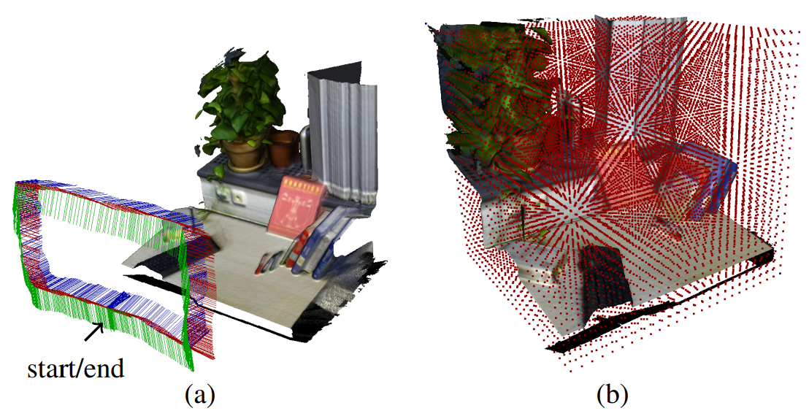
Experiments and Results – Qualitative
Fig. 8: Qualitative results of the paper on small work spaces. (a) shows a nearly drift-free pose estimation. (b) visualizes the corresponding voxel grid (downsampled). [1]

Slide 48
Experiments and Results – Quantitative
Evaluation on the TUM RGB-D benchmark [6]:
Comparison to KinFu [7] (based on the KinectFusion paper [2]) and RGB-D SLAM [8] by regarding the root-mean square absolute trajectory error
Fig. 9: Quantitative results evaluated on the TUM RGB-D benchmark, compared to KinFu and RGB-D SLAM. [1]

Slide 49
Experiments and Results – Quantitative
Evaluation on the TUM RGB-D benchmark [6]:
Comparison to KinFu [7] (based on the KinectFusion paper [2]) and RGB-D SLAM [8] by regarding the root-mean square absolute trajectory error
Fig. 9: Quantitative results evaluated on the TUM RGB-D benchmark, compared to KinFu and RGB-D SLAM. [1]

Slide 50
Experiments and Results – Quantitative
Evaluation on the TUM RGB-D benchmark [6]:
Comparison to KinFu [7] (based on the KinectFusion paper [2]) and RGB-D SLAM [8] by regarding the root-mean square absolute trajectory error
Fig. 9: Quantitative results evaluated on the TUM RGB-D benchmark, compared to KinFu and RGB-D SLAM. [1]

Slide 51
Experiments and Results – Quantitative
Evaluation on the TUM RGB-D benchmark [6]:
Comparison to KinFu [7] (based on the KinectFusion paper [2]) and RGB-D SLAM [8] by regarding the root-mean square absolute trajectory error
Parameter study
Influence of the truncation parameter
Fig. 10: Quantitative results regarding the truncation parameter. Evaluated on the TUM RGB-D benchmark. [1]

Slide 52
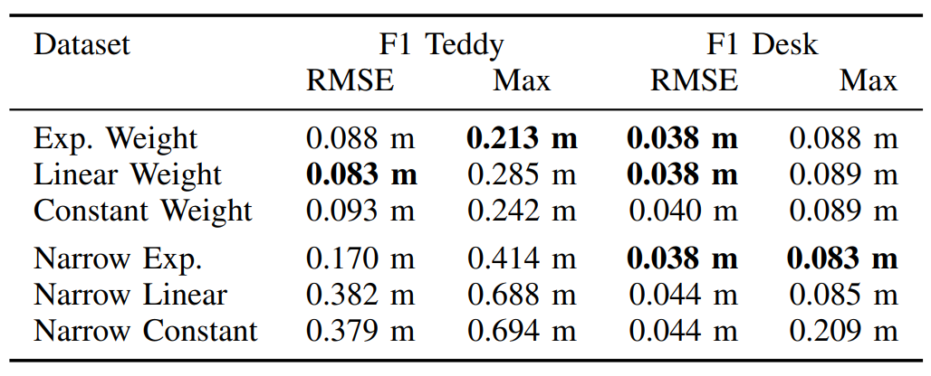
Experiments and Results – Quantitative
Evaluation on the TUM RGB-D benchmark [6]:
Comparison to KinFu [7] (based on the KinectFusion paper [2]) and RGB-D SLAM [8] by regarding the root-mean square absolute trajectory error
Parameter study
Influence of the truncation parameter
Influence of the weighting function
Fig. 11: Quantitative results regarding the weighting functions. Evaluated on the TUM RGB-D benchmark. [1]

Slide 53
Experiments and Results – Quantitative
Evaluation on the TUM RGB-D benchmark [6]:
Comparison to KinFu [7] (based on the KinectFusion paper [2]) and RGB-D SLAM [8] by regarding the root-mean square absolute trajectory error
Parameter study
Influence of the truncation parameter
Influence of the weighting function
Fig. 11: Quantitative results regarding the weighting functions. Evaluated on the TUM RGB-D benchmark. [1]

Slide 54
Experiments and Results – Quantitative
Evaluation on the TUM RGB-D benchmark [6]:
Comparison to KinFu [7] (based on the KinectFusion paper [2]) and RGB-D SLAM [8] by regarding the root-mean square absolute trajectory error
Parameter study
Influence of the truncation parameter
Influence of the weighting function
Robustness evaluation regarding the camera speed
Fig. 12: Quantitative results regarding the robustness against camera speed. Evaluated on the TUM RGB-D benchmark. [1]

Slide 55
Experiments and Results – Quantitative
Evaluation on the TUM RGB-D benchmark [6]:
Comparison to KinFu [7] (based on the KinectFusion paper [2]) and RGB-D SLAM [8] by regarding the root-mean square absolute trajectory error
Parameter study
Influence of the truncation parameter
Influence of the weighting function
Robustness evaluation regarding the camera speed
Runtime and memory consumption
 | Resolution m = 256
Method | Runtime | Memory
Presented paper | 23 ms | 128 MB (for SDF) + 256 MB (for color grid)
KinFu | 20 ms
RGB-D SLAM | 100 – 250 ms
Tab. 1: Quantitative results regarding the runtime and memory consumption.

Slide 56
Outline
Basics
Method Description
Experiments and Results
Personal Comments
Summary

Slide 57
Personal Comments
Method:
𝛿 for typical office scenes is given as 0.3 m: Possibility of a variable 𝛿?
Erroneous distance calculation for big angles between ray and principle axis: Consideration of the angle in the calculation?
Possibility of a loop with no improvement, due to a constant zone of the SDF: Truncation function with slightly increasing / decreasing zones?
Method fails in scenes with only co-planar surfaces: Usage of additional information (beside structure)?

Slide 58
Personal Comments
Results:
+ Improvement regarding accuracy / robustness compared to KinectFusion
+ Improvement regarding speed compared to RGB-D SLAM
Comparability to RGB-D SLAM
Contradiction: Doubling the resolution of the volume ($m$) leads to an increased runtime for pose optimization, even though this should be independent of the resolution

Slide 59
Outline
Basics
Method Description
Experiments and Results
Personal Comments
Summary

Slide 60
Summary
Method for real-time camera tracking and 3D reconstruction
Novelity compared to earlier method (KinectFusion [2]):
Camera tracking is directly based on the SDF
Advantages over earlier method (KinectFusion [2]):
Increased accuracy and robustness with comparable real-time capability
The reconstructed highly detailed models with absolute metric information and the accurate pose estimation can be directly used for the navigation of robots as quadrocopters

Slide 61
Thank you for your attention!

Slide 63
Backup Slides

Slide 64
Additional Information Regarding Projective Distances
Visualization
Calculation | Transformation of the global center coodrinate $x^{G}$ of the vertex in the local camera frame: $$x={\left(x,y,z\right)}^{T}=R^{T}\left(x^{G}−t\right)$$ Projection to pixel coordinates: $${\left(i,j\right)}^{T}=π(x)$$
 | $$d_{point−to−point}\left(x\right)≔z−I_{d}(i,j)$$ | Calculation of the surface normal for the pixel $n(i,j)$ $$d_{point−to−plane}\left(x\right)≔{\left(y−x\right)}^{T}n(i,j)$$
Disadvantages | Increasingly erroneous for angles $<90°$ between ray and surface | Assumption: Locally planar surface
Fig.13 : Projective point-to-point distance. [1]
Fig.14 : Projective point-to-plane distance. [1]
Tab. 2: Visualization, calculation, disadvantages of the projective point-to-point and point-to-plane distances.

Slide 65
Camera Pose Estimation - Likelihood
Assumption: Gaussian noise in the depth measurements
Maximize the likelihood of observing $I_{d}$ at a certain camera pose (with respect to $R,t$)
$$p\left(I_{d} | R,t\right)∝\prod_{i,j}{exp⁡\left(−{ψ\left(Rx_{i,j}+t\right)}^{2}\right)}$$
$$\left(R^{∗},t^{∗}\right)=arg\max_{R,t}{p\left(I_{d} | R,t\right)}$$

Slide 66
References
[1] E. Bylow, J. Sturm, C. Kerl, F. Kahl, and D. Cremers. Real-Time Camera Tracking and 3D Reconstruction Using Signed Distance Functions. In Robotics: Science and Systems (RSS), Online Proceedings (Vol. 9). Robotics: Science and Systems. http://www.roboticsproceedings.org/rss09/p35.pdf, 2013.
[2] R.A. Newcombe, S. Izadi, O. Hilliges, D. Molyneaux, D. Kim, A.J. Davison, P. Kohli, J. Shotton, S. Hodges, and A.W. Fitzgibbon. KinectFusion: Real-Time Dense Surface Mapping and Tracking. In ISMAR, pages 127– 136, 2011.
[3] D. Cremers. Slides related to the lecture: Computer Vision II: Multiple View Geometry. In https://vision.in.tum.de/teaching/ss2019/mvg2019/material, 2019.
[4] W.E. Lorensen, and H.E. Cline. Marching cubes: A high resolution 3D surface construction algorithm. Computer Graphics, 21(4):163–169, 1987.
[5] cvprtum. Real-Time Camera Tracking and 3D Reconstruction Using Signed Distance Functions. YouTube, 2013. https://youtu.be/MzLdRFSrtuI.
[6] J. Sturm, N. Engelhard, F. Endres, W. Burgard, and D. Cremers. A Benchmark for the Evaluation of RGB-D SLAM Systems. In IROS, 2012.
[7] KinectFusion Implementation in the Point Cloud Library (PCL). http://svn.pointclouds.org/pcl/trunk/.
[8] F. Endres, J. Hess, N. Engelhard, J. Sturm, D. Cremers, and W. Burgard. An Evaluation of the RGB-D SLAM System. In ICRA, 2012.

