Slide 1
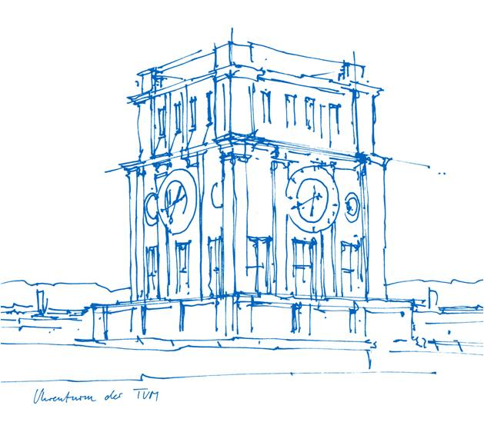
BAD SLAM: Bundle Adjusted Direct RGBD SLAM
Computer Vision Group
TUM Department of Informatics
Technical University of Munich

Slide 2
BAD SLAM: Bundle Adjusted Direct RGBD SLAM
Quoc Trung Nguyen
Garching, 8. December 2020

Slide 3
Outline
Overview of different approaches to SLAM
Direct RGB-D Bundle Adjustment
RGB-D SLAM Front End
Benchmark Dataset
Experiments and Results
Personal comments
Summary

Slide 4
Overview of SLAM
Notes:
SLAM: Simultaneous Localization and Mapping
Mapping: What does the world look like ? => integration information gathered with sensor to build a 3D model
Localization: Where am I ? => determine the pose of camera in 3D scene
Used in many applications: augmented reality, self-driving cars

Slide 5
Overview of SLAM
SLAM consists of two main stages:
Front end: track camera poses in real time
Back end: jointly optimizes 3D map and previous camera poses
Gold standard for back end:
Bundle Adjustment (BA)
Notes:
Bundle adjustment aims at jointly estimating 3D coordinates of points and camera parameters – typically the rigid body motion, but sometimes also intrinsic calibration parameters or radial distortion. Different models of the noise in the observed 2D points leads to different cost functions, zero-mean Gaussian noise being the most common assumption.

Slide 6
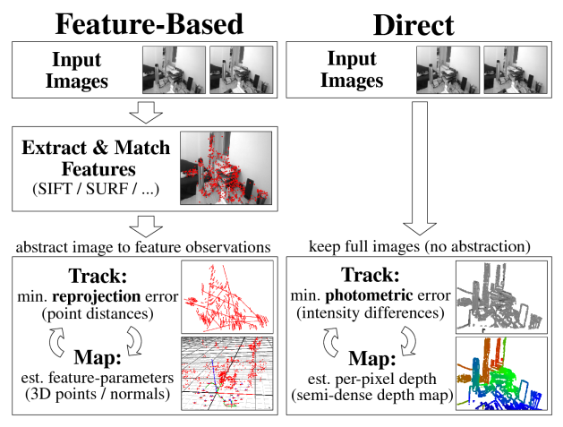
Indirect BA vs Direct BA
Notes:
Indirect BA:
A set of feature points is extracted from the images ,ideally points such as corners
One determines a correspondence of these points across the various images. This can be done either through local tracking (using optical flow approaches) or by random sampling of possible partners based on a feature
The camera motion is estimated based on a set of corresponding points using many different algorithms such as eight point, four point
For a given camera motion one can then compute a dense reconstruction using stereo reconstruction methods.
Disadvantage:
Much potentially valuable information contained in the colors of each image is discarded
Errors in the point correspondence may have devastating effects on the estimated camera motion
They do not address the highly coupled problems of motion estimation and dense structure estimation.
Direct BA: keep full information and optimizes the camera and scene parameters by minimizing a photometric error. Disadvantage: introduces many variables that need to be optimized. common assumption is that full BA is infeasible in real-time for direct and dense methods

Slide 7
Direct RGB-D Bundle Adjustment
Key concept:
Use both reprojection error and photometric error
Photometric error uses gradients rather than raw pixel intensities
Minimize the number of parameters by alternates between refining the 3D map and the camera poses
=> First dense BA approach for RGB-D SLAM that runs in realtime for smaller scenes

Slide 8
Data representation
Keyframe: defined by an RGB-D frame and its 6DOF camera pose
Surfel: defined by
3D center point ps
surface normal vector ns
radius rs
scalar visual descriptor ds
Surfel is only allowed to move along its normal direction

Slide 9
Cost function
Input : raw RGB-D input data stored in the keyframes
Parameters to optimize: surfel attributes, keyframe poses, camera intrinsics (optionally)
General idea: projecting surfels into each keyframe and calculate reprojection and photometric error between projected surfels and corresponding pixel measurements
Cost function:
$$C(K,S)=\sum_{kε K}{\sum_{s ε S_{k}}{{(ρ}_{Tukey}({σ_{D}}^{−1}r_{geom}\left(s,k\right))}+w_{photo}ρ_{Huber}({σ^{−1}}_{p}r_{photo}(s,k)))}$$
K: set of all keyframes
Sk : set of all surfels that have corresponding measurements in keyframe K

Slide 10
Cost function
Geometric residual:
$${r_{geom}\left(s,k\right)=\left(T_{G}^{k}n_{s}\right)}^{T}(π_{D,k}^{−1}\left({\hat{π}}_{D,k}\left(T_{G}^{k}p_{s}\right)\right)− T_{G}^{k}p_{s})$$
$p_{s}$: center of 3D point surfel
$T_{G}^{k}$: maps the position $p_{s}$ and normal $n_{s}$ of a surfel s from the global map coordinate system G to the local coordinate system of keyframe k
${\hat{π}}_{D,k}$: maps a 3D point in the local coordinate system of keyframe k to the center of the corresponding depth image pixel
$π_{D,k}^{−1}$: maps a depth pixel to its 3D point in the keyframe’s local coordinate system via its measured depth $d_{m}$
Standard deviation:
$$σ_{D}= δ\frac{d_{m}^{2}}{bf}\left|{\left(T_{G}^{k}n_{s}\right)}^{T}π_{k}(T_{G}^{k}p_{s})\right|$$
$b$: base line
$f$: focal length
$δ$: expected stereo matching error in pixel, set to 0.1

Slide 11
Cost function
Photometric residual:
$$r_{photo}\left(s,k\right)= {\left\|{I\left(π_{I,k}\left(s_{1}\right)\right)−I\left(π_{I,k}\left(p_{s}\right)\right) \atop I\left(π_{I,k}\left(s_{2}\right)\right)−I\left(π_{I,k}\left(p_{s}\right)\right)}\right\|}_{2} − d_{s}$$
$s_{1}$, $s_{2}$: fixed point on boundary of surfel s, such that $s_{1} − p_{s}$ and $s_{2} − p_{s}$ are orthogonal
$d_{s}$: visual descriptor of surfel s
$π_{I,k}$: projection function for RGB image and I(.)
Standard deviation:
$σ_{p}$: set to $\frac{1}{180}$

Slide 12
Surfel-measurement correspondence
To handle outliers, not all correspondence between surfel and its pixel project is considered in the cost function. Correspondence are only established if:
$p_{s}$projects to a pixel that has a depth measurement
The depth of the measurement and the projected surfel is similar enough:
The surfel normal is similar to the depth measurement’s normal

Slide 13
Optimization

Slide 14
Optimization
Surfel creation
partition the keyframes into 4×4 pixel cells
if no pixel in a cell corresponds to an existing surfel => create a new surfel s from one random depth pixel in the cell
$p_{s}$ : set to$T_{k}^{G}{π^{−1}}_{D,k}\left(p\right)$, p is corresponding depth pixel
$r_{s}$: minimum distance between $p_{s}$ and and the 3D points of the 4-neighborhood of p
Surfel position and descriptor optimization
jointly optimize by applying a Gauss-Newton iteration
only allow surfels to move along their normal directions , i.e optimize t in $p_{s}+t∙ n_{s}$
Surfel merging
merge surfel after first iteration
merge if
normals are within 40 deg of each other
positions are closer than 4 · 0.8 · min(rs1, rs2)

Slide 15
Optimization
Keyframe pose optimization
applying the Gauss-Newton method to cost function
Pose updates $ε$ : local updates in Lie algebra se(3)
$T_{G}^{k}=T_{k}^{g}∙ exp⁡(\hat{ε})$
Camera intrinsic optimization (optional)
Existing RGBD dataset (TUM RGB-D) is recorded by camera which is uncalibrated with asynchronous RGB-D frames and rolling shutter => need to optimize for camera intrinsic
No camera intrinsic optimization necessary for newly introduced dataset

Slide 16
RGB-D benchmark dataset
Table 1. ATE RMSE results in cm on TUM RGB-D datasets (rank in brackets). Ours achieves the second best average rank after ORB-SLAM2 and alongside BundleFusion. Our results without intrinsics and depth deformation optimization are clearly worse, showing that this is necessary for these datasets.

Slide 17
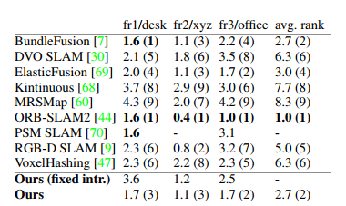
RGB-D benchmark dataset
Problems with existing dataset:
Inacurrate calibration for depth camera
Camera with rolling shutter problem ( as opposed to global shutter camera)
Asynchronicity between depth and color stream

Slide 18
RGB-D benchmark dataset
Table 2. ATE RMSE [cm] averages and medians for seven synthetic datasets per category. Asynchronous RGB-D frames (async) and rolling shutter (rs) both worsen the results.

Slide 19
New RGB-D benchmark
Us synchronized global shutter cameras and Xtion Live pro to record data
Color and depth images are recorded at the same time
SLAM benchmark consists of 61 training and 35 test datasets
benchmark with non-public ground truth and an online leaderboard

Slide 20
RGB-D dataset
Conclusion:
effects, such as depth distortion, need to be simulated for obtaining realistic results
These effects are better addressed in hardware, since modeling all of these effects in a direct SLAM system is laborious and may lead to high runtimes

Slide 21
Ablation study

Slide 22
Result
Evaluation on our benchmark’s training and test datasets. For a given threshold on the ATE RMSE (x-axis), the graphs show the number of datasets for which the method has a smaller error.

Slide 23
Personal comments
Existing datasets only give a partial picture of the SLAM algorithms performance.

Slide 24
Thank you

