Slide 1
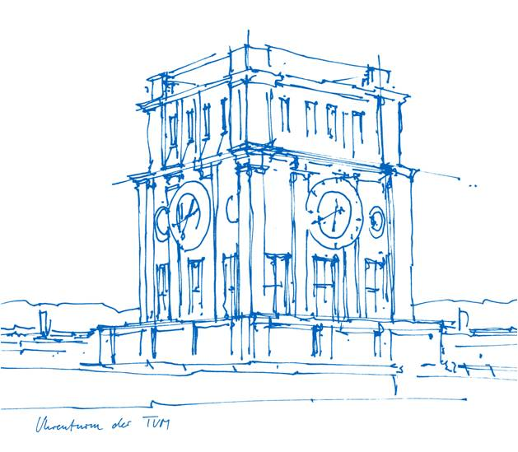
Occupancy Networks:
Learning 3D Reconstruction in Function Space
Mescheder et al.
Presenter: Hanzhi Chen
Supervisor: Lukas Köstler

Slide 2
Outline
Introduction
    Overview of 3D Representation Method
    Challenges
Method Description
    Occupancy Net
    Training Phase
    Inference Phase
Experimental Results
    Metrics for Evaluation
    Representation Power
    Single-view Image Reconstruction
    Point Clouds Completion
    Voxel Super-resolution
    Ablation Study
Limitations & Future Work
Summary

Slide 3
1. Introduction
Overview of 3D Representation Method
Challenges

Slide 4
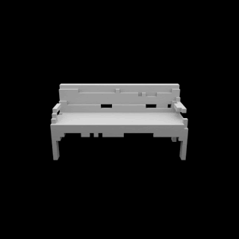
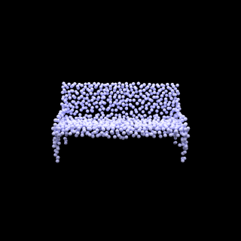
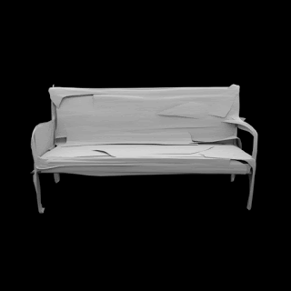
Overview of 3D Representation Methods
Voxel-based Method
Point-based Method
Mesh-based Method
Discretization into 3D grids;
Easy to manipulate as Tensor;
Curse of Discretization: Cubic Memory;
Manhattan world bias.
Discretization into 3D points;
Flexible & Computa-tionally Efficient;
Lack connectivity information;
Post-processing for surface extraction.
Discretization into vertices and faces;
Templates required for target domain;
Prone to self-intersections.
Notes:
Voxel-based Method
Voxel-based method is a straightforward generalization of pixels to the 3D domain. When using voxels, 3D geometry is represented as a discrete and equidistant occupancy grid. However, even though this method is easy to manipulate the data since you can directly transform the data in to 3d-dimensional tensor, it comes with a server drawback: curse of discretization, i. e. the memory requirements of voxels grow cubically with resolution. There is always a trade-off between representation power and memory requirement when using this method.
Point-based Method
An effective alternative representation of 3D geometry is given by 3D point clouds that can contain color and position information for each point on the surface of the object. However, even though this method is flexible and computationally efficient, it still lacks connectivity information of the underlying mesh and hence requires additional post-processing method to extract the 3D geometry.
Mesh-based Method
Mesh comprising vertices and faces is also considered to be a representation and recently it is always applied in some 3D reconstruction task. Unfortunately, this method requires a template mesh from the target domain if some complex topology is desired. However, if a template mesh is used, resulting model is restricted to a very specific domain and lacks generality to handle multiple object categories. Moreover, it is prone to generate self-intersecting meshes that result in unpleasant artifacts on the model.

Slide 5
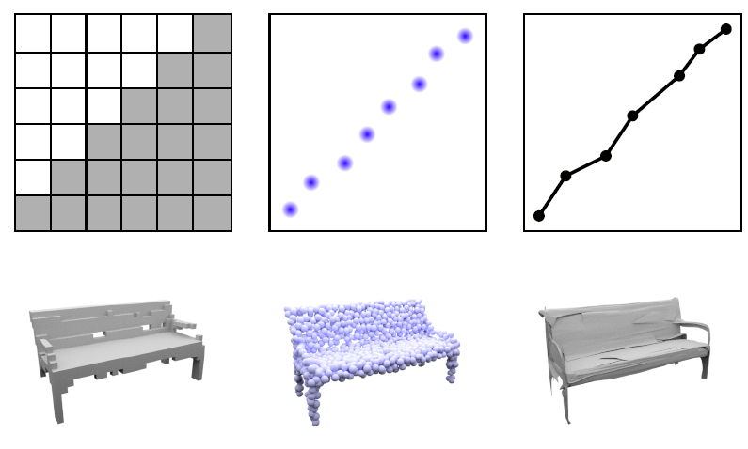
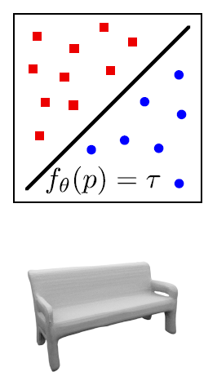
Challenges
A 3D representation method that:
Doesn’t suffer from Curse of Discretization
Preserves connectivity information
Not restricted to specific domain
Recovers details as much as possible
Implicit representation method doesn’t suffer these issues…
While the question is: How to find it?
Deep Learning! → Occupancy Net (ONet)

Slide 6
2. Method Description
  Occupancy Net
  Training Phase
  Inference Phase

Slide 7

Occupancy Net
Key Idea:
Don’t represent 3D shape explicitly like Voxels, Points and Meshes
Instead, treat the surface as a decision boundary of a non-linear classifier
$$f_{θ}: ℝ^{3}×X →[0, 1]$$
Queried 3D point in a bounding volume
Observation Prior: Image, Points or Voxels
Occupancy Probability
 | Binary Classifier | Occupancy Network
Category | Dog/Cat | Interior/Exterior
Input | Image | 3D point
Observation | - | Single-view image, etc.
Output | Prob. being a dog | Prob. being inside

Slide 8
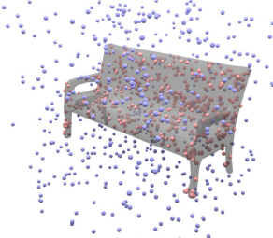
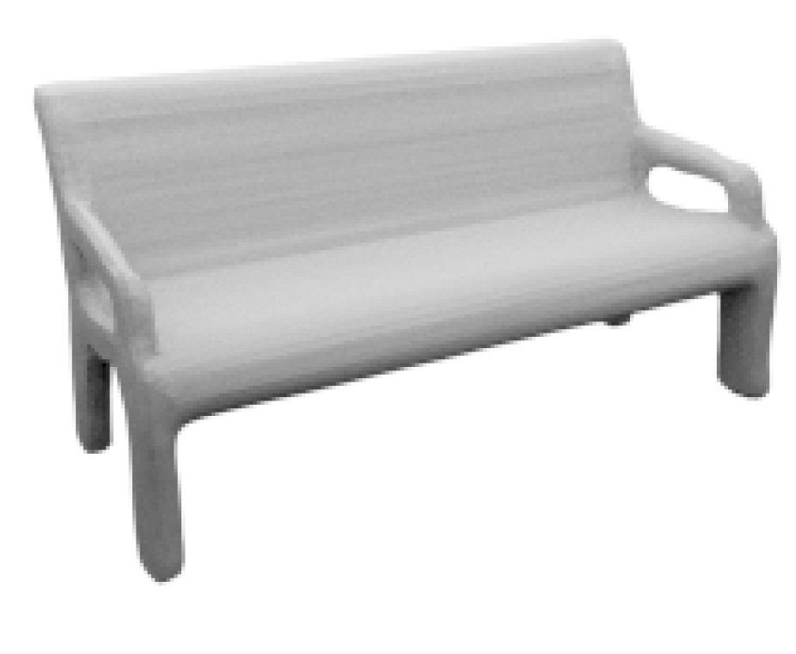

Occupancy Net
Key Idea:
Don’t represent 3D shape explicitly like Voxels, Points and Meshes
Instead, treat the surface as a decision boundary of a non-linear classifier
$$f_{θ}: ℝ^{3}×X →[0, 1]$$
Queried 3D point in a bounding volume
Observation Prior: Image, Points or Voxels
Occupancy Probability
Task-specific Encoder
Latent Code
Single-view Image
Occupancy
Network
Set of queried points
Classified Results
Final Mesh
Notes:
We will at first feed this observation, that is, a single view image into a task-specific encoder, here a Resnet pretrained on ImageNet will be selected. And a latent code will be generated after using this encoder. And then this latent code will act as a prior knowledge to condition our ONet on current category of object, and it will therefore predict the occupancy probability of each sampled 3D point. After knowing this probability, we can assign these points with corresponding identity with reference to a threshold value (remember in our case it is interior or exterior of the surface). Finally, by applying a surface extraction algorithm, final mesh of the surface from these points with their identity assigned by ONet.

Slide 9
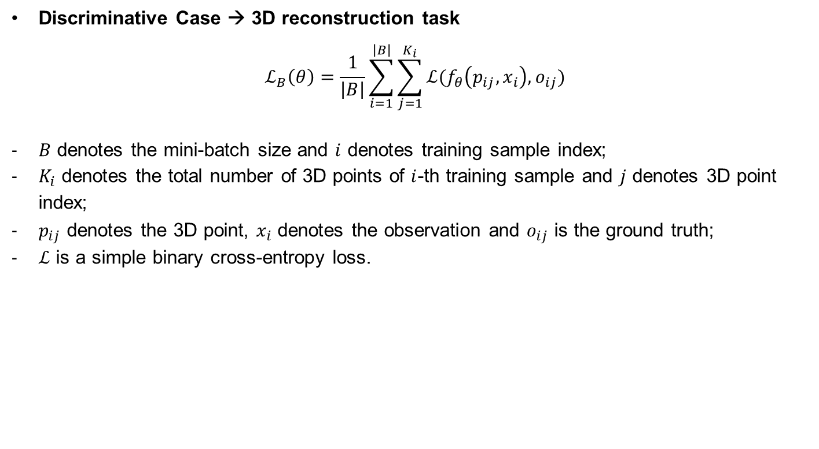
Training Phase
Discriminative Case → 3D reconstruction task
$$ℒ_{B}\left(θ\right)=\frac{1}{\left|B\right|}\sum_{i=1}^{\left|B\right|}{\sum_{j=1}^{K_{i}}{ℒ(f_{θ}\left(p_{ij},x_{i}\right),o_{ij})}}$$
$B$ denotes the mini-batch size and $i$ denotes training sample index;
$K_{i}$ denotes the total number of 3D points of $i$-th training sample and $j$ denotes 3D point index;
$p_{ij}$ denotes the 3D point, $x_{i}$ denotes the observation and $o_{ij}$ is the ground truth;
$ℒ$ is a simple binary cross-entropy loss.

Slide 10
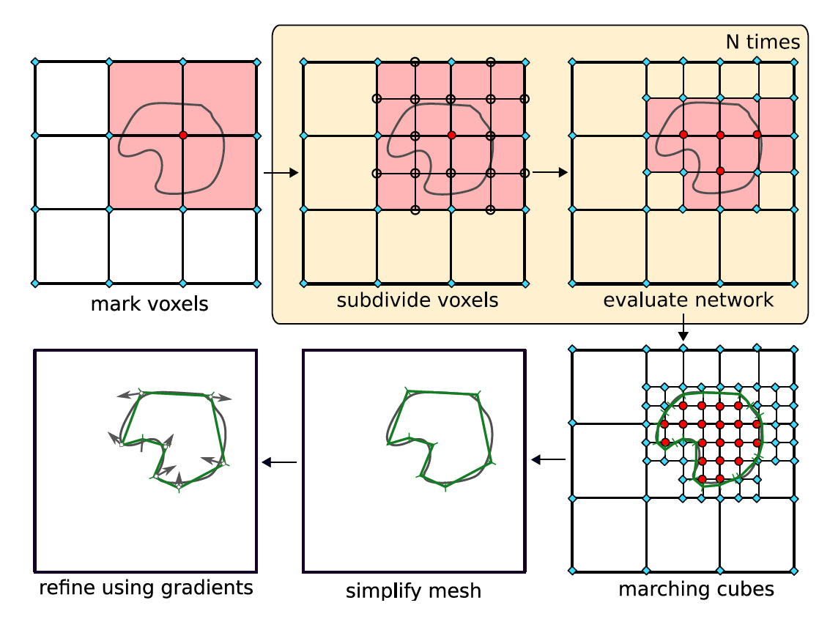
Inference Phase
Multiresolution IsoSurface Extraction Algorithm

Slide 11
3. Experimental Results
  Metrics for Evaluation
  Representation Power
  Single-view Image Reconstruction
  Point Clouds Completion
  Voxel Super-resolution
  Ablation Study

Slide 12
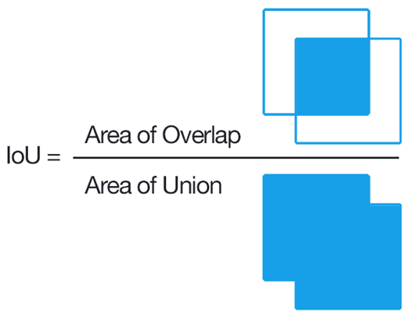
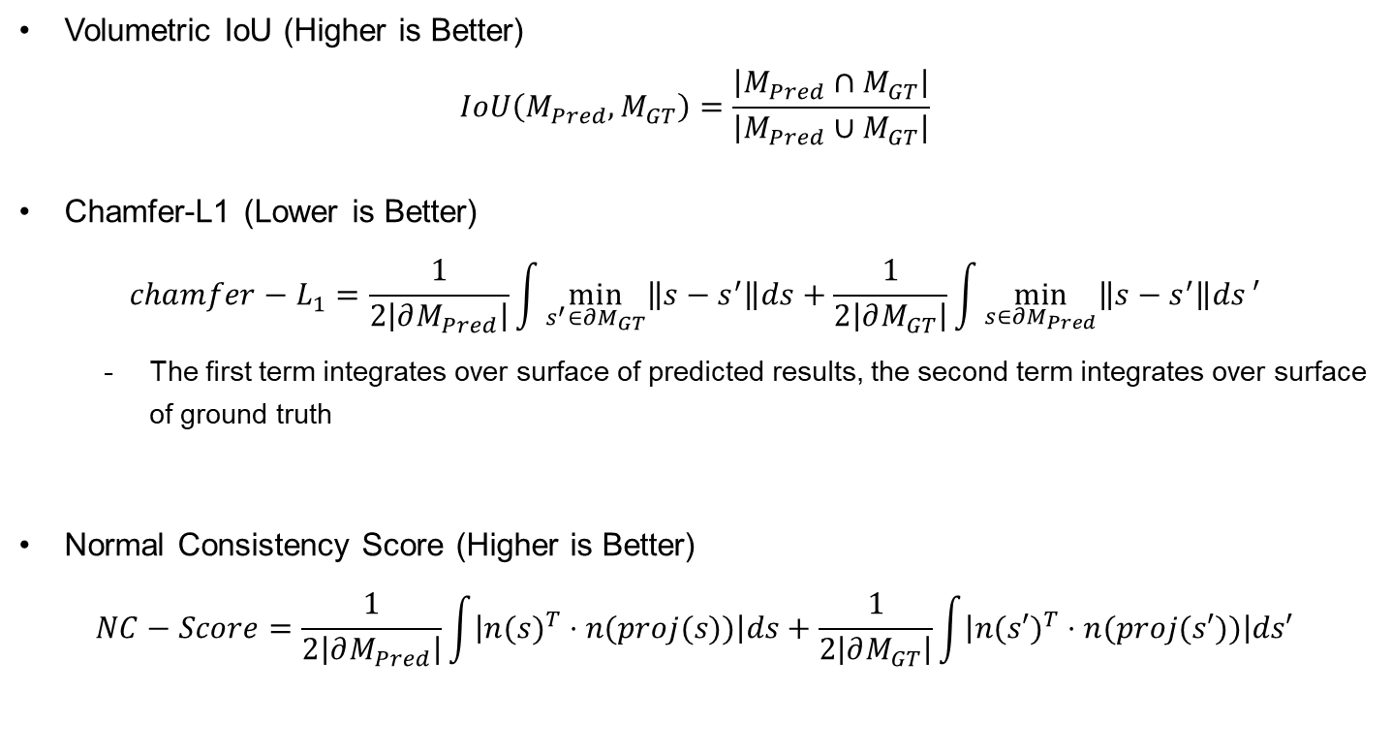
Metrics for Evaluation
Volumetric IoU (Higher is Better)
$$IoU\left(M_{Pred},M_{GT}\right)=\frac{\left|M_{Pred}∩M_{GT}\right|}{\left|M_{Pred}∪M_{GT}\right|}$$
Chamfer-L1 (Lower is Better)
$$chamfer−L_{1}=\frac{1}{2\left|∂M_{Pred}\right|}\int{\min_{s^{′}∈∂M_{GT}}\left\|s−s^{′}\right\|ds}+\frac{1}{2\left|∂M_{GT}\right|}\int{\min_{s∈∂M_{Pred}}\left\|s−s^{′}\right\|ds}′$$
      The first term integrates over surface of predicted results, the second term integrates over surface of ground truth
Normal Consistency Score (Higher is Better)
$$NC−Score=\frac{1}{2\left|∂M_{Pred}\right|}\int{\left|{n(s)}^{T}⋅n(proj(s))\right|ds}+\frac{1}{2\left|∂M_{GT}\right|}\int{\left|{n(s′)}^{T}⋅n(proj(s′))\right|ds′}$$
Notes:
Volumetric IoU is defined as the ratio between the volume of the intersection part of two meshes and that of their union.
For chamfer-L1 and normal consistency score, we don’t need to go into very details of the math formula, but the key is to remember that chamfer-L1 measures the overall distance between 2 meshes, and normal consistency score measures the overall direction consistency of 2 meshes.

Slide 13
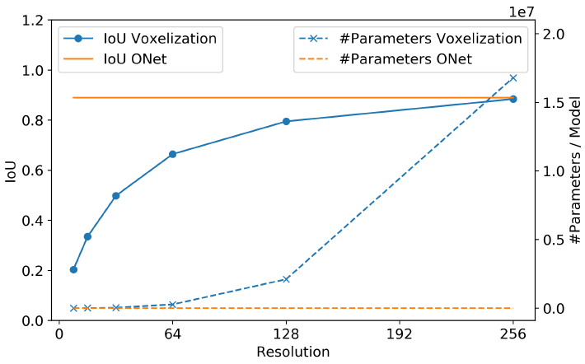
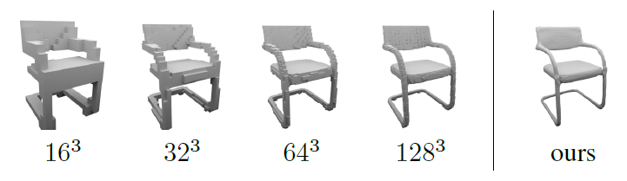
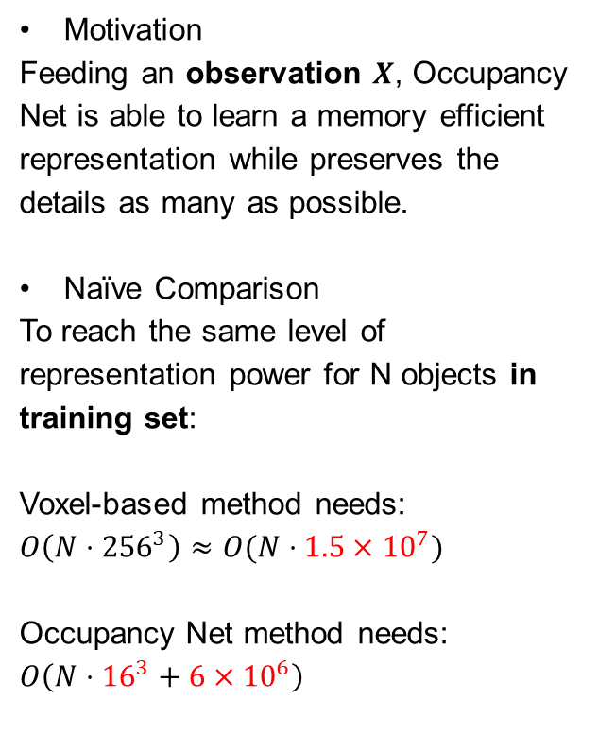
Representation Power
Motivation
Feeding an observation $X$, Occupancy Net is able to learn a memory efficient representation while preserves the details as many as possible.
Naïve Comparison
To reach the same level of representation power for N objects in training set:
Voxel-based method needs:
$$O\left(N⋅{256}^{3}\right)≈O(N⋅1.5×{10}^{7})$$
Occupancy Net method needs:
$$O\left({N⋅16}^{3}+6×{10}^{6}\right)$$
Number of parameters of 1 observation
Number of parameters of Occupancy Net
Notes:
And we can do a naïve calculation here: if we want to store N objects with the same representation power, which is the IoU in our case. Voxel-based method requires a space complexity with roughly N times 15 million. However, for ONet, it will be N times power of 16, which is the memory required for the observation input, plus the number of weights of the network, which is 6 million. As a result, as N increases, the discrepancy between them will become larger and larger.

Slide 14
Single-view Image Reconstruction
Motivation
Reconstruct mesh from an additional view of the object from a random camera location
Benchmarked Models
Quantitative Results
3D-R2N2: | Voxelization output
PSGN: | Point-clouds output
Pix2Mesh: | Mesh output
AtlasNet: | K Mesh patches output
 | IoU | Chamfer-L1 | Normal Consistency
3D-R2N2 | 0.493 | 0.278 | 0.695
PSGN | - | 0.215 | -
Pix2Mesh | 0.480 | 0.216 | 0.772
AtlasNet | - | 0.175 | 0.811
ONet | 0.571 | 0.215 | 0.834
Notes:
3D-R2N2: U-Net architecture, produce voxel representation as output
PSGN(Point Set Generation Network): A single image as input and outputs 1024 3D point coordinates
Pixel2Mesh: Mesh-based approach to reconstruct 3D shapes from single images
AtlasNet: Output K mesh patches and assemble them together

Slide 15
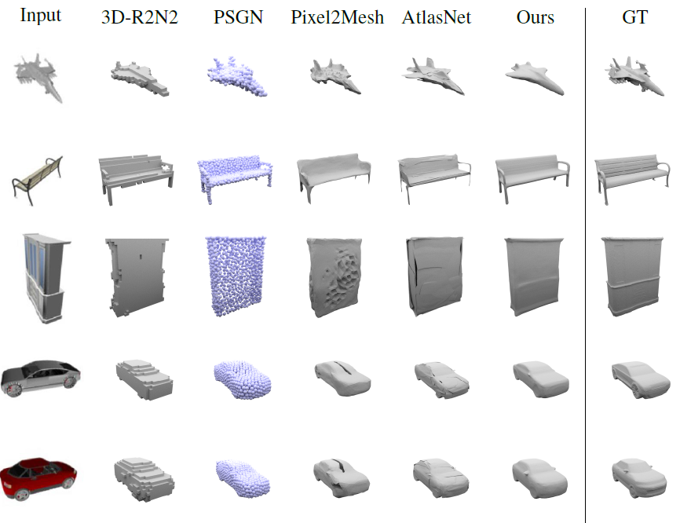
Single-view Image Reconstruction
Notes:
We can see that 3D-R2N2 produces very coarse representation and hence lack details compared with others.
For PSGN, it can generate high-fidelity output while it still requires post-processing to extract mesh from the point clouds.
It is also worth noting that Pix2Mesh can create compelling meshes, while often misses holes in the presence of complicated topologies such as chair or table.
As for AtlasNet, it can capture general geometry but produce artifacts in form of self-intersections and overlapping patches.

Slide 16
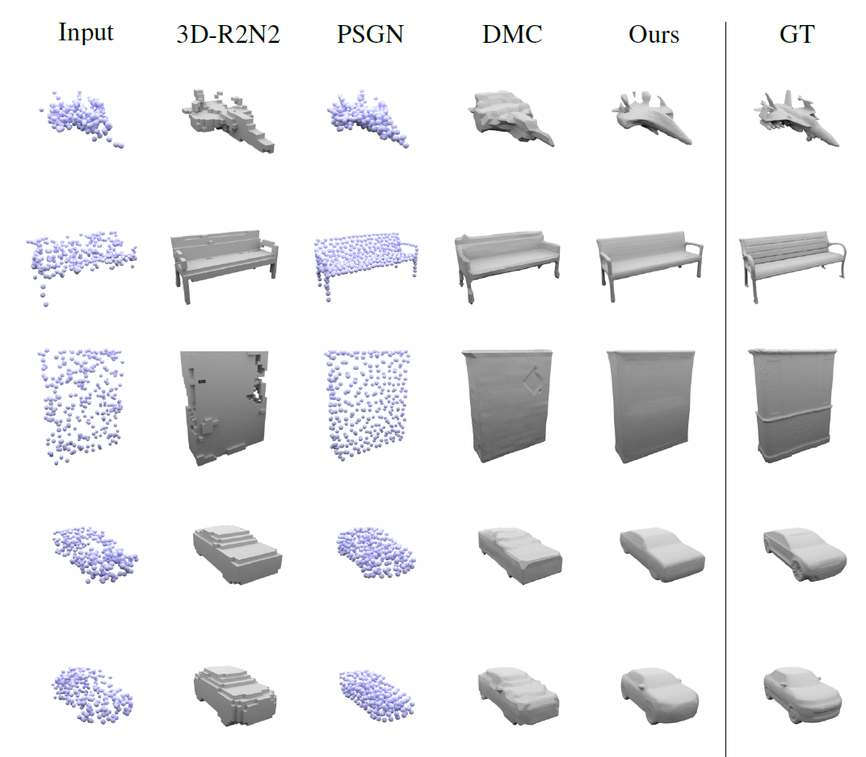
Point Cloud Completion
Motivation
Reconstruct mesh from noisy point clouds observation.
Conclusion
  SOTA results
  Better performance compared with single-view image reconstruction
 | IoU | Chamfer-L1 | Normal Consistency
3D-R2N2 | 0.565 | 0.169 | 0.719
PSGN | - | 0.144 | -
DMC | 0.674 | 0.117 | 0.848
ONet | 0.778 | 0.079 | 0.895
Notes:
In the second conditional task, ONet is applied to the problem reconstructing the mesh from noisy point clouds.
In this task, a PointNet encoder will be utilized to encode the noisy clouds. And we can also see that ONet achieves the best performance in volumetric IoU, Chamfer-L1 and Normal-consistency. It is interesting that all these three metrics are significantly better than the single-view image-based reconstruction task. This can be explained by the fact that this task is easier compared with task involving recognition since the model is only required to fill the gaps between the individual points.

Slide 17
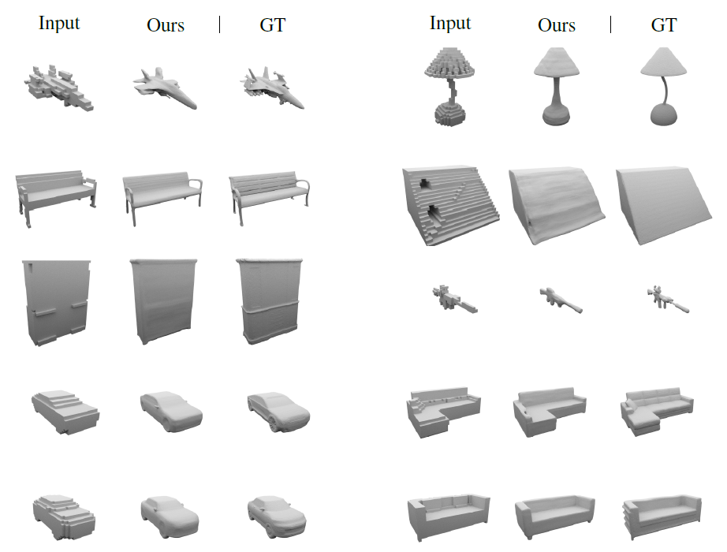
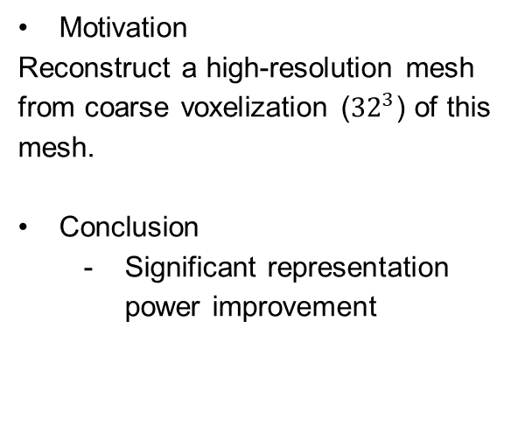
Voxel Super-resolution
Motivation
Reconstruct a high-resolution mesh from coarse voxelization (${32}^{3}$) of this mesh.
Conclusion
  Significant representation power improvement
 | IoU | Chamfer-L1 | Normal Consistency
Input | 63.1% | 0.136 | 0.810
ONet | 70.3% | 0.109 | 0.879

Slide 18
Ablation Study
Uniform sampling
sample 2048 points uniformly in the bounding volume of the ground truth mesh
Equal sampling
sample 1024 points inside and 1024 points outside mesh
Surface sampling
sample 1024 points uniformly and 1024 points on the surface of the mesh
Introduce bias! ☹
 | IoU | Chamfer-L1 | Normal Consistency
Uniform | 0.571 | 0.215 | 0.834
Equal | 0.475 | 0.291 | 0.835
Surface | 0.536 | 0.254 | 0.822
Notes:
1. Uniform sampling: sample 2048 points uniformly in the bounding volume of the ground truth mesh
2. Equal sampling: sample 1024 points inside and 1024 points outside mesh
3. Surface sampling: sample 1024 points uniformly and 1024 points on the surface of the mesh plus some Gaussian noise with standard deviation 0.1.

Slide 19
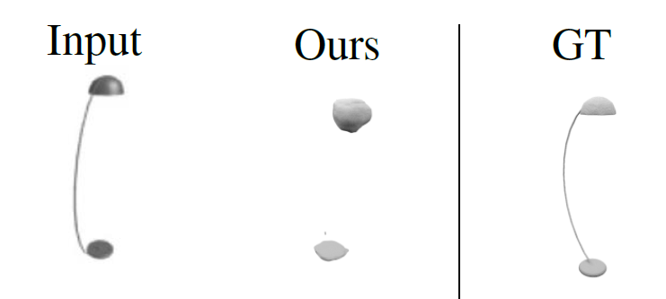
4. Limitations & Future Work
Occupancy net struggles with very thin details of the object such as rope or rod.
    Convolutional Occupancy Networks, Peng et al.
Inference algorithm for surface extraction is still not efficient for real-time applications
    DeepSDF, Park et al.
Fully supervised manner training requires heavy manual annotations
    Differentiable Volumetric Rendering, Niemeyer et al.
How to deploy this model in some real-time reconstruction system?
    My naïve idea ☺
Notes:
For forth issue, I would like to share my naïve idea on how to integrate this model into some real-time applications.
My idea is that we can treat this model a “refinement backend” for scenes to rich high quality. In the main thread of the real-time 3D reconstruction system, we can at first choose low resolution for reconstruction to enable fast processing speed. In another thread, an instance segmentation pipeline runs simultaneously to segment each instance in the scene and then sends all low-resolution voxelization results to the refinement thread to recover a high-resolution representation for each instance that treats it as a voxel super-resolution task.

Slide 20
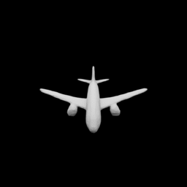
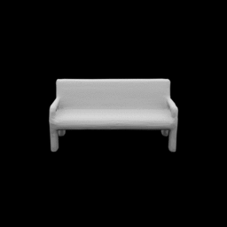
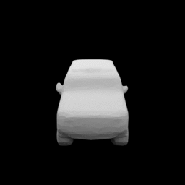
5. Summary
Occupancy network doesn’t suffer from curse of discretization;
Occupancy network is able to represent high-resolution meshes with significantly low memory requirements;
Given a raw observation, occupancy Net is able to represent a wide range of categories of 3D geometry;
Efficient inference algorithm, training strategy and further implementation in a real-time applications shall be considered in the next stage.

Slide 21
Reference
Papers:
  Meschede et al. “Occupancy Networks: Learning 3D Reconstruction in Function Space”, CVPR 2019
  Peng et al. “Convolutional Occupancy Networks”, ECCV 2020
  Park et al. “DeepSDF: Learning Continuous Signed Distance Functions for Shape Representation”, CVPR 2019
  Niemeyer et al. “Differentiable Volumetric Rendering: Learning Implicit 3D Representations without 3D Supervision”, CVPR 2020
Images:
  Slide 4: https://autonomousvision.github.io/occupancy-networks/
  Slide 20: https://github.com/autonomousvision/occupancy_networks

