Slide 1
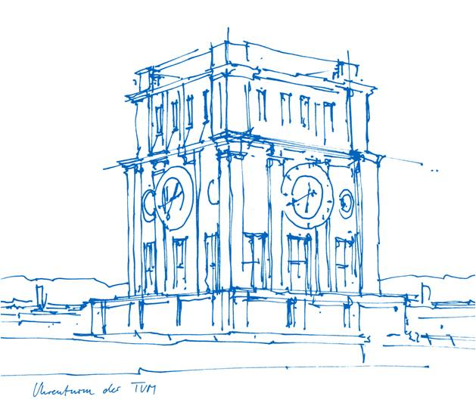
Practical SVBRDF Acquisition of 3D Objects with Unstructured Flash Photography
Recent Advances in 3D Computer Vision
Muhammed Alperen Özkan
06.10.2020

Slide 2
Overview
Prior Knowledge
Introduction
Method in Overall
Method in Detail
Results and Evaluation
Limitations
Conclusion

Slide 3
1. Prior Knowledge
Appearance is an interplay of
surface geometry
material properties
illumination characteristics

Slide 4
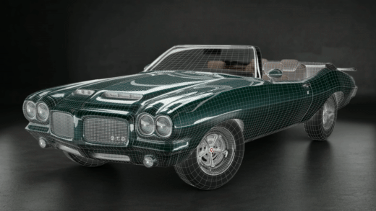
In order to obtain realistic digital objects the geometry and reflectance characteristics of the real world objects need to be understood.

Slide 5
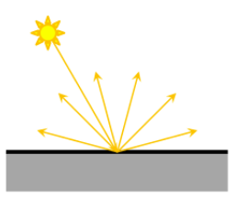
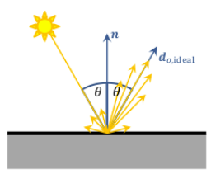
There is no technique for geometry and reflectance acquisition that works for all kind of materials.
Diffuse surfaces
Specular surfaces

Slide 6
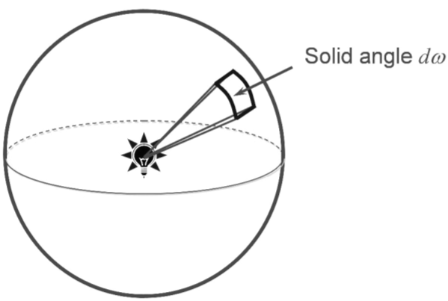
Radiometry Basics
Light is a form of electromagnetic energy and generally symbolized with rays which can be parameterized with an origin and a direction.
Radiant Flux or Radiant Power is the flow of radiant energy per unit time.
Solid angles are used to describe light being emitted in different directions.

Slide 7
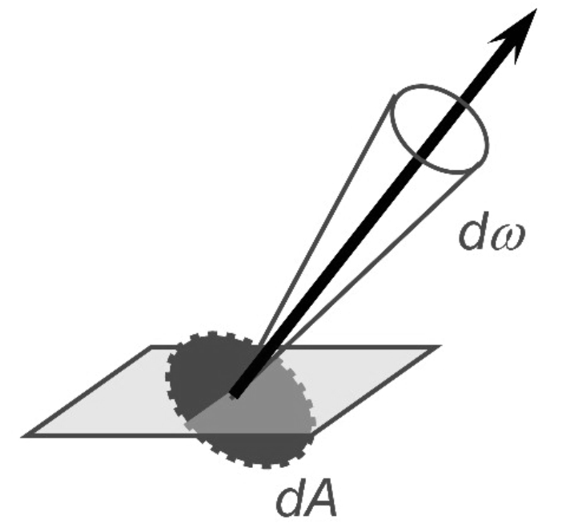
Irradiance is the amount of light falling onto a surface.
Radiance is the power emitted per unit projected area which is perpendicular to the viewing direction per unit solid angle.

Slide 8
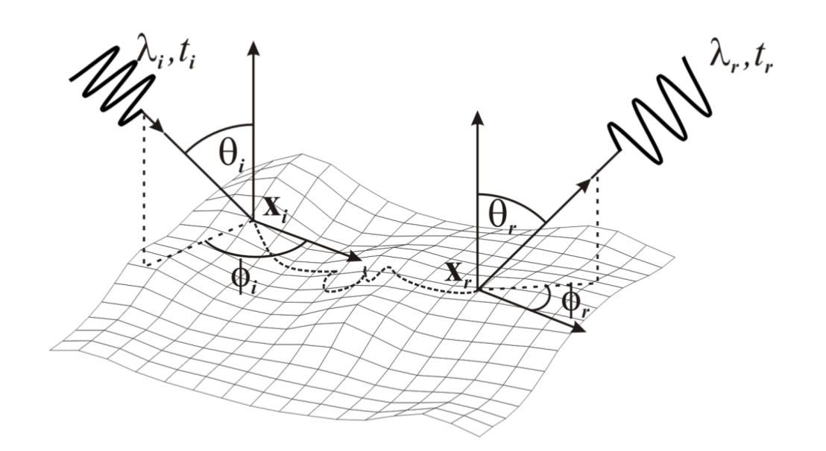
Reflectance Functions

Slide 9
Bidirectional Reflectance Distribution Function
BRDF is a simple reflectance function that expresses interactions of the light with the surface.
It is the ratio between the reflected radiance of a surface and the irradiance that caused that reflection.

Slide 10
Spatially Varying Bidirectional Reflectance Distribution Function
Real-world objects generally exhibit more complex behaviors, such as a BRDF that changes from point to point on the surface.

Slide 11
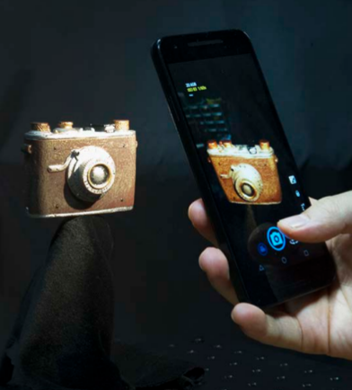
2. Introduction
A compact, practical method for 3D geometry and reflectance acquisition by using multiple unstructured flash photographs taken with off-the-shelf cameras as input.

Slide 12
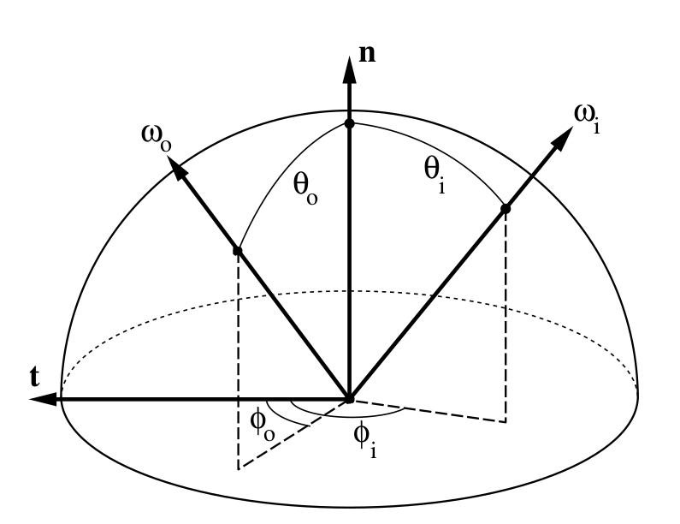
Prior Work
In order to measure such a BRDF, locally flat surfaces should be illuminated with directed solid angle ωᵢ and sensors should be placed
to subtend an output directed solid angle ωₒ.

Slide 13
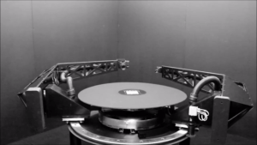
Gonioreflectometers
These specialized devices are not practical and cheap.

Slide 14
In order to obtain an efficient acquisition,
arrays of light sources
digital projectors
digital cameras
can be used.

Slide 15
Lightweight Acquisition Setups
There are also lightweight setups but these methods work for near flat 2D objects or make further assumptions about the material characteristics.
Riviere et al. [2015] and Hui et al. [2017]
Higo et al. [2009] and Park et al. [2016]

Slide 16
3. Method in Overall
An inverse-rendering problem is solved with an iterative alternating optimization approach, which updates the four unknown elements
W →set of blending weights {ω_{p},b},
F_{b} →set of basis BRDFs {f_{b}},
N → set of shading normals {ñ_{p}},
X → set of 3D points {x_{p}},
until the rendering results satisfy the input images.

Slide 18
4. Method in Detail
Image Formation Model
Reconstructing the SVBRDF
Reconstructing the Normals
Geometry Update

Slide 19
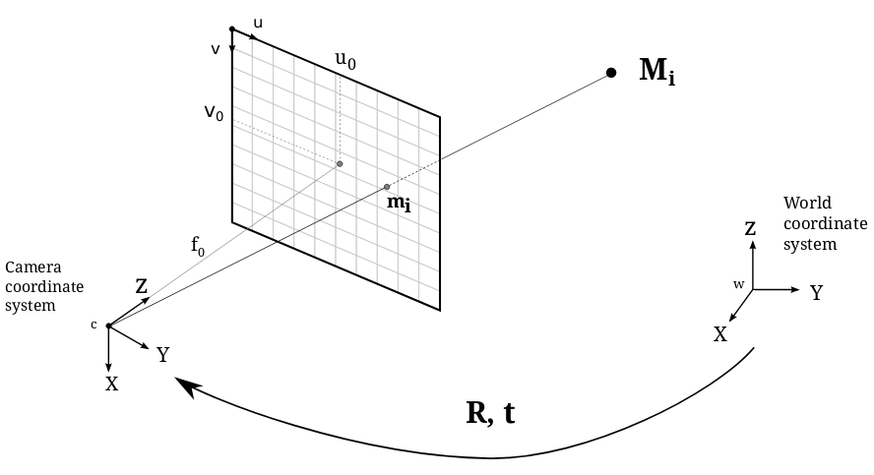

Slide 20
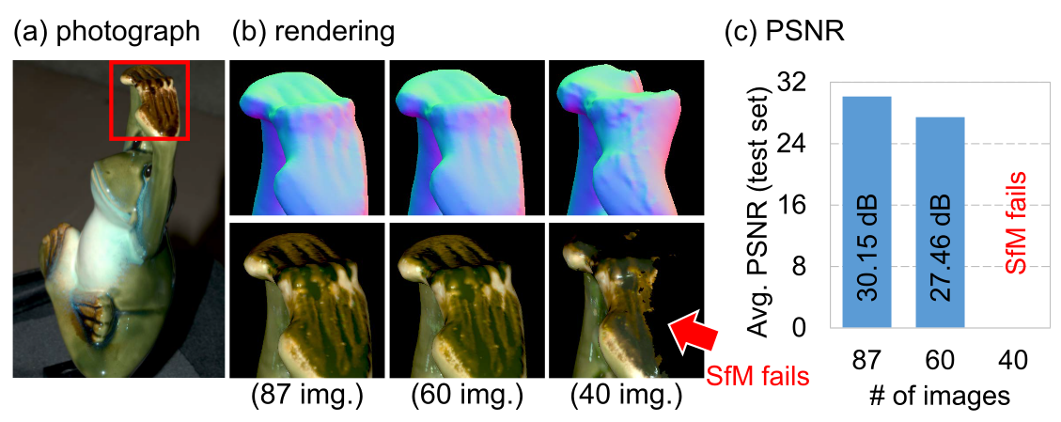
Between 100 – 400 images are captured per object.
What about recording a video instead of taking many pictures?
motion blur
inaccurate focus
lower dynamic range of the still images

Slide 21
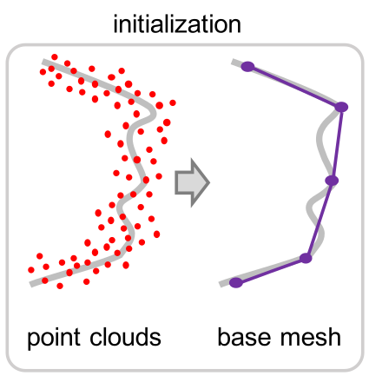
After having the camera parameters and the images, 3D dense point cloud is obtained by using MVS [Schönberger et al. 2016].
However MVS suffers from noise due to the reflection created by flash photography. Reflection violates diffuse reflectance assumption of MVS.
Therefore, initial geometry is modified further with screened Poisson surface reconstruction [Kazhdan and Hoppe 2013].

Slide 22
Image Formation Model
Image formation model proposed by Debevec and Malik [1997] is used,
Reflectance function at point x is captured with the following formula,

Slide 23
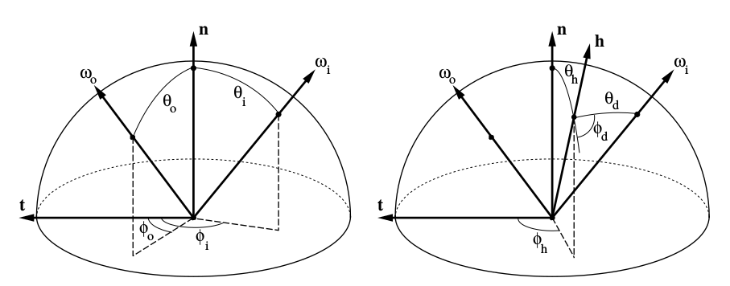
Reconstructing the SVBRDF
SVBRDF is represented by basis BRDFs and spatial weights.
Variables of the reflectance function are changed as in the work of Rusinkiewicz et.al. [1998] in order to obtain an efficient reparameterization.

Slide 24
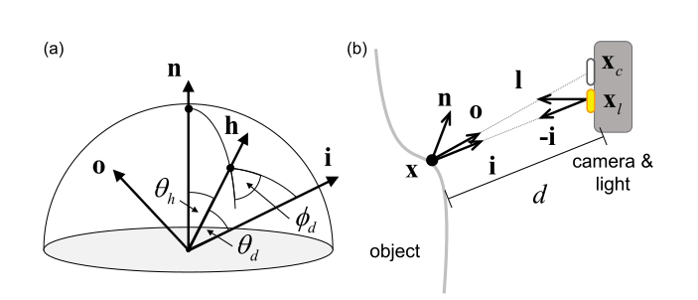
Dense sampling is obtained along the inclination angle of the halfway vector θ_{h} and the azimuthal angle φ_{d} of the difference vector but not along the inclination angle of the difference vector θ_{d}.

Slide 25
Slightly modified version of Cook-Torrance (CT) model [1982] is used to represent the basis BRDFs.
ρ_{d} and ρ_{s} are the diffuse and specular albedos.
D is a tabulated function D(θ_{h}) ∈ R^{M}
G is the geometric term
F is the Fresnel term

Slide 26
Reflectance f’_{p,k} is calculated with the formulas mentioned in image formation model and decomposed further as follows.
Basis BRDFs from the previous slide are represented as coefficient vectors
f_{b} = [ρ_{d} , ρ_{s}.F.D(θ_{h})] ∈ R^{M +1}
Φ_{p,k} ∈ R^{M +1} is the measurement vector specifying the sampled θ_{h} angles and the geometric factor G/(4(n · i)(n · o)) per pixel observation

Slide 27
A minimization problem is defined over all images (K) and all vertex points (P) by putting all together.
In order to update F_{b} , this problem is minimized with fixed W.

Slide 28
In order to find the optimal W, rough initial weights are calculated by using K-Means clustering w.r.t. the initial F_{b} values found by observing median brightness per vertex.
Cluster number K is found empirically.

Slide 29
In order to update W , this time same problem is minimized with fixed F_{b}.

Slide 30
Reconstructing the Normals
After basis BRDFs and weights are estimated, reverse-rendering problem is optimized w.r.t. n_{p}.
Current surface normals {n_{p}} are used for initialization. As long as radiances, directions and reflections of vertices are all known shading normals {ñ_{p}} can be found by a standard linear least squares regression.

Slide 31
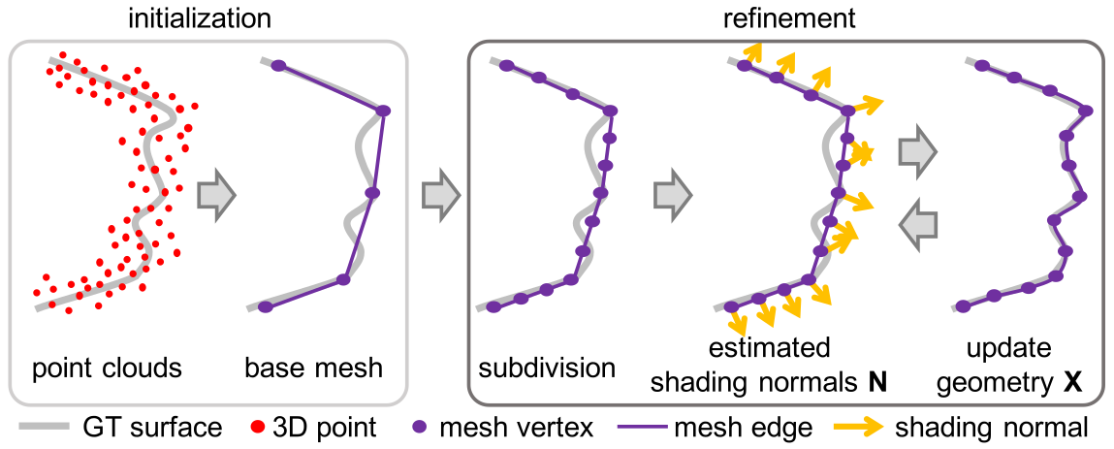
Geometry Update
After obtaining SVBRDF and shading normals, 3D geometry need to be updated in order to agree with the gained knowledge.
Screened Poisson surface reconstruction and marching cubes [Kazhdan and Hoppe 2013]
methods are used to update the geometry.

Slide 32
SVBRDF, shading normals and geometry are updated until convergence.
In order to evaluate the geometry Hausdorff distance [Cignoni et al. 1998] between the previous mesh and the new X is used.
Captured images are separated into training and testing groups and test RMS error of the photometric difference is used to decide whether to continue or stop.

Slide 33
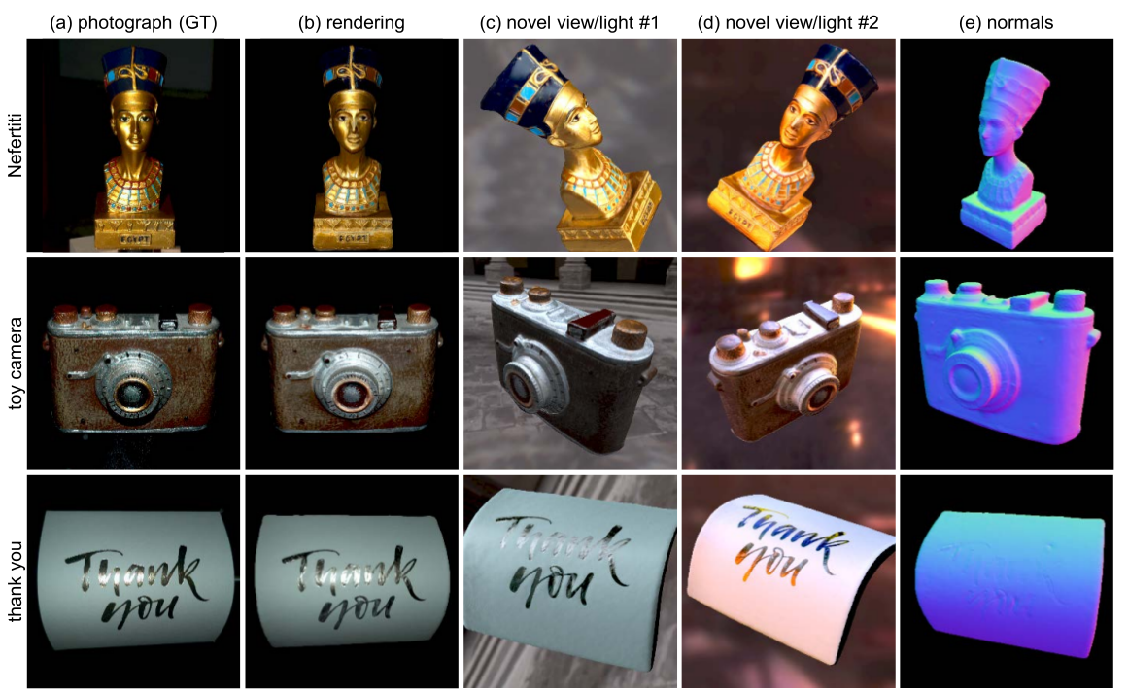
5. Results and Evaluation

Slide 34
Validation of the BRDF Model
MERL BRDF dataset is used to validate the calculated reflectance values.

Slide 35
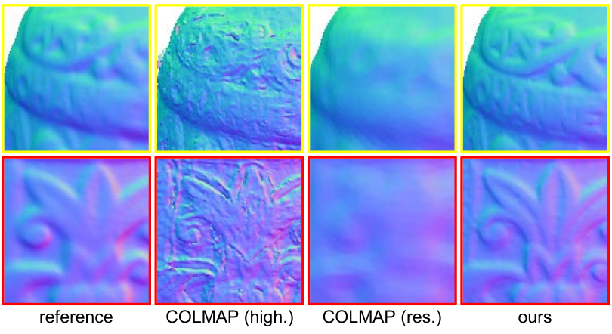
Validation of the Geometry
Geometry is compared against a setup with commercial 3D desktop scanner NextEngine and the state of the art 3D reconstruction method COLMAP [Schönberger 2016].

Slide 36
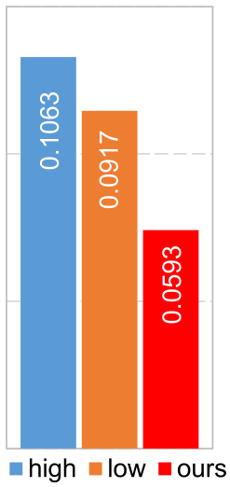
Proposed method yields a final reconstruction on-par with the professional 3D scanner if it uses low resolution result of the 3D scanning as initial geometry.
avg. geo. diff. [mm]

Slide 37
Performance
Desktop PC with the specified hardware as follows,
Each step of the initialization for obtaining the base rough geometry and extrinsic camera parameters approximately takes:
CPU | Intel i7-3770 3.40 GHz
Memory | 32 GB
GPU | NVIDIA GTX1080
SFM | 5 minutes
MVS | 2 – 4 hours
Meshing | 1 minute
One iteration | 10 minutes

Slide 38
6. Limitations
All surface points may not be captured properly.
Image-based 3D modeling techniques may not capture complex geometries like pinecones accurately.
SVBRDF does not take into account interreflections, subsurface scattering, nor transparency in our light transport model.

Slide 39
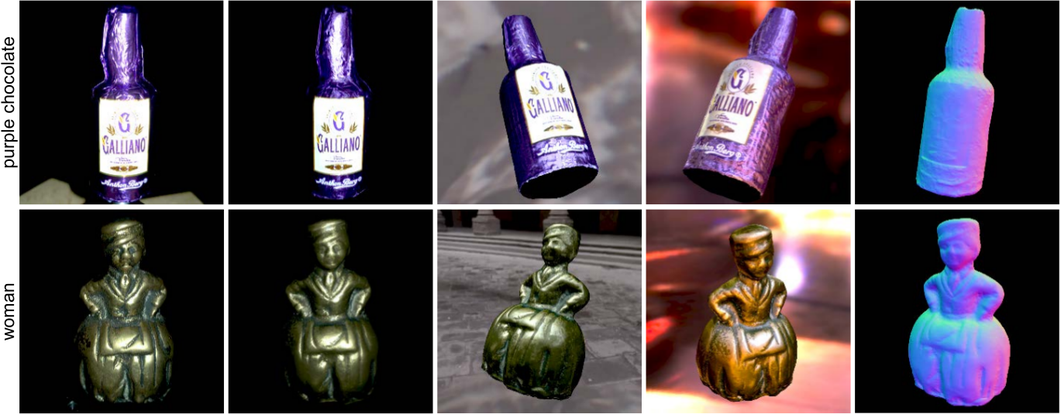
7. Conclusion
To sum up, authors offer a practical solution to obtain state-of-the-art acquisition of spatially varying reflectance and 3D geometry simultaneously by just using off -the-shelf cameras while similar works usually require more complex hardware.

Slide 40
References
Michael Kazhdan and Hugues Hoppe. 2013. Screened poisson surface reconstruction. ACM Transactions on Graphics (TOG) 32, 3 (2013), 29.
Jérémy Riviere, Pieter Peers, and Abhijeet Ghosh. 2015. Mobile Surface Reflectometry. Computer Graphics Forum (2015).
Zhuo Hui, Kalyan Sunkavalli, Joon-Young Lee, Sunil Hadap, Jian Wang, and Aswin Sankaranarayanan. 2017. Reflectance Capture Using Univariate Sampling of BRDFs. In Proc. IEEE Conference on Computer Vision and Pattern Recognition (CVPR). 5362–5370.
Tomoaki Higo, Yasuyuki Matsushita, Neel Joshi, and Katsushi Ikeuchi. 2009. A hand-held photometric stereo camera for 3-d modeling. In Computer Vision, 2009 IEEE 12th International Conference on. IEEE, 1234–1241.
Jaesik Park, Sudipta Sinha, Yasuyuki Matsushita, Yu Wing Tai, and In So Kweon. 2016. Robust Multiview Photometric Stereo using Planar Mesh Parameterization. IEEE Transactions on Pattern Analysis and Machine Intelligence (2016).
Johannes L. Schönberger. 2016. COLMAP. https://colmap.github.io.
Johannes L Schönberger, Enliang Zheng, Jan-Michael Frahm, and Marc Pollefeys. 2016. Pixelwise view selection for unstructured multi-view stereo. In European Conference on Computer Vision. Springer, 501–518.
Paul E. Debevec and Jitendra Malik. 1997. Recovering High Dynamic Range Radiance Maps from Photographs. In Proc. ACM SIGGRAPH ’97. 369–378.
Szymon Rusinkiewicz. 1998. A New Change of Variables for Efficient BRDF Representation. In Rendering Techniques ’98 (Proceedings of Eurographics Rendering Workshop ’98), G. Drettakis and N. Max (Eds.). Springer Wien, 11–22.

Slide 41
References
Robert L. Cook and Kenneth E. Torrance. 1982. A Reflectance Model for Computer Graphics. ACM Transactions on Graphics (TOG) 1, 1 (1982), 7–24. https://doi.org/10.1145/357290.357293
Paolo Cignoni, Claudio Rocchini, and Roberto Scopigno. 1998. Metro: Measuring error on simplified surfaces. In Computer Graphics Forum, Vol. 17. Wiley Online Library, 167–174.
Weyrich, Tim, et al. Principles of appearance acquisition and representation. Now Publishers Inc, 2009.
Weinmann, Michael, and Reinhard Klein. "Advances in geometry and reflectance acquisition (course notes)." SIGGRAPH Asia 2015 Courses. 2015. 1-71.
Nam, Giljoo, et al. "Practical SVBRDF acquisition of 3D objects with unstructured flash photography." ACM Transactions on Graphics (TOG) 37.6 (2018): 1-12.

