Slide 1
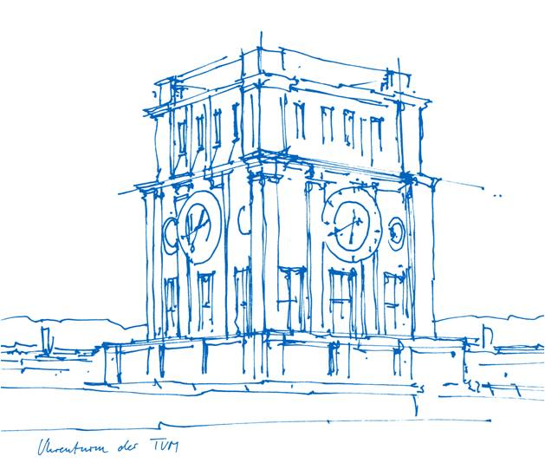
Seminar: Recent Advances in 3D Computer Vision
Speaker: Lukas Schneidt
Supervisor: Björn Häfner
Technische Universität München
Computer Science – Computer Vision Group
München, 11.10.2022

Slide 2
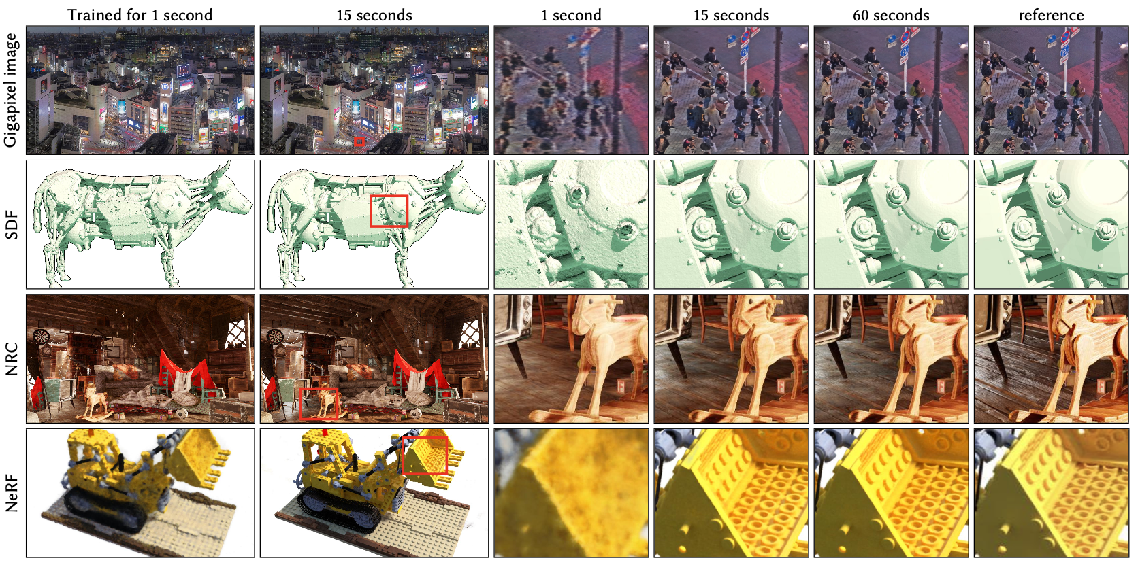
Instant Neural Graphics Primitives with a Multiresolution Hash Encoding
Thomas Müller, NVIDIA, Switzerland, Alex Evans, NVIDIA, United Kingdom, Christoph Schied, NVIDIA, USA, Alexander Keller, NVIDIA, Germany
SIGGRAPH 2022 – Best paper award

Slide 3
Content
Introduction
Background and Related Work
Multiresolution Hash Encoding
Experiments
Discussion and Future Work
Summary

Slide 4
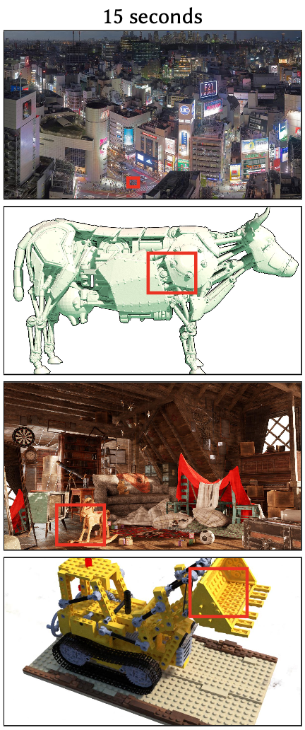
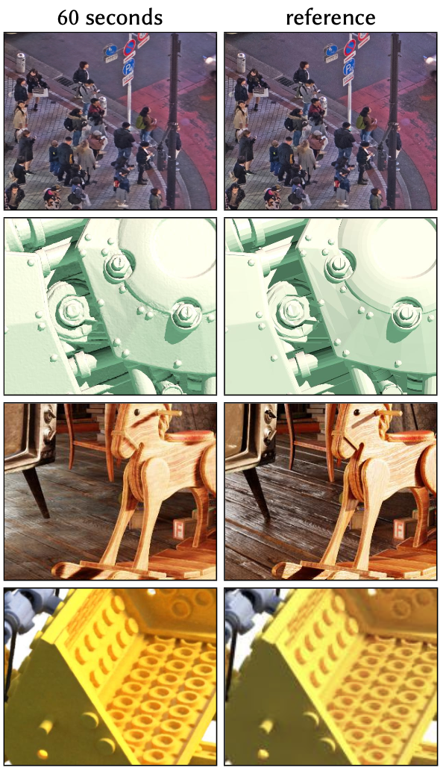
Introduction
Gigapixel Image
Neural signed distance functions (SDF)
Neural radiance caching (NRC)
Neural radiance and density fields (NeRF)
Notes:
MLP learns the mapping from 2D coordinates to RGB colors of a high-resolution image.

Slide 5
Introduction
Gigapixel Image
Neural signed distance functions (SDF)
Neural radiance caching (NRC)
Neural radiance and density fields (NeRF)
Notes:
the MLP learns the mapping from 3D coordinates to the distance to a surface.

Slide 6
Introduction
Gigapixel Image
Neural signed distance functions (SDF)
Neural radiance caching (NRC)
Neural radiance and density fields (NeRF)
Notes:
the MLP learns the 5D light field of a given scene from a Monte Carlo path tracer

Slide 7
Introduction
Gigapixel Image
Neural signed distance functions (SDF)
Neural radiance caching (NRC)
Neural radiance and density fields (NeRF)
Notes:
the MLP learns the 3D density and 5D light field of a given scene from image observations and corresponding perspective transforms.

Slide 8
Background and Related Work
Parametric encodings
Arrange additional trainable parameters in an auxiliary data structure, such as a grid or a tree
Look-up and interpolate parameters
Trade-off between larger memory footprint and smaller computational cost
Sparse parametric encodings
Notes:
The idea is to arrange additional trainable parameters (beyond weights and biases) in an auxiliary data structure, such as a grid or a tree, and to look-up and (optionally) interpolate these parameters depending on the input vector x ∈ R𝑑

Slide 9
Background and Related Work
Parametric encodings
Arrange additional trainable parameters in an auxiliary data structure, such as a grid or a tree
Look-up and interpolate parameters
Trade-off between larger memory footprint and smaller computational cost
Sparse parametric encodings
Notes:
Dense grids of trainable features consume much more memory than the neural network weights.
A demonstration of the reconstruction quality of different encodings and parametric data structures for storing trainable feature embeddings. Our encoding (e) with a similar total number of trainable parameters as the frequency encoding configuration (b) trains over 8× faster, due to the sparsity of updates to the parameters and smaller MLP. Increasing the number of parameters (f) further improves reconstruction accuracy without significantly increasing training time.

Slide 10
Multiresolution Hash Encoding

Slide 11
Multiresolution Hash Encoding

Slide 12
Multiresolution Hash Encoding
Scale Input x
$b ≔exp⁡(\frac{\ln{N_{max} − \ln{N_{min}}}}{L −1}$)
$N_{L} ≔ \left\lfloor N_{min}∗\left.b^{l}\right\rfloor \right.$
$x ∗ N_{l}$
Round down and up
$\left\lfloor x_{l}\right\rfloor = \left\lfloor x ∗ N_{l}\right\rfloor$
$\left\lceil x_{l}\right\rceil = \left\lceil x ∗ N_{l}\right\rceil$

Slide 13
Multiresolution Hash Encoding
Scale Input x
$b ≔exp⁡(\frac{\ln{N_{max} − \ln{N_{min}}}}{L −1}$)
$N_{L} ≔ \left\lfloor N_{min}∗\left.b^{l}\right\rfloor \right.$
$x ∗ N_{l}$
Round down and up
$\left\lfloor x_{l}\right\rfloor = \left\lfloor x ∗ N_{l}\right\rfloor$
$\left\lceil x_{l}\right\rceil = \left\lceil x ∗ N_{l}\right\rceil$
Span voxel

Slide 14
Multiresolution Hash Encoding
Scale Input x
$b ≔exp⁡(\frac{\ln{N_{max} − \ln{N_{min}}}}{L −1}$)
$N_{L} ≔ \left\lfloor N_{min}∗\left.b^{l}\right\rfloor \right.$
$x ∗ N_{l}$
Round down and up
$\left\lfloor x_{l}\right\rfloor = \left\lfloor x ∗ N_{l}\right\rfloor$
$\left\lceil x_{l}\right\rceil = \left\lceil x ∗ N_{l}\right\rceil$
Span voxel
Map corners to entries in respective feature vector and interpolate

Slide 15
Multiresolution Hash Encoding
Scale Input x
$b ≔exp⁡(\frac{\ln{N_{max} − \ln{N_{min}}}}{L −1}$)
$N_{L} ≔ \left\lfloor N_{min}∗\left.b^{l}\right\rfloor \right.$
$x ∗ N_{l}$
Round down and up
$\left\lfloor x_{l}\right\rfloor = \left\lfloor x ∗ N_{l}\right\rfloor$
$\left\lceil x_{l}\right\rceil = \left\lceil x ∗ N_{l}\right\rceil$
Span voxel
Map corners to entries in respective feature vector and interpolate
Repeat for all resolutions

Slide 16
Multiresolution Hash Encoding
Scale Input x
$b ≔exp⁡(\frac{\ln{N_{max} − \ln{N_{min}}}}{L −1}$)
$N_{L} ≔ \left\lfloor N_{min}∗\left.b^{l}\right\rfloor \right.$
$x ∗ N_{l}$
Round down and up
$\left\lfloor x_{l}\right\rfloor = \left\lfloor x ∗ N_{l}\right\rfloor$
$\left\lceil x_{l}\right\rceil = \left\lceil x ∗ N_{l}\right\rceil$
Span voxel
Map corners to entries in respective feature vector and interpolate
Repeat for all resolutions

Slide 17
Multiresolution Hash Encoding
Scale Input x
$b ≔exp⁡(\frac{\ln{N_{max} − \ln{N_{min}}}}{L −1}$)
$N_{L} ≔ \left\lfloor N_{min}∗\left.b^{l}\right\rfloor \right.$
$x ∗ N_{l}$
Round down and up
$\left\lfloor x_{l}\right\rfloor = \left\lfloor x ∗ N_{l}\right\rfloor$
$\left\lceil x_{l}\right\rceil = \left\lceil x ∗ N_{l}\right\rceil$
Span voxel
Map corners to entries in respective feature vector and interpolate
Repeat for all resolutions

Slide 18
Multiresolution Hash Encoding

Slide 19
Multiresolution Hash Encoding
L = 2
Notes:
Mention here that L=2 and T = 8 (instead of T=2^19). Also explain Collisions here for the first time.

Slide 20
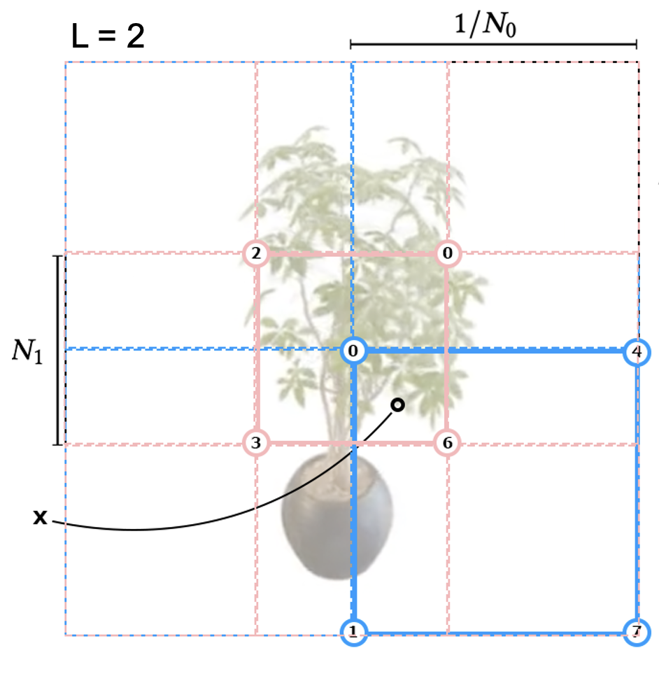
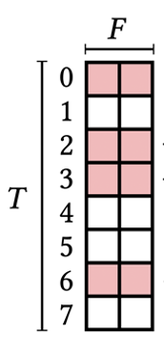
Multiresolution Hash Encoding Implicit Hash Collision Resolution
Finer resolution levels:
+ Capture small features
- Many collisions
Finer resolution levels:
+ Capture small features
- Many collisions
Collision → average gradients:
Point on surface of radiance field contributes strongly
Point in empty space contributes weakly
Notes:
May appear counter-intuitive that this encoding can reconstruct scenes faithfully (because of hash collisions).
It’s due to the multi resolutions.
Hash Collisions: Disparate points which hash to the same table entry. A Collision occurs when different integer coordinates hash to the same index. These are pseudo-randomly scattered across space, and it’s statistically unlikely to occur simultaneously at every level for a given pair of points.

Slide 21
Multiresolution Hash Encoding Implicit Hash Collision Resolution
Finer resolution levels:
+ Capture small features
- Many collisions
Coarser resolution levels:
+ No Collisions
- Only represent low-resolution scene
Collision → average gradients:
Point on surface of radiance field contributes strongly
Point in empty space contributes weakly
Notes:
May appear counter-intuitive that this encoding can reconstruct scenes faithfully (because of hash collisions).
It’s due to the multi resolutions.
Hash Collisions: Disparate points which hash to the same table entry. A Collision occurs when different integer coordinates hash to the same index. These are pseudo-randomly scattered across space, and it’s statistically unlikely to occur simultaneously at every level for a given pair of points.

Slide 22
Multiresolution Hash Encoding Implicit Hash Collision Resolution
Finer resolution levels:
+ Capture small features
- Many collisions
Coarser resolution levels:
+ No Collisions
- Only represent low-resolution scene
Collision → average gradients:
Point on surface of radiance field contributes strongly
Point in empty space contributes weakly
Notes:
May appear counter-intuitive that this encoding can reconstruct scenes faithfully (because of hash collisions).
It’s due to the multi resolutions.
Hash Collisions: Disparate points which hash to the same table entry. A Collision occurs when different integer coordinates hash to the same index. These are pseudo-randomly scattered across space, and it’s statistically unlikely to occur simultaneously at every level for a given pair of points.

Slide 23
Multiresolution Hash Encoding
L = 2

Slide 24
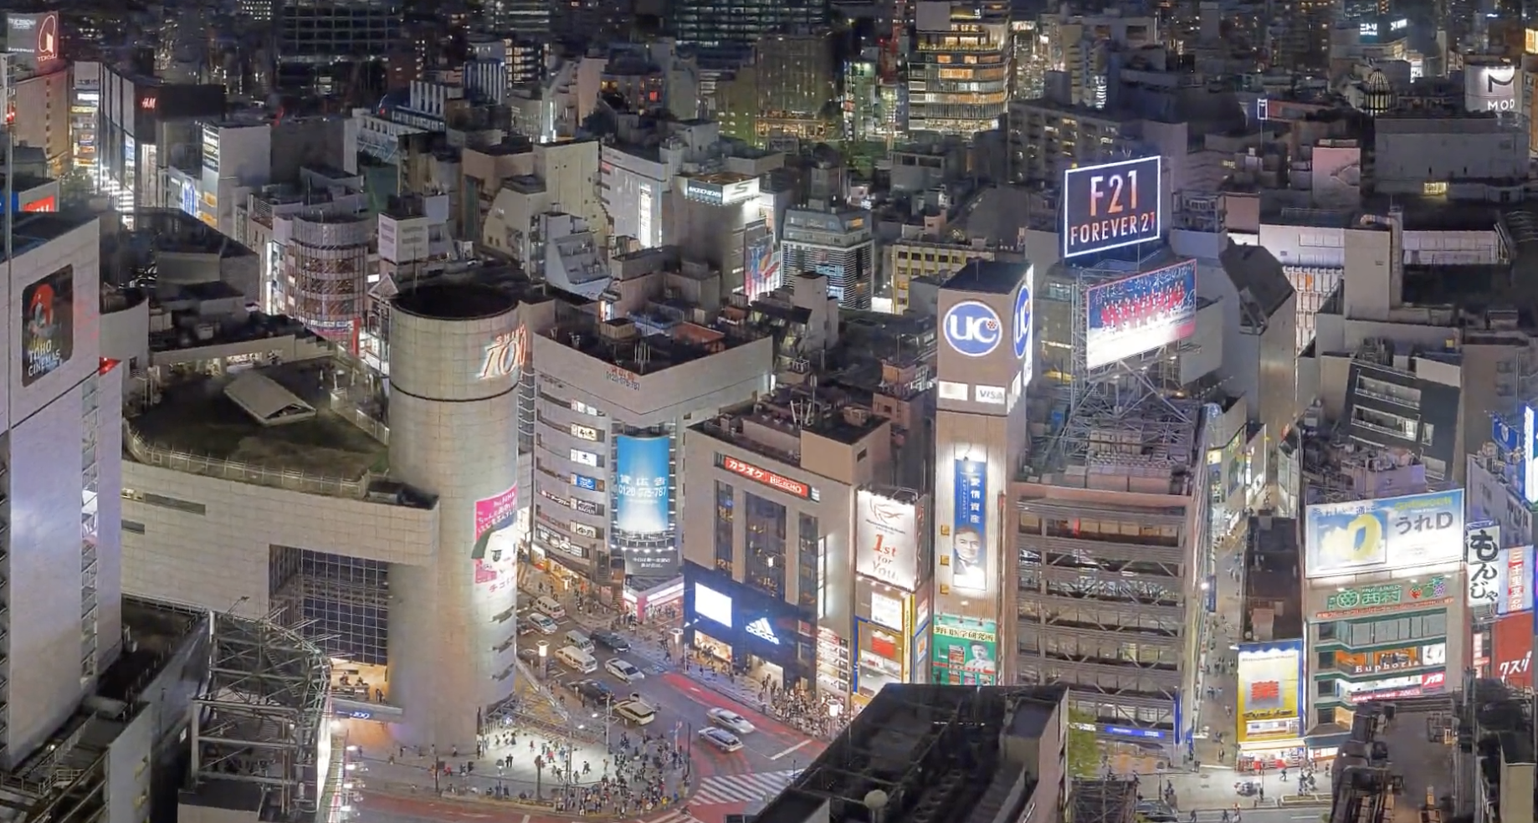
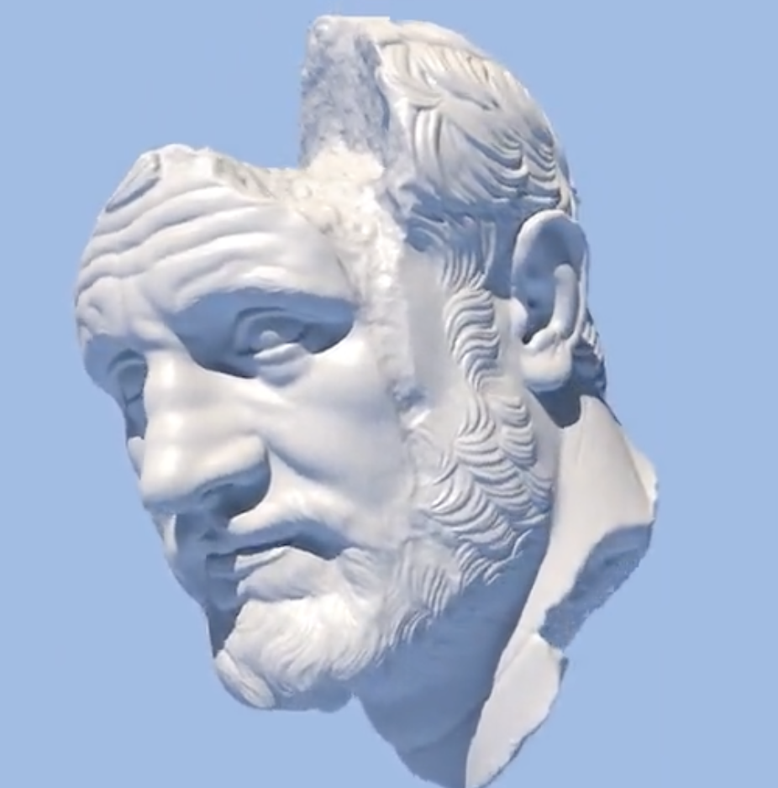
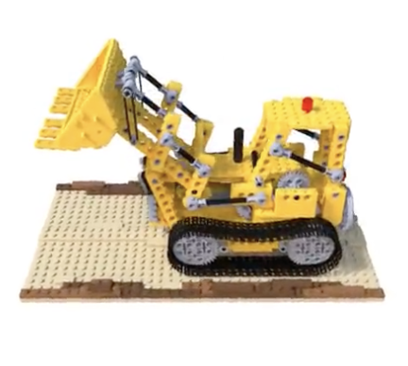
Multiresolution Hash Encoding Performance vs. Quality
Hash Table Size: T
Notes:
Memory footprint is linear in T, whereas quality and performance tend to scale sub-linearly.
Figure: Test error vs. training time for a wide range of T-values for three neural graphics primitives.
T should be used to tweak the encoding to the desired performance characteristics.
A performance cliff is visible at 𝑇 > 2 19 where the cache of our RTX 3090 GPU becomes oversubscribed (particularly visible for SDF and NeRF). The plot also shows model convergence over time leading up to the final state. This highlights how high quality results are already obtained after only a few seconds. Jumps in the convergence (most visible towards the end of SDF training) are caused by learning rate decay. For NeRF and Gigapixel image, training finishes after 31 000 steps and for SDF after 11 000 steps

Slide 25
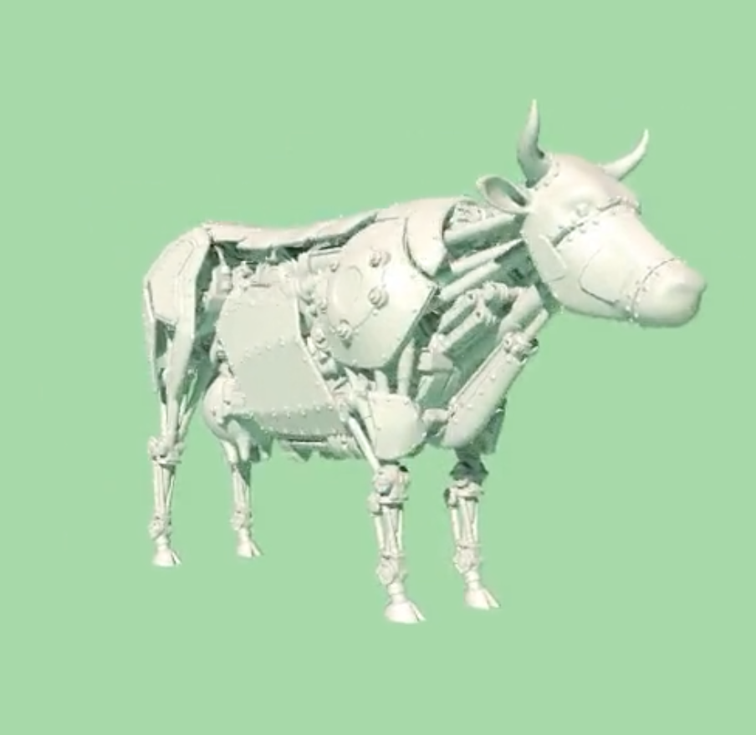
Multiresolution Hash Encoding Performance vs. Quality
Number of Levels L
Number of feature dimensions F
Notes:
Hyperparameters L and F also trade off quality and performance. Analysed in second figure for an approximately constant number of trainable encoding parameters theta. They found F=2, L=16 to be a favorable Pareto optimum in all tested applications.
Test error over training time for fixed values of feature dimensionality 𝐹 as the number of hash table levels 𝐿 is varied. To maintain a roughly equal trainable parameter count, the hash table size 𝑇 is set according to 𝐹 · 𝑇 · 𝐿 = 2 24 for SDF and NeRF, whereas gigapixel image uses 2 28. Since (𝐹 = 2, 𝐿 = 16) is near the best-case performance and quality (top-left) for all applications, we use this configuration in all results. 𝐹 = 1 is slow on our RTX 3090 GPU since atomic half-precision accumulation is only efficient for 2D vectors but not for scalars. For NeRF and Gigapixel image, training finishes after 31 000 steps whereas SDF completes at 11 000 steps.

Slide 26
Multiresolution Hash Encoding Online Adaptivity and d-Linear Interpolation
Online Adaptivity:
If distribution of inputs changes during training, finer grid levels will experience fewer collisions → more accurate function can be learned
d-linear Interpolation:
Interpolation ensures that encoding and ist composition with the neural network are continuous.

Slide 27
Multiresolution Hash Encoding Online Adaptivity and d-Linear Interpolation
Online Adaptivity:
If distribution of inputs changes during training, finer grid levels will experience fewer collisions → more accurate function can be learned
d-linear Interpolation:
Interpolation ensures that encoding and its composition with the neural network are continuous.

Slide 28
Experiments Gigapixel Image Approximation
Notes:
For comparison, on the Tokyo panorama from Figure 1, ACORN achieves a PSNR of 38.59 dB after 36.9 h of training. With a similar number of parameters (𝑇 = 2 24), our method achieves the same PSNR after 2.5 minutes of training, peaking at 41.9 dB after 4 min.

Slide 29
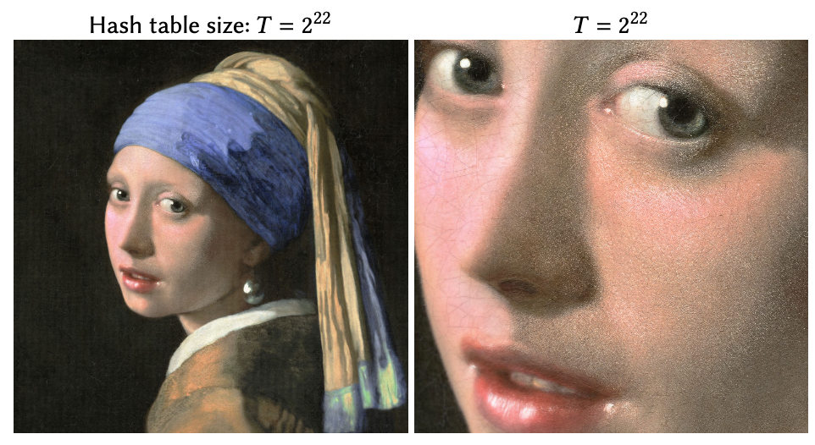
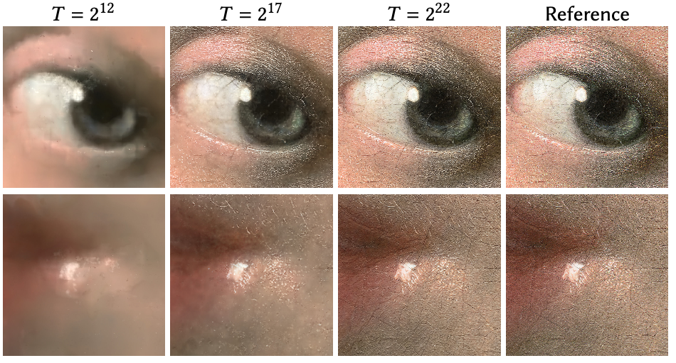
Experiments Gigapixel Image Approximation
Notes:
Showcases the level of detail.

Slide 30
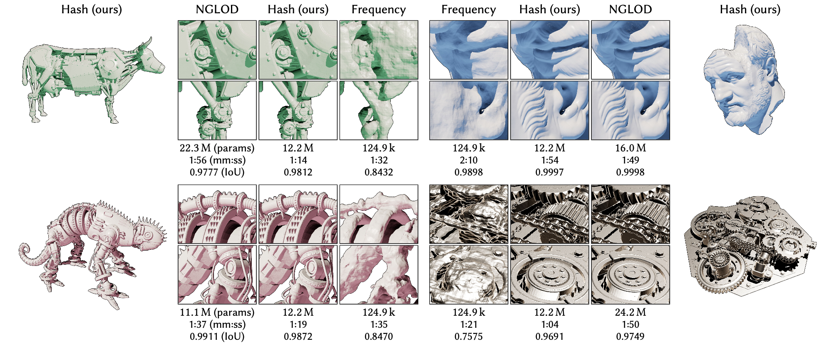
Experiments Signed Distance Functions

Slide 31
Experiments Signed Distance Functions

Slide 32
Experiments Neural Radiance Caching
Notes:
In neural radiance caching [Müller et al. 2021], the task of the MLP is to predict photorealistic pixel colors from feature buffers; see Figure 8.
Summary of the neural radiance caching application [Müller et al. 2021]. The MLP 𝑚 enc(𝑥; 𝜃); Φ is tasked with predicting photorealistic pixel colors from feature buffers independently for each pixel. The feature buffers contain, among other variables, the world-space position x, which we propose to encode with our method. Neural radiance caching is a challenging application, because it is supervised online during real-time rendering. The training data are a sparse set of light paths that are continually spawned from the camera view. As such, the neural network and encoding do not learn a general mapping from features to color, but rather they continually overfit to the current shape and lighting. To support animated content, training has a budget of one millisecond per fram

Slide 33
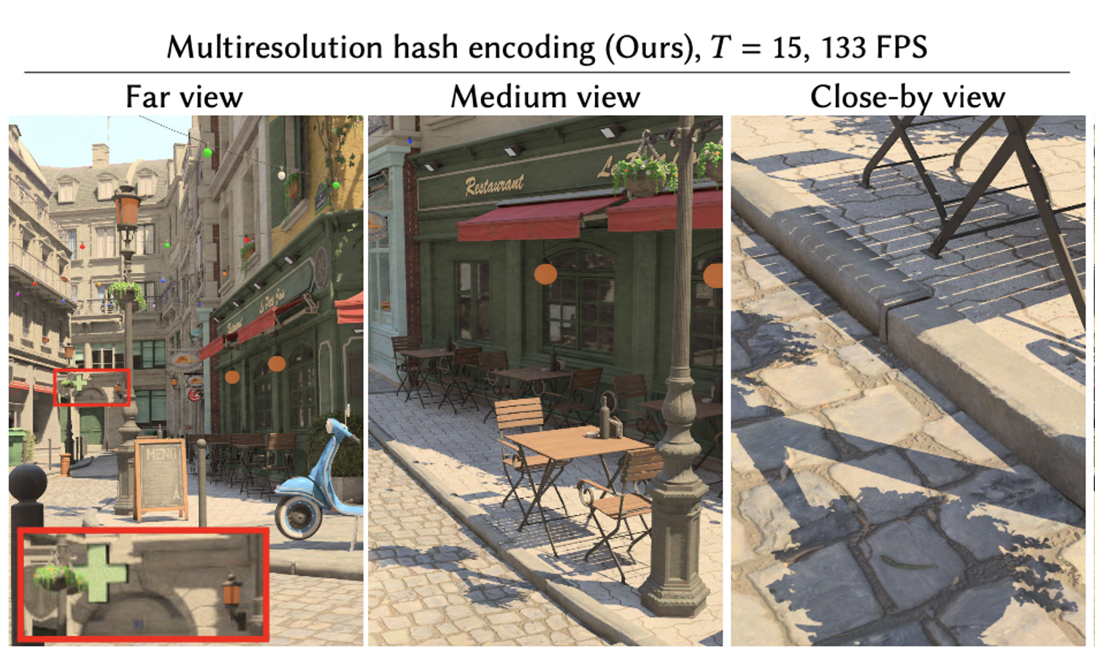
Experiments Neural Radiance Caching

Slide 34
Experiments Neural Radiance Caching

Slide 35
Experiments Neural Radiance and Density Fields (NeRF)

Slide 36
Experiments Neural Radiance and Density Fields (NeRF)

Slide 37
Experiments Neural Radiance and Density Fields (NeRF)
Comparison with high-quality offline NeRF

Slide 38
Experiments Neural Radiance and Density Fields (NeRF)

Slide 39
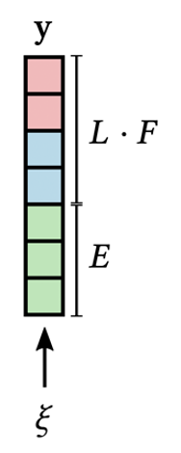
Discussion and Future Work
Concatenation vs. Reduction
Concatenation allows for independent, fully parallel processing of each resolution
Reduction of dimensionality of encoded result may be too small to encode useful information
Reduction may be favorable when neural network is significantly more expensive than encoding
Choice of hash function
PCG32 RNG, with superior statistical properties
Order LSBs of $ℤ^{d}$ by space-filling curve and only hashing higher bits
Treat hash function as tiling of space into dense grids

Slide 40
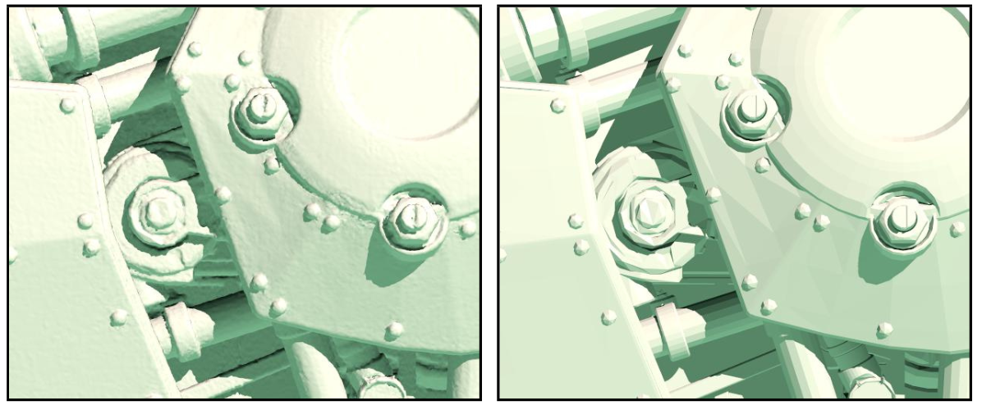
Discussion and Future Work
Microstructure due to hash collisions
Hash encoding NGLOD

Slide 41
Summary
Automatically focuses on relevant detail
Independent of task
Overhead allows online training and inference
Speeding up NeRF by several orders of magnitude
Matches performance of concurrent non-neural 3D reconstruction techniques
Single-GPU training times are within reach for many graphics applications

Slide 42
Summary
Automatically focuses on relevant detail
Independent of task
Overhead allows online training and inference
Speeding up NeRF by several orders of magnitude
Matches performance of concurrent non-neural 3D reconstruction techniques
Single-GPU training times are within reach for many graphics applications

Slide 43
Summary
Automatically focuses on relevant detail
Independent of task
Overhead allows online training and inference
Speeding up NeRF by several orders of magnitude
Matches performance of concurrent non-neural 3D reconstruction techniques
Single-GPU training times are within reach for many graphics applications

Slide 44
Summary
Automatically focuses on relevant detail
Independent of task
Overhead allows online training and inference
Speeding up NeRF by several orders of magnitude
Matches performance of concurrent non-neural 3D reconstruction techniques
Single-GPU training times are within reach for many graphics applications

Slide 45
Summary
Automatically focuses on relevant detail
Independent of task
Overhead allows online training and inference
Speeding up NeRF by several orders of magnitude
Matches performance of concurrent non-neural 3D reconstruction techniques
Single-GPU training times are within reach for many graphics applications

Slide 46
Summary
Automatically focuses on relevant detail
Independent of task
Overhead allows online training and inference
Speeding up NeRF by several orders of magnitude
Matches performance of concurrent non-neural 3D reconstruction techniques
Single-GPU training times are within reach for many graphics applications

Slide 47
Q&A
Any Questions?

Slide 48
Thank you!

Slide 49
Introduction
Adaptivity
Coarse Resolution – 1:1 mapping
Fine Resolution - Hash Table
No structural Updates to data structure
Efficiency
Hash Tabel lookups are O(1)
Avoiding execution divergence and serial pointer-chasing
Resolutions may be queried in parallel
Independent from Task

Slide 50
Introduction
Adaptivity
Coarse Resolution – 1:1 mapping
Fine Resolution - Hash Table
No structural Updates to data structure
Efficiency
Hash Tabel lookups are O(1)
Avoiding execution divergence and serial pointer-chasing
Resolutions may be queried in parallel
Independent from Task

Slide 51
Introduction
Adaptivity
Coarse Resolution – 1:1 mapping
Fine Resolution - Hash Table
No structural Updates to data structure
Efficiency
Hash Tabel lookups are O(1)
Avoiding execution divergence and serial pointer-chasing
Resolutions may be queried in parallel
Independent from Task

Slide 52
Multiresolution Hash Encoding
Scale Input x
$b ≔exp⁡(\frac{\ln{N_{max} − \ln{N_{min}}}}{L −1}$)
$N_{L} ≔ \left\lfloor N_{min}∗\left.b^{l}\right\rfloor \right.$
$x ∗ N_{l}$
Round down and up
$\left\lfloor x_{l}\right\rfloor = \left\lfloor x ∗ N_{l}\right\rfloor$
$\left\lceil x_{l}\right\rceil = \left\lceil x ∗ N_{l}\right\rceil$
Span voxel with 2^{d} integer vertices
Map each corner to an entry in respective feature vector array
Spatial Hash Function
$h\left(x\right)=({}_{i=1}^{d}{⨁{x_{i}π_{i}}} mod T)$

Slide 53
Multiresolution Hash Encoding
Number of trainable encoding parameters $θ$ bounded by L*T*F
L resolution levels
T feature vectors per level
F dimensional feature vectors

Slide 54
Experiments Neural Radiance Caching
Notes:
In neural radiance caching [Müller et al. 2021], the task of the MLP is to predict photorealistic pixel colors from feature buffers; see Figure 8.
Summary of the neural radiance caching application [Müller et al. 2021]. The MLP 𝑚 enc(𝑥; 𝜃); Φ is tasked with predicting photorealistic pixel colors from feature buffers independently for each pixel. The feature buffers contain, among other variables, the world-space position x, which we propose to encode with our method. Neural radiance caching is a challenging application, because it is supervised online during real-time rendering. The training data are a sparse set of light paths that are continually spawned from the camera view. As such, the neural network and encoding do not learn a general mapping from features to color, but rather they continually overfit to the current shape and lighting. To support animated content, training has a budget of one millisecond per fram

Slide 55
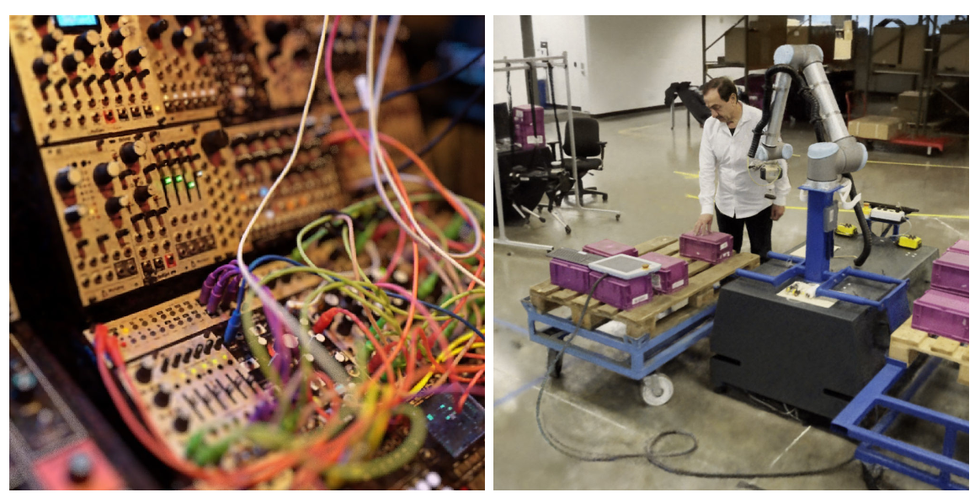
Experiments Neural Radiance and Density Fields (NeRF)
Model Architecture:
Density MLP: hash encoded position mapped to 16 output values
Color MLP: adds view-dependent color variation
Accelerated ray marching:
Maintain occupancy grid that coarsely marks empty vs. non-empty space
Additionally cascade it and distribute samples exponentially

Slide 56
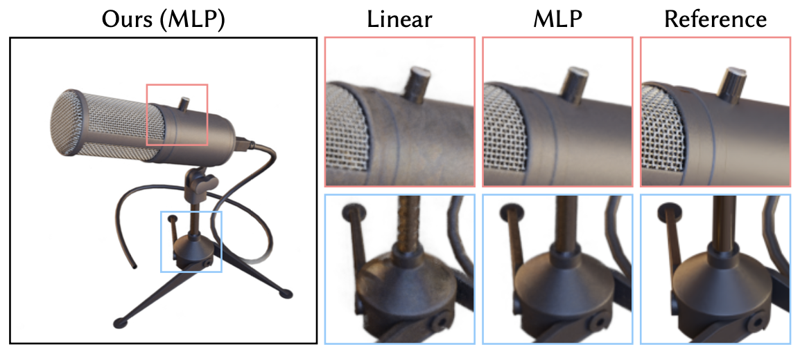
Experiments Neural Radiance and Density Fields (NeRF)
Comparison with direct voxel lookups

Slide 57
NeRF Model Architecture

Slide 58
Discussion and Future Work
Choice of hash function
PCG32 RNG, with superior statistical properties
Order LSBs of $ℤ^{d}$ by space-filling curve and only hashing higher bits
Treat hash function as tiling of space into dense grids

Slide 59
Discussion and Future Work
Microstructure due to hash collisions
60 seconds reference
Other applications
Heterogenous volumetric density fields

Slide 60
Implementation
Performance Considerations
Hash tables evaluated level by level to optimally use GPU‘s caches
Performance on tested hardware constant for T<= 2¹⁹
Architecture
MLP with two hidden layers with a width of 64 neurons, ReLU activation and linear output layer
N_{max} is set to:
2048 x scene size for NeRF and SDF
Half of gigapixel image width
2¹⁹ for radiance caching
Notes:
This is explained by the 6 MB L2 cache of our NVIDIA RTX 3090 GPU, which becomes too small for individual levels when 2 · 𝑇 · 𝐹 > 6 · 2 20, with 2 being the size of a half-precision entry.

Slide 61
Implementation
Initialization
Weights are initialized according to Glorot and Bengio to provide reasonable scaling of activations and their gradients
Hash table entries initialized using $𝒰\left({−10}^{−4}, {10}^{−4}\right)$ to provide randomnes
Training
Trained by applying Adam with $β$₁ = 0.9, $β$₂ = 0.99, $ε$ = 10⁻¹⁵
Weak L2 regularization to prevent divergence
Gigapixel and NeRF: L₂ Loss
SDF: MAPE
NRC: luminance-relative L₂ Loss
Learning rate of 10⁻⁴ for SDF and 10⁻² otherwise
Notes:
uniform distribution U (−10−4 , 10−4 ) to provide a small amount of randomness while encouraging initial predictions close to zero. We also tried a variety of different distributions, including zero-initialization, which all resulted in a very slightly worse initial convergence speed.
Adam significantly accelerates convergence of hash table entries when their gradients are sparse and weak.
Lastly, we skip Adam steps for hash table entries whose gradient is exactly 0. This saves ∼10% performance when gradients are sparse, which is a common occurrence with 𝑇 ≫ BatchSize. Even though this heuristic violates some of the assumptions behind Adam, we observe no degradation in convergence.

Slide 62
Implementation
Non-spatial input dimensions
Auxiliary dimensions such as view direction and material parameters (light field)
One-blob encoding [Müller et al. 2019] is used in radiance caching
Spherical Harminocs basis in NeRF

