Slide 1
DiffusionNET:
Discretization Agnostic Learning on Surfaces
Recent Advances in 3D Computer Vision
Til Stotz (03757560) Til.Stotz@tum.de Robotics, Cognition, Intelligence WS22/23

Slide 2
Table of Contents
01
What is DiffusionNet?
Introduction, Overview
02
Related Work xxxxx xxxxxxx
PointNET,
DGCNN
03
Method
Ingredients,
Network Architecture
04
Results & Discussion
Performance, Limitations

Slide 3
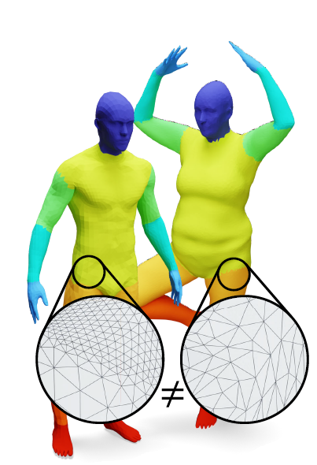
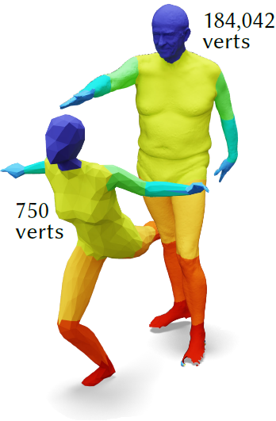
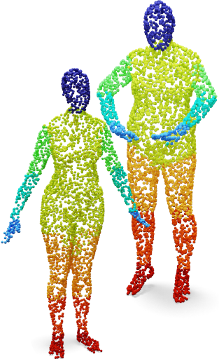
What is DiffusionNET?
01
Plug-and-play neural network for deep learning on 3D surfaces
Simple, robust and efficient networks
Ingredients: standard MLP, diffusion and spatial gradient features
Sampling Agnostic
Resolution Agnostic
Representation Agnostic

Slide 4
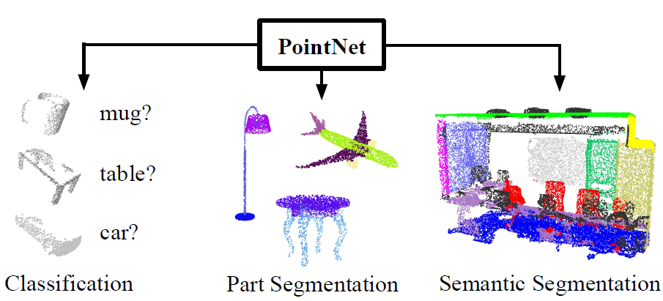
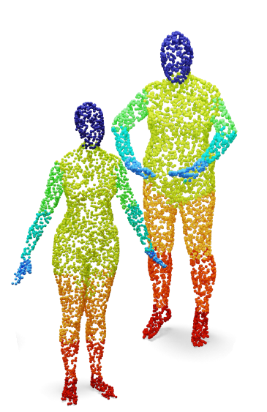

Related Work: (1) PointNET
02
Neural network architecture for point sets
High performance on classification, segmentation
Drawbacks:
  Point clouds only
  Not suitable for deformable shapes
Source: Charles R Qi, Hao Su, Kaichun Mo, and Leonidas J Guibas. 2017a. Pointnet: Deep learning on point sets for 3d classification and segmentation. Proc. Computer Vision and Pattern Recognition (CVPR), IEEE 1, 2 (2017), 4.
Notes:
Point-based methods (PointNET, PointNET++ and its extensions): simple, flexible, applicability, but accuracy often lower than using surface-based methods, not well suited for non-rigid shape analysis
Surface and graph-based methods: ?

Slide 5
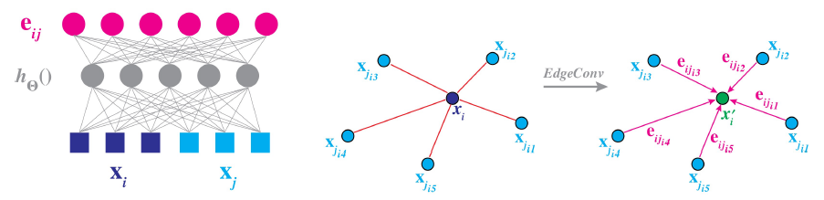

Related Work: (2) Dynamic Graph CNN
02
CNN-based neural network
Propagates information along edges
Drawbacks:
  Bad performance under remeshing
  Worse propagation on dense point clouds
Source: Yue Wang, Yongbin Sun, Ziwei Liu, Sanjay E. Sarma, Michael M. Bronstein, and Justin M. Solomon. 2019. Dynamic Graph CNN for Learning on Point Clouds. ACM Transactions on Graphics (TOG) (2019).
Notes:
Point-based methods (PointNET, PointNET++ and its extensions): simple, flexible, applicability, but accuracy often lower than using surface-based methods, not well suited for non-rigid shape analysis
Surface and graph-based methods: ?

Slide 6
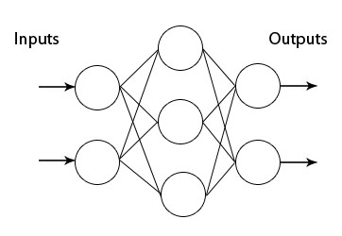
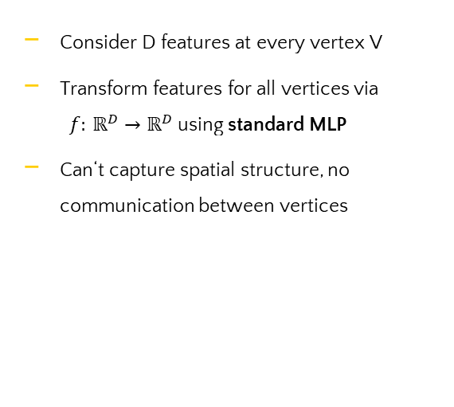
Method: (1) Multi-layer Perceptron
03
Consider D features at every vertex V
Transform features for all vertices via $f: ℝ^{D}→ℝ^{D}$ using standard MLP
Can‘t capture spatial structure, no communication between vertices

Slide 7
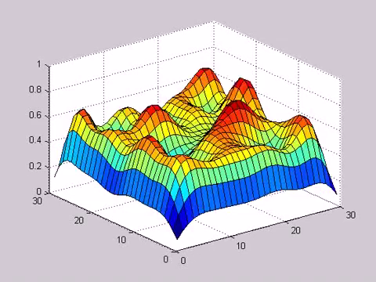
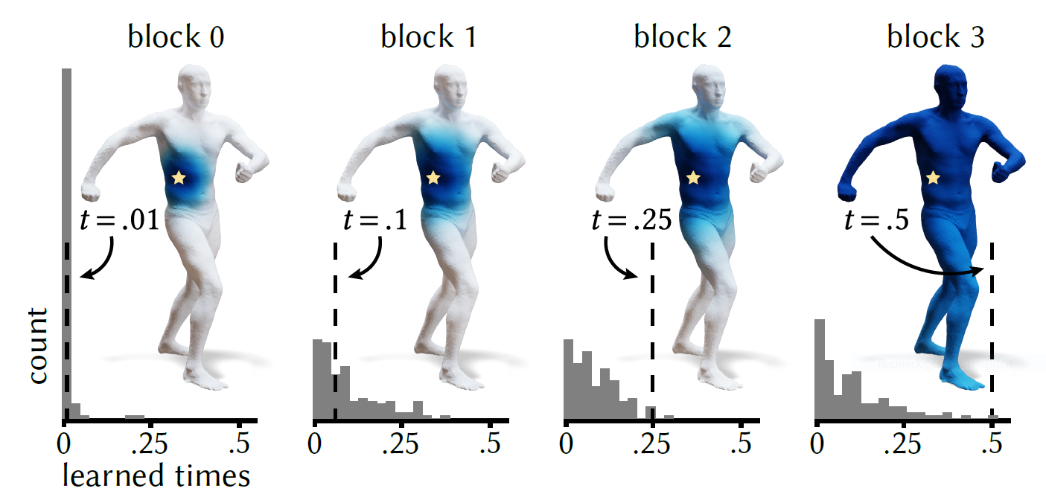
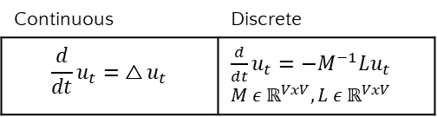
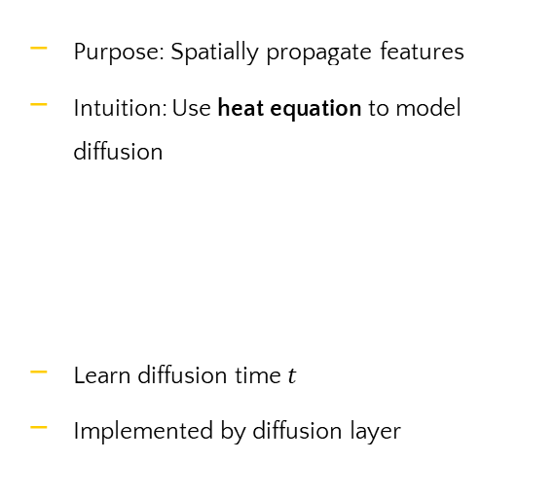
Method: (2) What is Diffusion?
03
Purpose: Spatially propagate features
Intuition: Use heat equation to model diffusion
Learn diffusion time $t$
Implemented by diffusion layer
https://www.youtube.com/watch?v=twBcpxrWm5E
Continuous | Discrete
$$\frac{d}{dt}u_{t}= △u_{t}$$ | $\frac{d}{dt}u_{t}={−M}^{−1}Lu_{t}$ $M ε ℝ^{VxV},L ε ℝ^{VxV}$

Slide 8
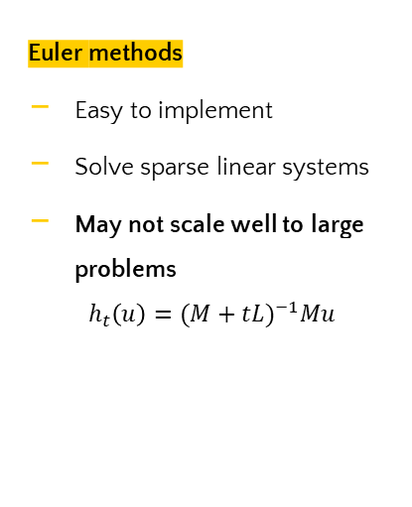
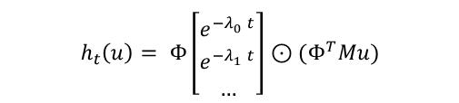
Method: (2) Computing Diffusion
03
Euler methods
Easy to implement
Solve sparse linear systems
May not scale well to large problems
$$h_{t}\left(u\right)={(M+tL)}^{−1}Mu$$
Spectral acceleration
Based on Laplacian eigenfunctions
Diffusion reduces to elementwise exponentiation
$$h_{t}\left(u\right)= Φ\left[\begin{matrix}e^{−λ_{0}^{}t} \\ e^{−λ_{1}^{}t} \\ …\end{matrix}\right]⊙(Φ^{T}Mu)$$

Slide 9
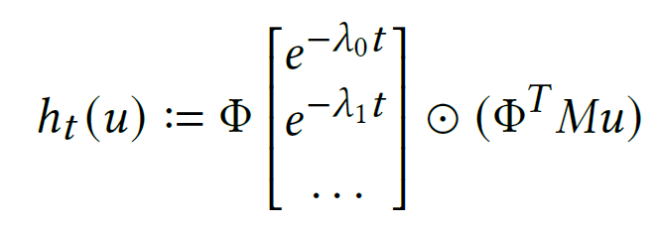
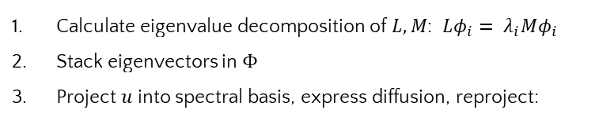
Method: (2) Computing Diffusion ctd.
03
Calculate eigenvalue decomposition of $L, M$: $Lφ_{i}= λ_{i}Mφ_{i}$
Stack eigenvectors in $Φ$
Project $u$ into spectral basis, express diffusion, reproject:
Reprojection
Project into spectral basis
Calculate diffusion for time t

Slide 10
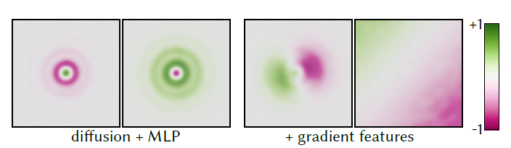
Method: (3) Spatial Gradient Features
03
Diffusion layer: Radially-symmetric filters only
Spatial gradient features: Directional filters
Procedure:
  Precompute gradients
  Learn features from dot product between gradient pairs
  Gradients first undergo learned scaling/rotation

Slide 11
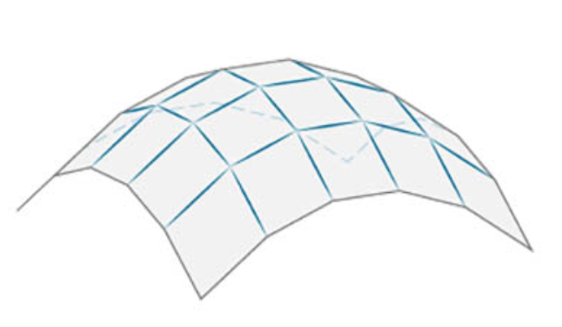
Method: (3) Spatial Gradient Features
03
Given a mesh or point cloud with V vertices, for all V:

Slide 12

Method: (3) Spatial Gradient Features
03
Given a mesh or point cloud with V vertices, for all V:
  Define tangent plane
$$\vec{n}$$

Slide 13
Method: (3) Spatial Gradient Features
03
Given a mesh or point cloud with V vertices, for all V:
  Define tangent plane
  Project neighboring vertices
$$\vec{n}$$

Slide 14


Method: (3) Spatial Gradient Features
03
Given a mesh or point cloud with V vertices, for all V:
  Define tangent plane
  Project neighboring vertices
  Estimate gradient in tangent plane
  Express gradients as complex number
$$Re$$
$$Im$$
$$\vec{n}$$

Slide 15
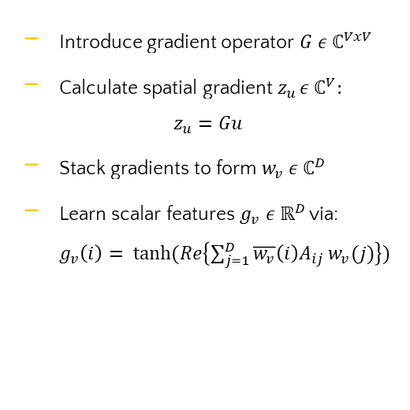
Method: (3) Spatial Gradient Features
03
Introduce gradient operator $G ε{ ℂ}^{VxV}$
Calculate spatial gradient$z_{u }ε ℂ^{V}$:
$$z_{u}=Gu$$
Stack gradients to form $w_{v} ε ℂ^{D}$
Learn scalar features $g_{v} ε ℝ^{D}$via: $g_{v}\left(i\right)= tanh⁡(Re\left\{\sum_{j=1}^{D}{\overline{w_{v}}\left(i\right)A_{ij}}w_{v}(j)\right\})$
$$Re$$
$$Im$$
$$\vec{n}$$

Slide 16
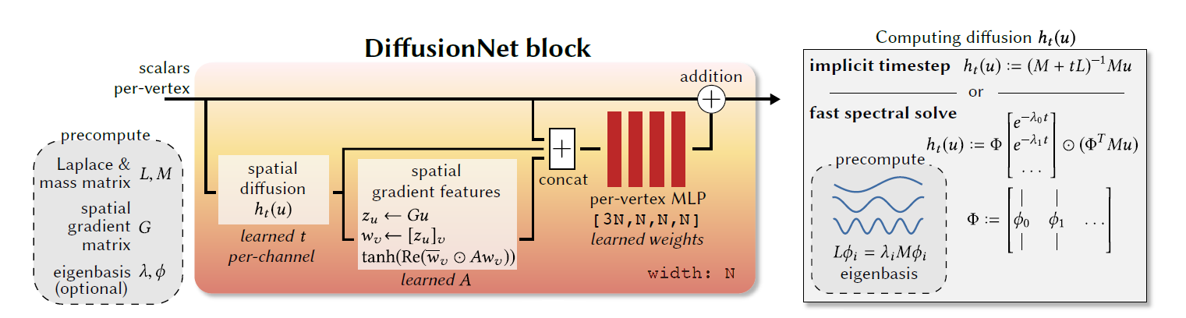
Method: (4) DiffusionNET Architecture
03

Slide 17
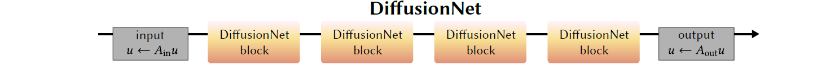
Method: (4) DiffusionNET Architecture
03
Feature selection:
  Basic: 3D vertex coordinates (xyz)
  Rigid & non-rigid invariance: Heat kernel signatures (HKS)
HKS: network invariant to orientation-preserving deformations

Slide 18
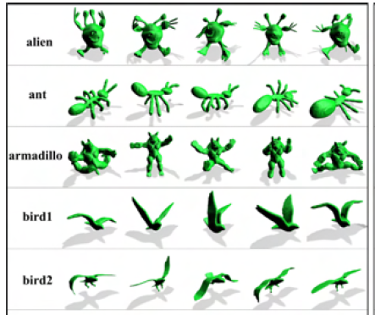
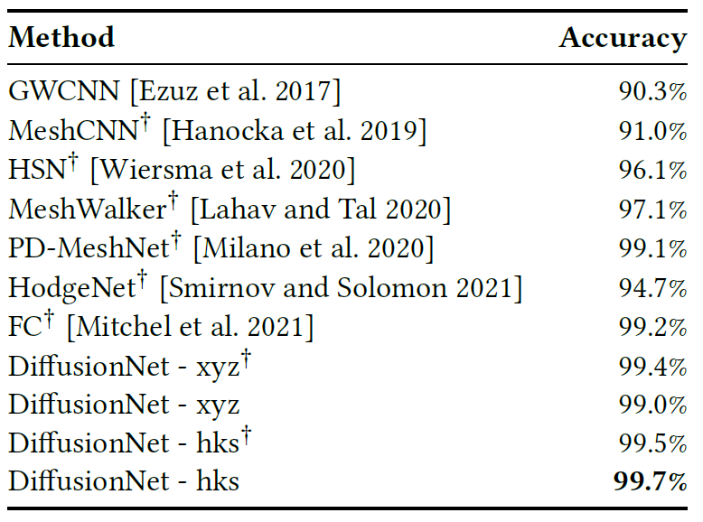
Experiment Results: (1) Classification
04
New state-of-the-art in classification on SHREC-11:
Source: Lian, Zhouhui & Godil, Afzal & Bustos, Benjamin & Daoudi, Mohamed & Hermans, Jeroen & Kawamura, Shun & Kurita, Yukinori & Lavoué, Guillaume & Nguyen, Hien & Ohbuchi, Ryutarou & Ohkita, Yuki & Ohishi, Yuya & Porikli, Fatih & Reuter, Martin & Sipiran, Ivan & Smeets, Dirk & Suetens, Paul & Tabia, Hedi & Vandermeulen, Dirk. (2011). SHREC '11 Track: Shape Retrieval on Non-rigid 3D Watertight Meshes.. Eurographics Workshop on 3D Object Retrieval. 79-88. 10.2312/3DOR/3DOR11/079-088.

Slide 19
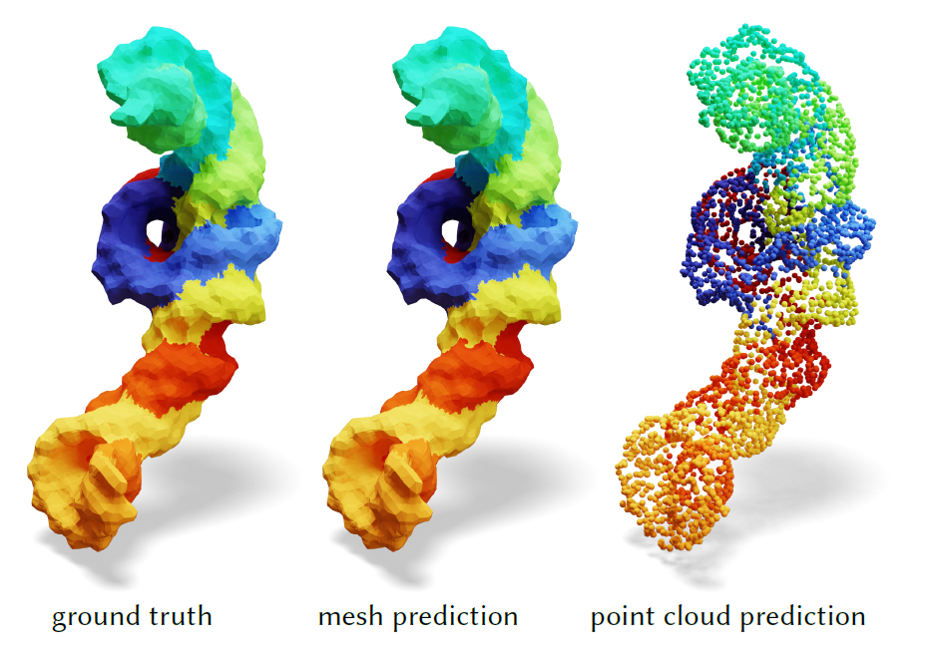
Experiment Results: (2) Molecular Segmentation
04
New state-of-the-art in segmentation tasks
RNA mesh consists of 14k vertices
Training: 38ms, requiring 2.2GB of GPU memory
Accurate results for meshes and point clouds

Slide 20
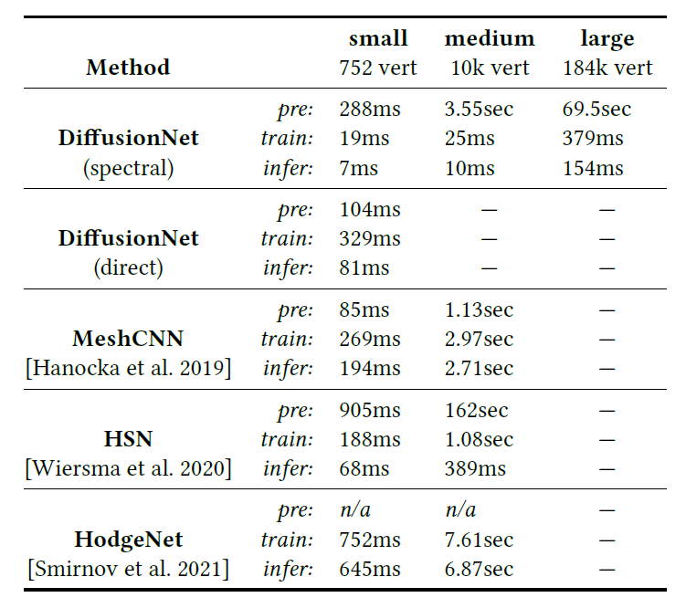
Experiment Results: (3) Human Segmentation
04
DiffusionNET directly trains on mid-size inputs
Scales well to large meshes due to spectral acceleration
Most other approaches inapplicable to large meshes

Slide 21
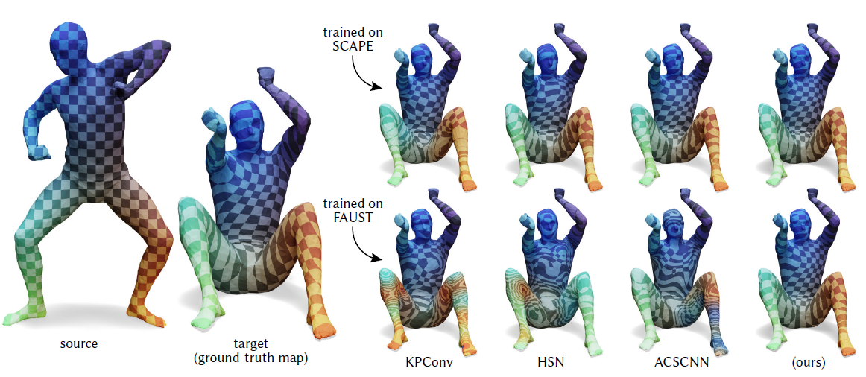
Experiment Results: (3) Functional Correspondence
04
DiffusionNET outperforms other methods in nonrigid correspondence

Slide 22
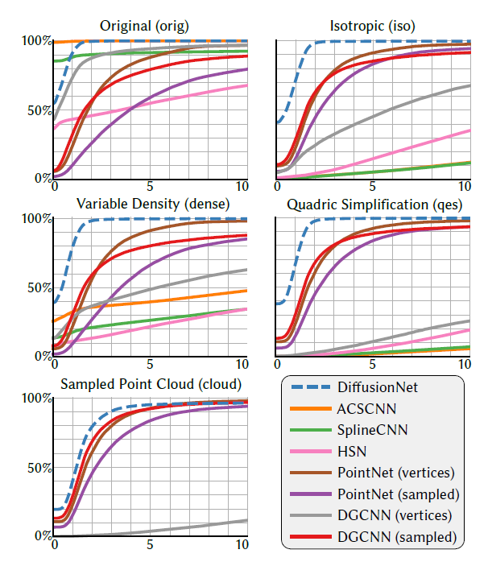
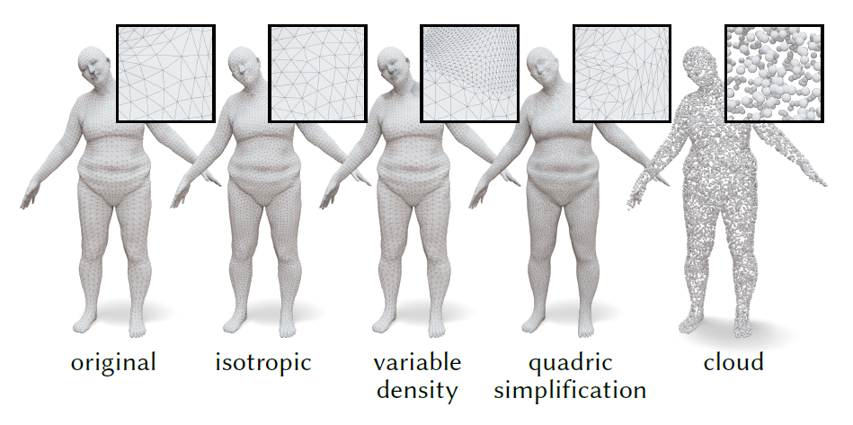
Experiment Results: (4) Discretization Agnostic Learning
04
Different discretization techniques
Performance of different networks

Slide 23
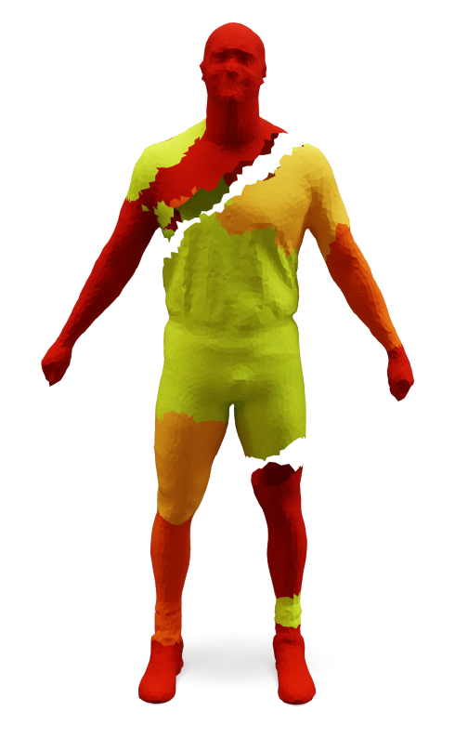
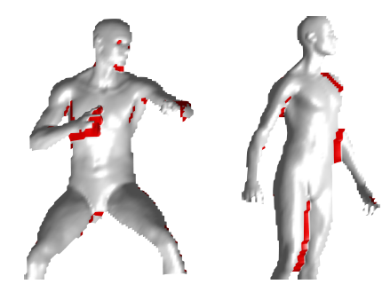
Limitations
04
No diffusion for disconnected components
Diffusion at topological merges
Source: Z. Lahner, E. Rodola, M. M. Bronstein, D. Cremers, O. Burghard, L. Cosmo, A. Dieckmann, R. Klein and Y. Sahillioglu, SHREC'16: Matching of Deformable Shapes with Topological Noise, Proc. of Eurographics Workshop on 3D Object Retrieval (3DOR), May 2016.

Slide 24
Thanks!
Any questions?
Til Stotz (03757560) Til.Stotz@tum.de Robotics, Cognition, Intelligence WS22/23

